Slide 1


Slide 2
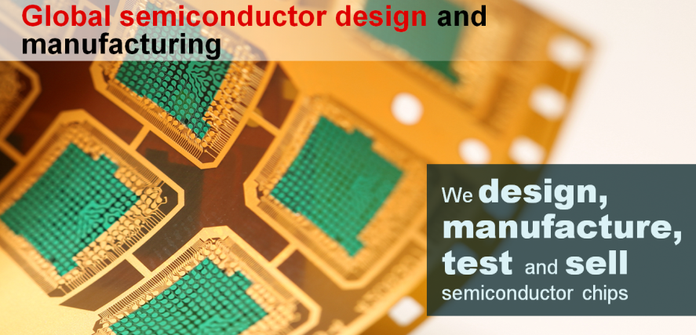


Want to work for TI?
Internships
Rotation Programs
Full-time positions
careers.ti.com
What does TI do?
What we’ve done
for nearly 90 years…
We connect electronics customers to devices and technology that will help them build amazing products!

Slide 3

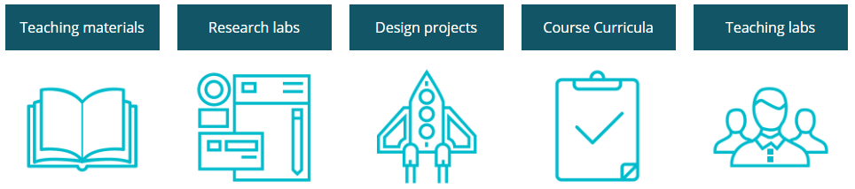
Reaching students and faculty @ university.ti.com
The Texas Instruments University Program is dedicated to supporting engineering educators, researchers and students worldwide.

Slide 4


Mark Easley
University Marketing Manager
Raleigh, NC
Software Engineer
Over 7 years at TI
Embedded Systems
& IoT experience
Notes:
Presenter: Intent of this slide is to add your photo and a bit more about yourself.
Suggested discussion items:
Your name
Your role(s) at TI
Your key responsibilities at TI
Most Memorable Moments at TI (examples may include)
Highlight development opportunities (i.e. were you in Make an Impact, or a rotation program?)
Career path
WW experience (traveling to China, India, etc.)
Innovation opportunities
What attracted them to TI
What keeps them at TI
Opportunity, collaboration, innovation, standards winning determination

Slide 5
Today’s agenda
IoT and Automation
What? Why? How?
TI-RSLK MAX Build & Test
Watch assembly video, build, use TI-RSLK Debug tool, customize appearance
TI-RSLK MAX Programming
Setup Energia and robot library
Practice Line following and Finite State Machine
TI-RSLK MAX Competition
Solve the maze time trial
Autonomous relay race
Quick Survey: Who is competing in a Robotics competition? Who is taking / has taken an embedded systems course? Freshman design course? Senior design course? Mechatronics or Robotics course?

Slide 6
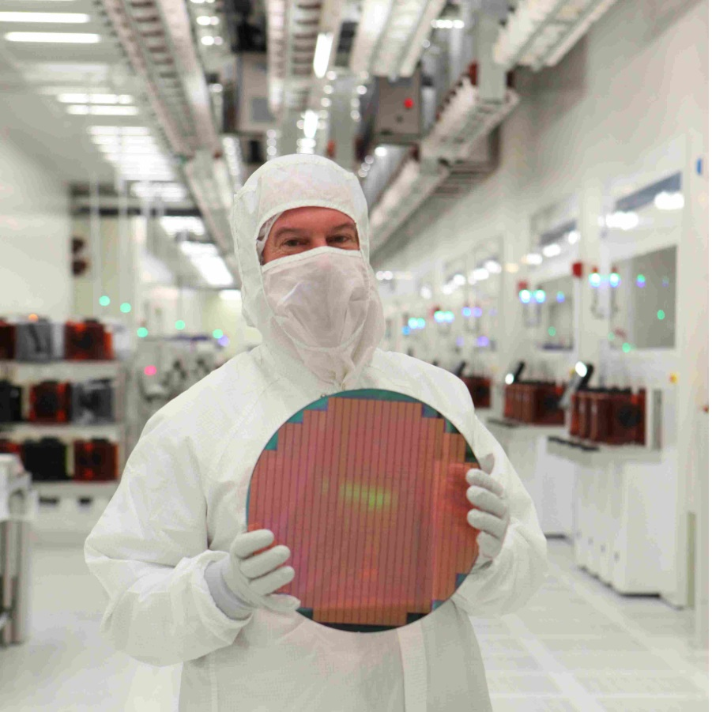
Let’s take a quick look at how we manufacture products at TI

Slide 7
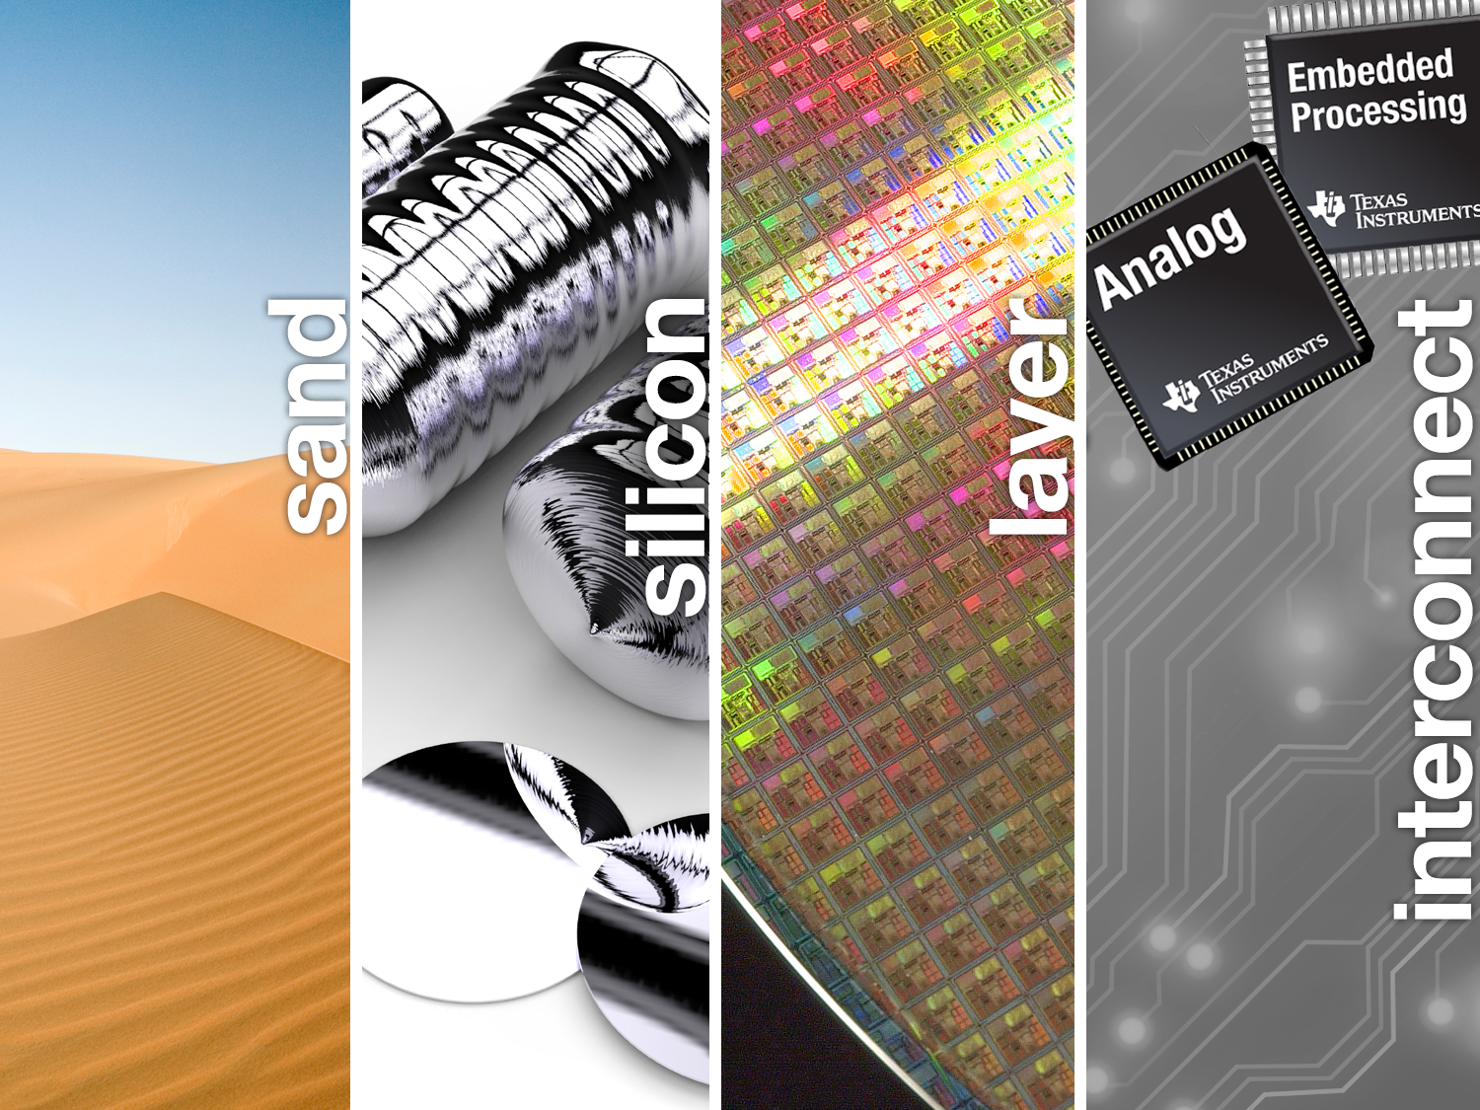

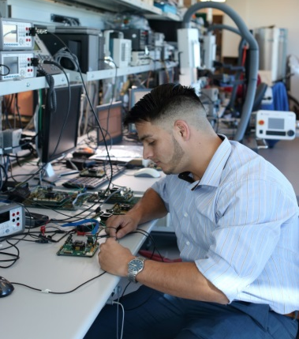

Semiconductor Industry

Slide 8
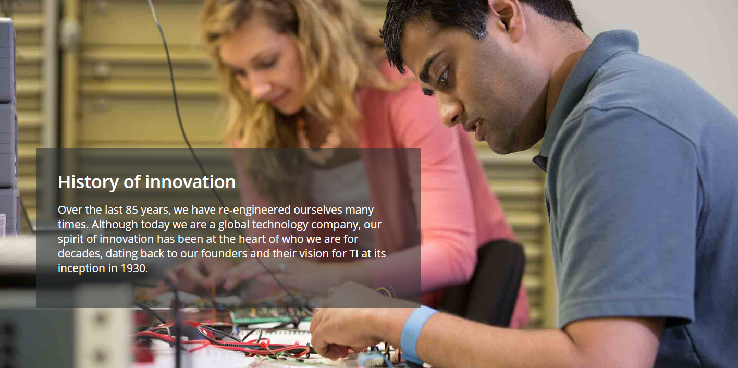

Slide 9


Slide 10
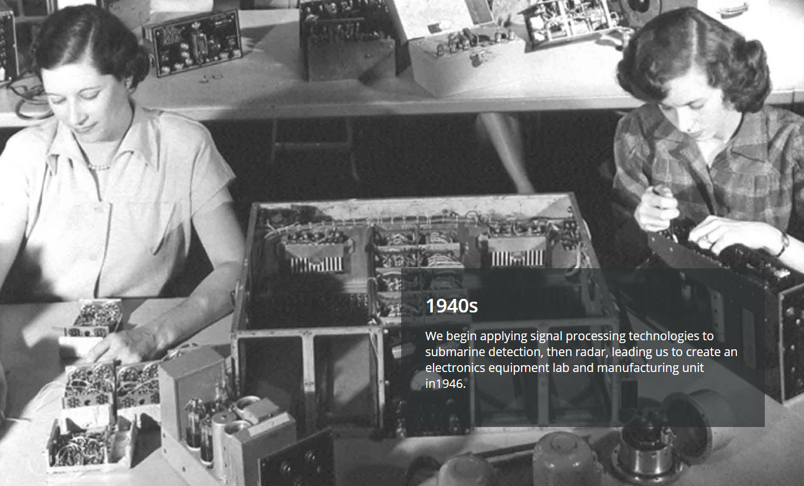

Slide 11
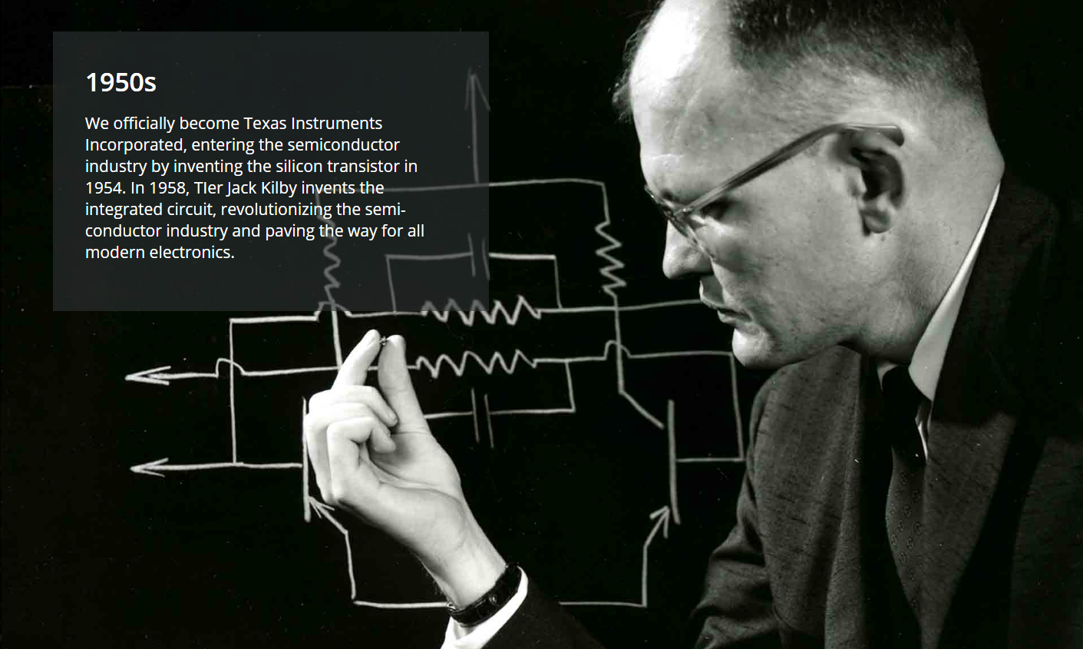

Slide 12

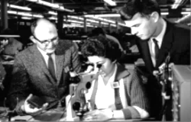
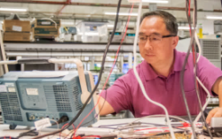
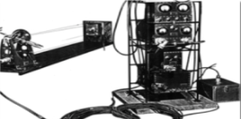
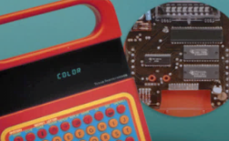
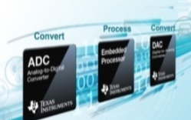





Our history of reinvention
1940s
Defense systems
1970s
Microprocessors
2000s
Analog and Embedded
Present day
Industrial and automotive technologies
1930s
Oil exploration
1950s
Integrated circuit
1980s
DSP, DLP® Cinema
2000s
Applied research – Kilby Labs

Slide 13
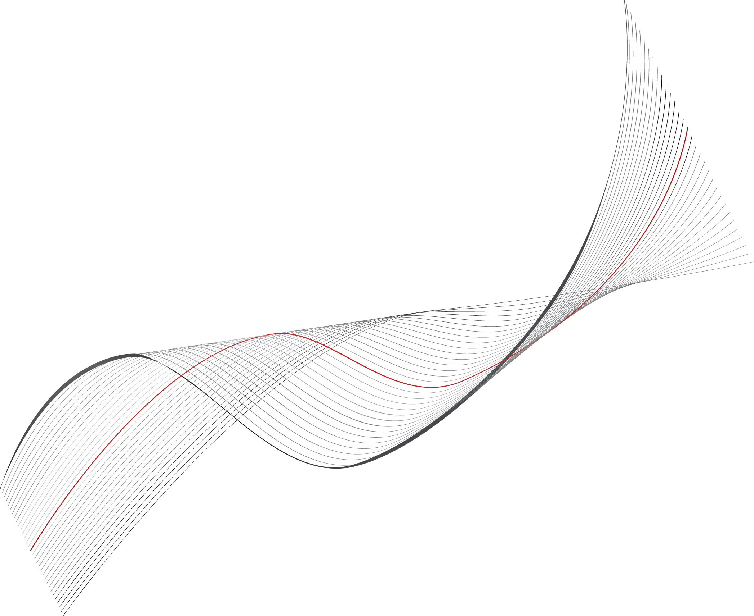

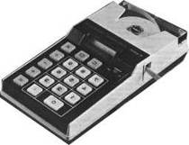

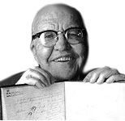






Nearly Nine Decades of InnovaTIon
2010s
2000s
Industry’s
first 300mm
analog wafer fab
1960s
1970s
Applies signal processing to consumer products
1980s
1990s
Introduces world’s fastest analog-to- digital converter and lowest-power DC-DC converter
1950s
Invents the handheld calculator
Introduces single-chip digital signal processor
Creates
first apps processor for multi-media cell phones
1940s
Invents the integrated circuit
Applies signal
measurement to magnetic anomaly detection
1930s
Revolutionizes oil exploration by measuring reflected signals
Notes:
13

Slide 14






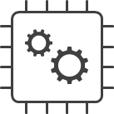



Customers count on us to deliver great products, engineering expertise and support
PORTFOLIO
Analog Power Products
Analog Signal Chain
Embedded Processing
High Volume Analog & Logic
DLP® Products
Key markets
Industrial
Automotive
Personal electronics
Communications equipment
Enterprise systems
Supply continuity Multi-sourcing
On-time delivery
200-mm
300-mm
Manufacturing
Quality and reliability
Support
Easy part selection
Reference designs
Online
support
Training
Technical sales and support
TI store

Slide 15
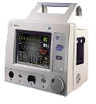
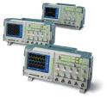

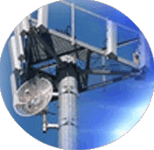
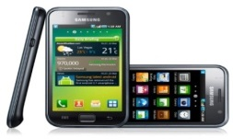

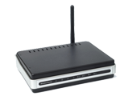


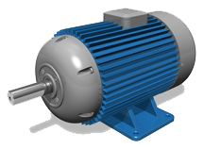

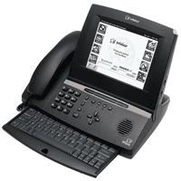


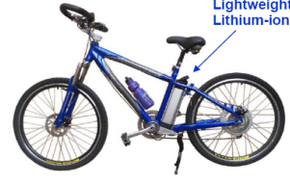
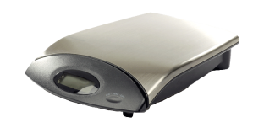
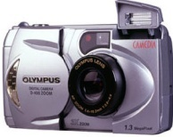



Everyday electronics that use TI technology
Smart phones
Test equipment
Wireless
infrastructure
Medical
Smart energy meters
Wireless LANs
Automotive & HEV
Analog and
Embedded Processing
Motor control
Digital TV
IP phones
Computing
Industrial weigh scales
Digital
still cameras
eBike
Digital audio & radio
Digital video recorder/server

Slide 16
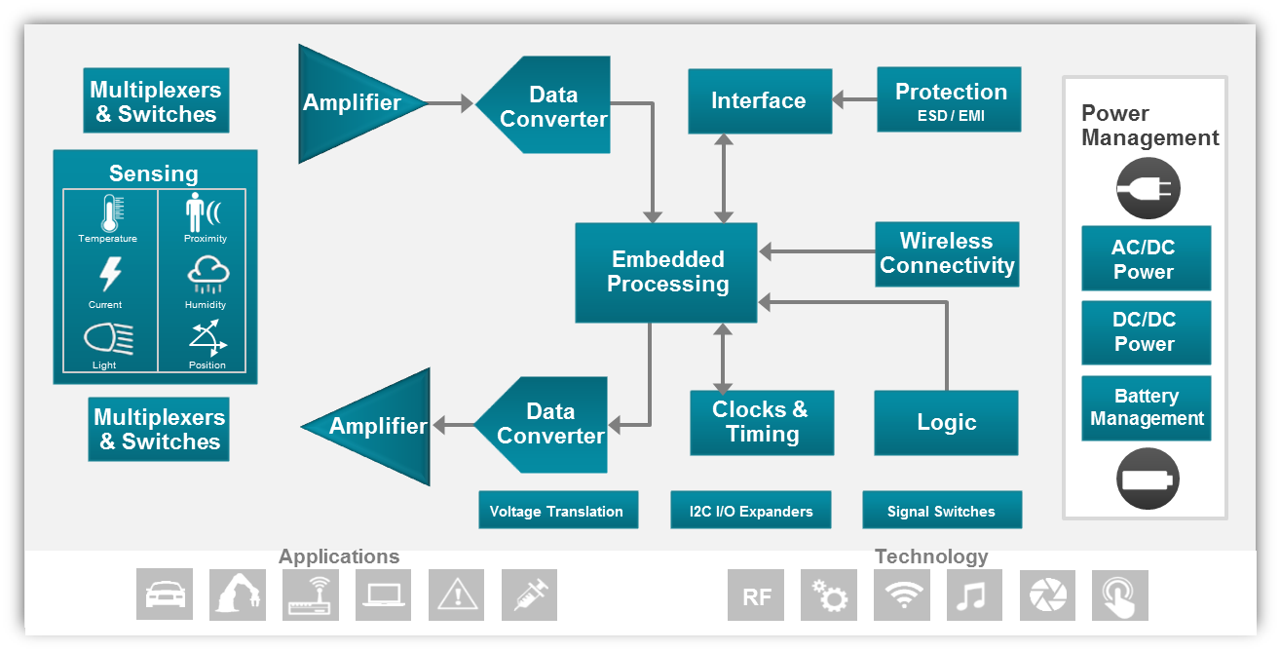
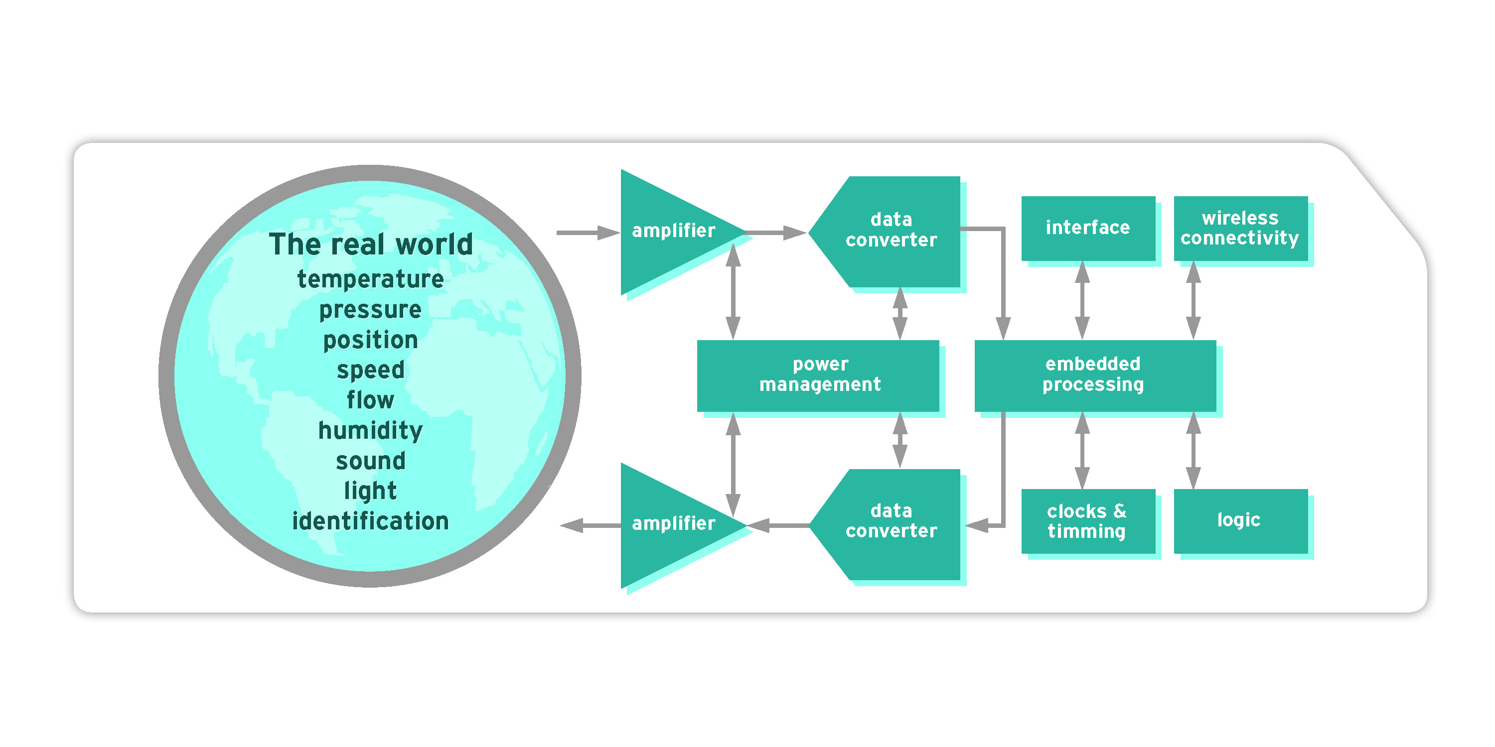
TI technologies at the heart of every system
Signal chain from the real world to the digital realm

Slide 17

Careers at TI

Slide 18
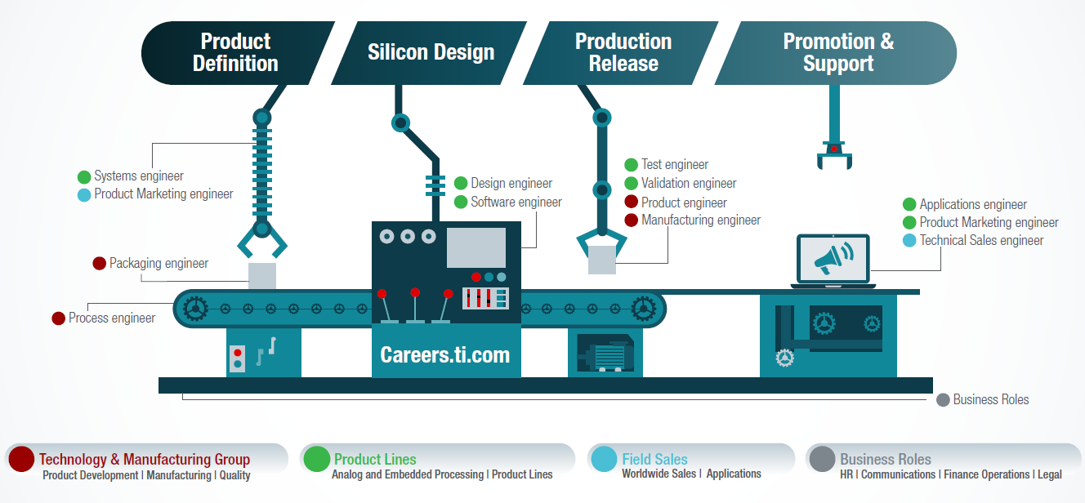
Engineering Positions at TI

Slide 19

We’re looking for…
A top-performing student with a GPA of 3.0 or higher
Pursuing undergraduate or graduate degree in:
Electrical/Computer Engineering
Computer Science
Chemical Engineering
Industrial Engineering
Mechanical Engineering
Materials Science
Finance/Accounting
Management Information Systems
Human Resources
Marketing/Communications
We’re changing the world, one chip at a time. Join us.

Slide 20
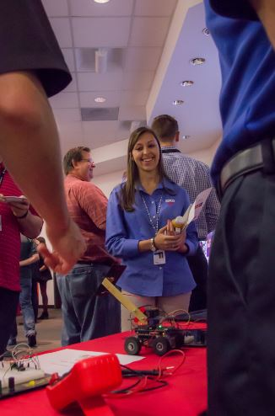
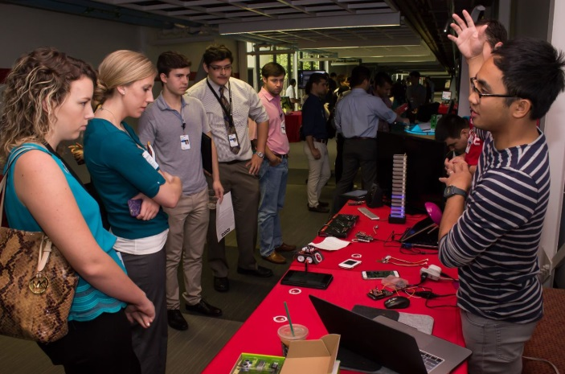
Engineering internship opportunities
Applications Engineer
Design Engineer
Facilities
IT
Manufacturing Engineer
Product Engineer
Software Engineer
Technical Sales
Other engineering roles
Join a fun, collaborative environment, with flexible schedules and access to invaluable insight from TI leaders.
You dive into projects right away that challenge you to find creative solutions to complex problems.

Slide 21
Engineering New Grad Opportunities
Rotational Programs
Analog Design Engineer
Applications Engineer
Jumpstart your career!
TI’s robust rotation programs provide you the opportunity to solve problems and invent solutions through a variety of hands-on, meaningful experiences from the very first day on the job. Receive personal mentorship from world-class experts, along with training and development opportunities to help you quickly make an impact at TI.
Embedded Processing Software Engineer
Technology and Manufacturing
Information Technology
Product Engineer
Technical Sales Engineer
Product Marketing Engineer

Slide 22
Job titles only cover a small portion of your work contributions…
Know your primary directives but expand and grow your role
Process Engineer
Design Engineer
Product Engineer
Test Engineer
Software Engineer
Quality Engineer
Applications Engineer
Technical Sales Engineer
Systems Engineer
Validation Engineer
Product Marketing Engineer

Slide 23
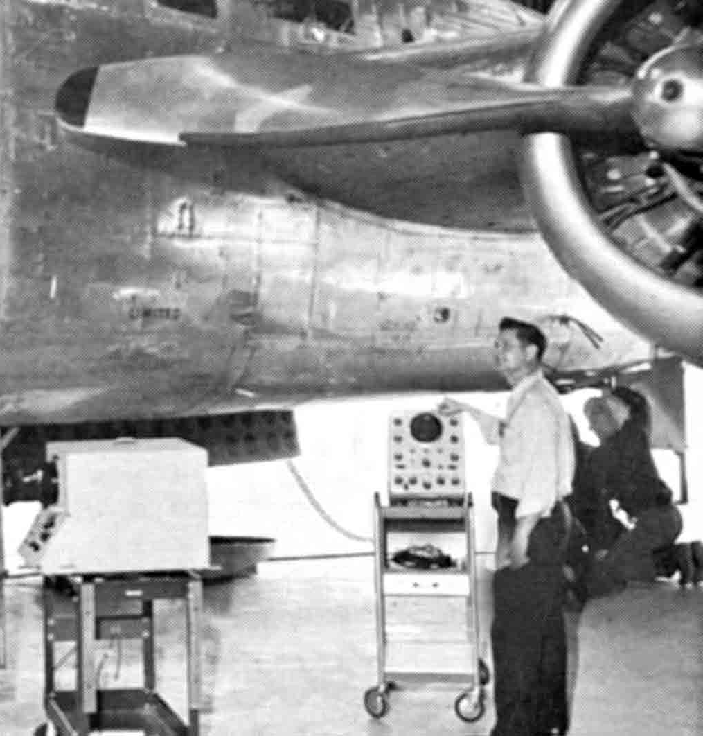
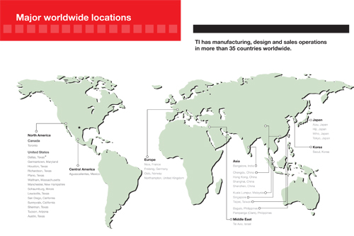
Electronics and Semiconductor
is a Global business
Chance to work in major cities across the nation and even the world!
Notes:
If you want more insight into individual roles, check out the slider tool on our website at careers.ti.com

Slide 24

Diverse and global workforce
More than
30,000
Employees in
35 countries
TI headquarters
Facilities
Manufacturing sites
Notes:
Diverse and global workforce
We have more than 30,000 employees who work in 35 countries*. Our worldwide presence includes:
Headquarters in Dallas, Texas.
13 semiconductor manufacturing sites where chips are tested and packaged for final use.
Design and sales support offices in North America, South America, Europe, Asia and Australia.
Diverse and global workforce
Our worldwide workforce is diverse and collaborative, which contributes to our flexibility, fosters problem solving and fuels innovation, ultimately making our company stronger.

Slide 25

Embedded Systems create a world of possibilities that will continue to change everything
Electronics rapid prototyping with TI’s broad portfolio of MCUs, analog & connectivity solutions
IoT + Automation
Texas Instruments
November 2019

Slide 26

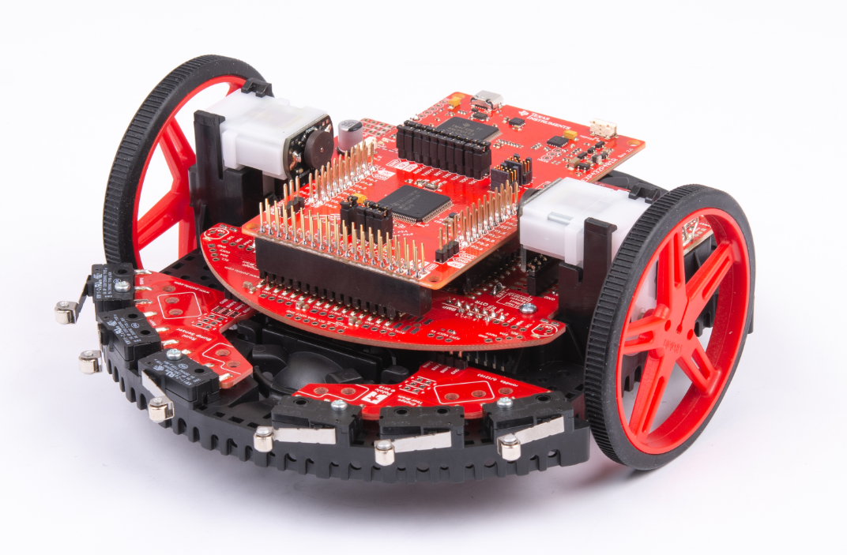
TI Robotics System Learning Kit
Notes:
Thank you Allye for the introduction – I am excited to provide an overview of the recently launched Robotics System Learning Kit called The TI-RSLK MAX by Texas Instruments.

Slide 27
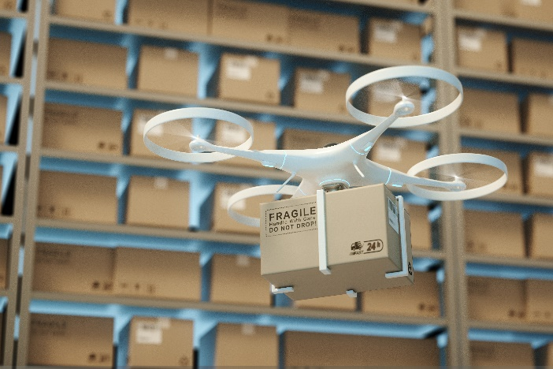
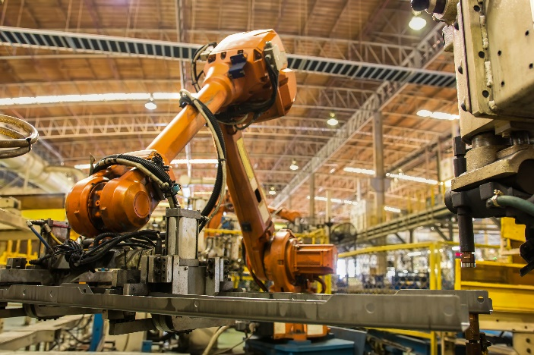
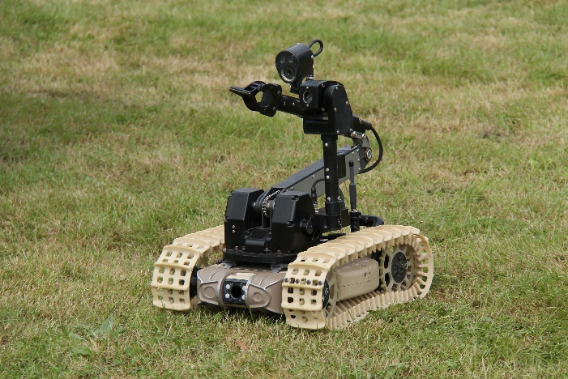
Innovate and accelerate with robotics systems learning
Robotics are everywhere!
Autonomous vehicles
Factory automation
Security
Notes:
Let me start by saying that industry trends have evolved from wanting to just innovate … to needing to accelerate the pace of innovation
What do these mean to engineers and the engineering process is this: a) Solve complex system problems that are now interdisciplinary in nature b) Do it Faster !
The system choices engineers make in integrating hardware and software will ultimately affect the
effectiveness of their application.
So why choose robotics for systems learning ?
Robotics is a great example of a complex integrated engineering system, it is multi-disciplinary! This is why TI has developed the TI-RSLK,it We think, it can be an excellent teaching tool that prepares students for applying systems knowledge and experience in industry. upon graduation.
And why not? Robots are fun, engaging and can help with learning difficult subjects without realizing how difficult the subject matter is.. Make learning a life long journey!!

Slide 28
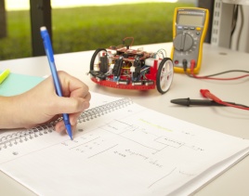
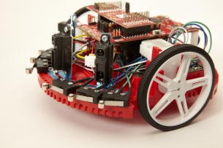
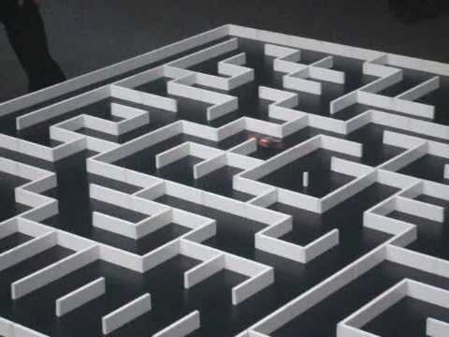
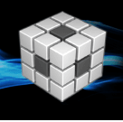

Meet the TI-RSLK product family
The TI-RSLK (robotics system learning kit) product family includes a series of low-cost robotics kits and classroom curriculum that provide educators and students with hands-on, customizable options for learning electronic systems design.
The TI-RSLK includes:
Code Composer™ Studio
Curriculum Hardware Software Projects TI Resources
Notes:
Recognizing that system's thinking is essential and this is a skill needed today and in the future…
last year, TI created the robotics learning kit to fill a gap existing in the engineering curriculum.
RSLK is targeted at students in University however it can be used by anyone that wants to learn how electronics systems work or achieve this higher learning of how things work …using robotics.
The curriculum is comprehensive and modular and available online.
It comes with 20 learning modules that address the fundamentals of embedded systems and progresses to more advanced applications learning.
The kit includes all components needed to build a competition ready robot.

Slide 29
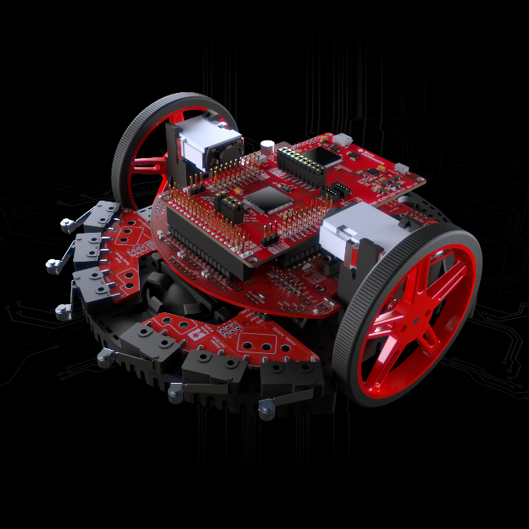
Introducing the TI-RSLK MAX
The newest addition to the TI-RSLK product family, the TI-RSLK MAX is simple to use, build and test.
With a solderless assembly process, students can have their own fully-functioning system built in under 15 minutes.
Notes:
This year TI introduced the TI-RSLK MAX the newest addition to the TI-RSLK product family.
It is simple to use, build and test.. This kit option is “ solderless” i.e does not require any soldering resources, the speed at which robot can be assembled, allows students to have a robot system up and ready to code in less than 15 mins..
Included with this kit, is a new updated curriculum which is available online on ti.com/rslk.

Slide 30
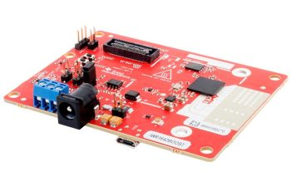
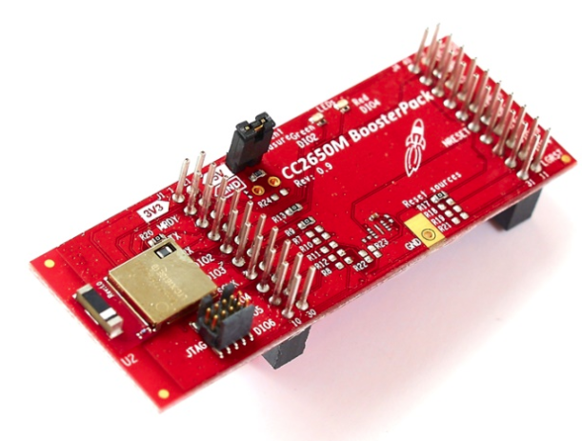
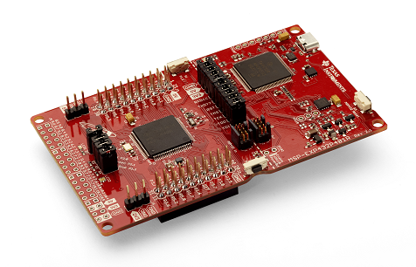
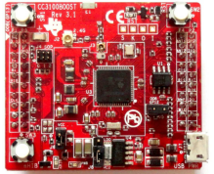
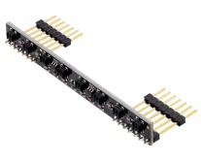
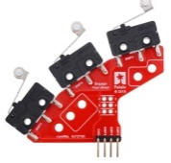
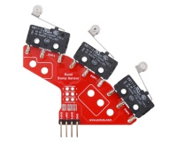







Hardware for TI-RSLK MAX (kit)
KIT CONTENTS OPTIONAL PURCHASES
Cost: US$109 Teaches the foundations of an electronic system; robot can solve its way through a maze with line detection
Line IR sensors
SimpleLink Bluetooth® low energy CC2650 module BoosterPack™ plug-in module
SimpleLink Wi-Fi® CC3100 wireless network processor BoosterPack plug-in module
SimpleLink™ MSP432P401R MCU LaunchPad™ Development Kit
Bump switches
Chassis & Motor assembly with encoder
Wires
Robot arm
LCD screen
OLED screen
TI-RSLK Chassis Board
+ other mechanical & electronic components
Distance IR sensors
Notes:
Ok so what is in the kit.. The new kit includes the industry-leading SimpleLink™ MSP432P401R microcontroller (MCU) LaunchPad™ Development Kit, also used with the classic RLSK. Now, the new MAX robot kit
has easy-to-connect sensors, and a new versatile chassis board that turns the robot into a mobile learning platform. Through accompanying core and supplemental curriculum, students learn how to integrate their hardware and software knowledge to build and test a system. For advanced learning, students can purchase other hardware components especially to demonstrate wireless communication and Internet of Things (IoT) capabilities. The kit is available on the TI store for $109.

Slide 31

Designed with today’s classroom in mind
Low-cost makes it accessible for students to own or for classroom sets to be reused year-over-year
Easily implemented into large classes and multiple course-types
Works well for classrooms without access to soldering equipment.
Notes:
As you can see TI-RSLK MAX is relatively a low cost educational kit for students to own or universities to use in their classrooms
The new RSLK MAX kit can be assembled and disassembled for re-use over and over..
Large classes or even small classes that do not have access to soldering stations and equipment can take advantage of this kit.
This kit is a great educational platform that can teach many topics in one course or it can be used in several courses.. The flexibility allows you to go wider or deeper in your learning.

Slide 32


Engage students with robotic challenges
The TI-RSLK series helps students physically grasp abstract concepts while having fun. The TI-RSLK MAX can solve a maze, line follow and avoid obstacles, and can also be designed to complete any challenge or task students dream up.
Notes:
So this summer, our TI interns got a preview of the new RSLK MAX which lead to a “competitive summer” for these young students!
The intern teams were given some of the curriculum modules, along with a robot kit, and were asked to compete in a challenge ! They did not have much time, the easy build allowed them to spend more time on the learning, testing and debugging!
They were judged on robot speed, battery-energy efficiency and innovation. In the end they had a lot of fun, learnt how to build a robot system, worked in teams across the company… all engaged to solve a challenge.
Surely memories for a life time. A good start for these future innovators…

Slide 33

Preparing future engineers with TI-RSLK MAX
The TI-RSLK MAX teaches systems-thinking through robotics, providing a foundation for future product design
Provides a hands-on experience, which is proven to be more engaging and fun
As early as freshmen year, students are seeing abstract concepts come to life in real ways
Students prepare for their future by working as a team and using real-world engineering tools to solve problems
TI-RSLK MAX is available for purchase for $109 on the TI Store
Notes:
The TI University team developed the TI- RSLK MAX to help prepare future engineers. Our goal was to provide access to a low cost robotic system kit that can provide high educational value to students, educators and even the self-learners!
“Better Systems thinking” means better product design and better solutions for the customer!
The intention here is not just to build the robot but understand the underlying knowledge of the principles to make better choices!
With the RSLK MAX we wanted to specifically target Freshmen to have this learning experience.
They can build a robot and have it up and running at the start of the course, so they can appreciate and feel engaged when learning abstract and complex engineering concepts.
We hope that this could lead to innovation and acceleration and MAXimize their chances of success!

Slide 34




The Internet of Things a history
The Rise of Electronics
From large desktop computers to tiny battery powered devices, EVERY innovation is all part of the same technology revolution
1800s-1900s
1900s-1960s
1958
Edison & Tesla
It pretty much always starts with the lightbulb, harnessing electricity for human applications, took lots of famous people to get to this point
Tubes, Transistors & Radio
Electric computation and communication becomes possible and mainstream with the creation of the basic building blocks
The Integrated Circuit
Jack Kilby, a TI engineer, changed the world by inventing a practical way to shrink the size of electronics

Slide 35



The Internet of Things a history
The Rise of Electronics
From large desktop computers to tiny battery powered devices, EVERY innovation is all part of the same technology revolution
1970s-1990s
1990s-2010s
2000s-2030s
The PC Age
Personal computers change business and productivity in every aspect of life worldwide
The Internet Age (& Mobile)
Computers and electronics can talk to each other creating a whole new world of applications
The IoT Age
Affordable connectivity and processing gives all electronics additional capabilities for new data driven and world changing behavior

Slide 36
The Internet of Things a history
This tech wave will have lasting effects on EVERY industry
Government
Transportation
Industrial
Aviation
Opportunity to Disrupt
Agriculture
Manufacturing
Energy
Retail / Ecommerce
Medical
Automotive
Military
Marine / Aquaculture
Food
Real Estate
Finance
Construction

Slide 37
Mechatronics a history
Definitions
Clarity on where the fields of mechanical and electrical technical knowledge intersect
Aeronautics
Robotics
Automation
Avionics
Airplanes require many electromechanical subsystems to enable advanced flight such as lighting, communication, and safety systems
Mechatronics
Mobile robots that operate on land, sea, air can perform tasks too dangerous or difficult for humans or can scale beyond human capacity
Electromechanical
Machines & Systems
Application specific machines that perform repetitive mechanical tasks and are human interface driven

Slide 38



Mechatronics a history
The Rise of Machines
Mechanics has been a field throughout human history and the ability to master it has built civilizations
1400s
1400s
1800s
Leonardo Da Vinci
Mechanical inventions that derive from study of the natural world and the dynamics and statics of motion and construction
Johannes Gutenberg
The printing press is a classical machine that allowed humanity to spread ideas at a larger scale
Charles Babbage
Mechanical computer shows the concept of a programmable machine

Slide 39

Mechatronics + IoT a birds eye view
IoT Data passes from physical hardware layers to software layers back and forth, connecting the real and digital worlds
Hardware + Software at every stage
Computers
The
Internet
Edge
Cloud
Connected Things
Phones
Think services
Google, Amazon, Facebook, etc.
Think servers
Server farms & data centers
Think products
Anything that can talk to the internet or connect to something else that can talk to the internet
Think infrastructure
Routers, switches, cell towers, fiber optic cable, satellite transmitters, phone lines

Slide 40
The Internet of Things a birds eye view
IoT Data passes from physical hardware layers to software layers back and forth, connecting the real and digital worlds
OT
Operational Technology
Sensors, Actuators, Nodes
IT
Information Technology
Cloud, Servers, Routers
Hardware + Software at every stage
Computers
The
Internet
Edge
Cloud
Connected Things
Phones
Think services
Google, Amazon, Facebook, etc.
Think servers
Server farms & data centers
Think products
Anything that can talk to the internet or connect to something else that can talk to the internet
Think infrastructure
Routers, switches, cell towers, fiber optic cable, satellite transmitters, phone lines

Slide 41

Product Development a birds eye view
Hardware is hard, so you need to have a plan and understand the product development cycle
Summary from Maker.io
1
3
5
7
9
Concept
Evaluation
Prototyping
Marketing
Distribution
2
4
6
8
10
Research
Design
Funding
Production
Support

Slide 42
Product Development a birds eye view
Two major tasks in design and engineering – both have value!
Optimize
Make a process, product, or service incrementally better than previous iterations
Innovate
Attempt a new process, product, or service to radically disrupt previous methods or solutions
Summary from Maker.io
1
3
5
7
9
Concept
Evaluation
Prototyping
Marketing
Distribution
2
4
6
8
10
Research
Design
Funding
Production
Support

Slide 43


TI LaunchPad & BeagleBone Embedded System Design a bird’s eye view
Cloud
Embedded System
Power Management
Communication
Processing
Analog
Sensor
RF Radio
/ Wired
Comm
MCU
LaunchPad
or MPU
BeagleBone
Design Accessories
Plug-in modules
Through hole (breadboard) circuits
Oscilloscope & logic analyzer & multimeter
EDA / CAD tool (PCB and enclosure design)
IDEs and SW Dev tools
Power
Display
Motor Control
Input /
Output

Slide 44






Power: Line Power vs Disposable Battery vs Rechargeable Battery a comparison
What’s the difference?
Alkaline
Li-Ion
Li-Po or Li-Poly
Lead Acid
Nickel Metal Hydride
Nickel Cadmium
Design Considerations
Do I need continuous power?
How convenient is it to recharge in the application?
How mobile is the application?
What is the form factor?
What are the aesthetics and usability requirements?
Make use of tools like TI WEBENCH

Slide 45

Motors: Brushless vs Brushed vs Stepper a comparison
What’s the difference?
Brushless
Brushed
Stepper
AC / DC
Design Considerations
Do I need accurate movement? (Stepper, encoders, hall effect sensors)
Do I need high torque?
Low complexity or high complexity control?
Do I need high efficiency or long life?
Do I need low cost?
Big portion of IoT is around intelligent movement
Make use of motor drivers and software libraries like TI MotorWare

Slide 46

Motors: Brushless vs Brushed vs Stepper a comparison
Advantages
Cheapest and simplest motor
Speed linear to applied voltage
Simple Motor Control
Disadvantages
High maintenance
Low life-span (due to physical wear on brushes)
Advantages
High efficiency, long life
Little to no maintenance
High output power
Disadvantages
More complicated motor control
More expensive
Advantages
Accurate position control
Excellent low speed torque
Long life
Disadvantages
Low efficiency
Prone to noise, ripple, and resonance
Cannot accelerate loads rapidly

Slide 47






Displays: LCD vs OLED vs LED vs ePaper a comparison
What’s the difference?
LCD
OLED
LED Matrix
LED Segment
ePaper
Cloud GUI, Web App, or Mobile App
Design Considerations
Do I need color graphics?
Does it require high refresh? Video?
Do I need to display digits or alphanumeric?
Does it need to be low power or battery free? Backlight?
How will it mount in the enclosure?
Make use of display drivers
and software libraries like
TI Graphics Libraries

Slide 48









Easily add RF for wireless applications!

Slide 49






Which wireless?
Tradeoffs between range, bandwidth, cost, power usage, adoption
(NFC / RFID)
(LPWAN)
(Cellular)
Ubiquitous
High bandwidth
Higher power usage
Common
Small range
Lower power
Very low cost
Super near range
Low bandwidth
Low power
Low cost
Limited to certain cities
Wider range
Low bandwidth
Higher cost
Wide range
High bandwidth
Expensive – Data & HW
Infrared
Satellite
Proprietary
Mesh networking
Low power
Very low cost
IPV6 Addressable
Mesh networking
Low power
Very low cost
Not IP addressable
Line of Sight
Low power
Very low cost
Global range w/ Sat available
Expensive – Data & HW
Licensed and unlicensed spectrum with trade offs

Slide 50
Which wireless?
Tradeoffs between implementation effort
Wi-Fi Primary Use Cases
Smart Home
Industrial/Commercial
Fixed position connectivity
Medical
Direct connect
Access a wide variety of APIs directly
Only requires domain expertise in internet and firmware
High data rate
Poor for mobile and rural use cases
Requires a middleman gateway (Smartphone or embedded bridge)
Everything is custom
Need domain expertise in frontend and backend, UX, UI, firmware
Low data rate
Poor for crowded environment
BLE Primary Use Cases
Wearable
Phone accessory
Streaming music
Smart Home
Medical

Slide 51




















TI LaunchPad and BeagleBone in the cloud
Cloud-connected TI Hardware is supported by various cloud partners & protocols via Wi-Fi, BLE, LTE, or Ethernet.

Slide 52



TI LaunchPad & IoT a bird’s eye view
Cloud Service Provider
Cloud services
Access to data, dashboards, etc
MCU +
Ethernet
LaunchPad
MCU + RF
SoC
LaunchPad
RF
Booster
Pack
IoT Gateways
Your portal to the cloud
RF
Booster
Pack
Ethernet
Wi-Fi
LaunchPads
MSP430
MSP432
TM4C
C2000
Hercules
MCU
LaunchPad
RF BoosterPacks
Zigbee / Zwave
6LoWPAN / Thread
Bluetooth / Wi-Fi
SubGHz RF / NFC
LTE / Satellite
Wireless
Nodes
Connecting your devices
MCU + RF
SoC
LaunchPad
MCU + RF SoC LaunchPads
CC3200 MCU + WiFi
CC2650 MCU + BLE
CC1310 MCU + SubGHz RF
CC1350 MCU + SubGHz/2.4GHz
BoosterPack

Slide 53


Microprocessors: Microcontrollers vs Single Board Computers a comparison
What’s the difference?
TI LaunchPad
BeagleBone
Arduino
RasPi
Design Considerations
Do I need an operating system?
Do I want it to be low cost?
Can I program in C or do I need to use another language?
Do I need real-time capability?

Slide 54




Microcontroller
CPU
UART
FRAM
or Flash
SRAM

Slide 55


AM3358 Microprocessor

Slide 56
Microprocessors: Microcontrollers vs Single Board Computers a comparison
Considerations:
Power
Integration
Performance
Cost
Advantages
Overall less complex
Overall less cost
Overall lower power consumption
Real-time capable
Disadvantages
Less flexible software paths
Less performance for computation intensive applications
Only able to run RTOS but not full OS options
Advantages
Overall higher performance
Overall more peripheral capabilities
More flexible software options and the ability to run Linux OS
Disadvantages
More cost and complexity
Managing Linux related updates
Real-time capabilities often limited
Higher power consumption

Slide 57

Performance vs Power

Slide 58

MSP430 is leading ultra-low power processor
MSP430 microcontroller running off three grapes.
It ran for almost two weeks before the grapes dried out too much.
Is this how raisins are made?

Slide 59
TI LaunchPad & BeagleBone Embedded System Design a bird’s eye view
Embedded System
Power Management
Communication
Processing
Analog
Sensor
RF Radio
/ Wired
Comm
MCU
LaunchPad
or MPU
BeagleBone
Power
Display
Motor Control
Input /
Output

Slide 60


Making MADE simple
{
}
With the BeagleBone
Hardware & Software

Slide 61



With BeagleBone Black and Capes
Why Beaglebone Black is great?
Price ~$45
Large community
Online resources from TI and Beagleboard.org
Full Linux capable single board computer
Multiple supported SW paths
Completely open source for building your own derivative products!

Slide 62

BeagleBone Black
Processor: AM335x 1GHz ARM® Cortex-A8
512MB DDR3 RAM
4GB 8-bit eMMC on-board flash storage
3D graphics accelerator
NEON floating-point accelerator
2x PRU 32-bit microcontrollers
Connectivity
USB client for power & communications
USB host
Ethernet
HDMI
2x 46 pin headers … Add a ‘Cape’
Software Compatibility
Debian
Android
Ubuntu
Cloud9 IDE on Node.js w/ BoneScript lib
plus much more
BeagleBone Black

Slide 63
Automation
What is it and who cares?
There are many reasons why automation is taking over
Efficiency and Safety
Cost savings
Technology availability and accessibility
This extends to all aspects
IoT gives us data that we can use for automation (proof it is worth the investment)
IoT enables automation to be scalable (can apply in many areas)
Examples
Making stuff, driving stuff, delivering stuff, trading stuff, cooking stuff

Slide 64
Automation
Robots and Machines that learn
The big trend right now is in AI / ML but understand this is part of the larger theme of accelerating automation
AI is not effective at real world manipulation
Software traditionally aids humans with work in the physical realm, but now humans are too expensive or are going beyond the limits of what is perceived as reasonable work
Robots and machines are an increasingly key part of the automation equation
Don’t forget the human element in any system!
Just because a human will do work based on various motivations doesn’t mean that is a “good” job (trucking, warehouse, industrial work, hazardous materials work, military/police)
Even though business demand is high, can’t overwork people and make unrealistic work-life balance

Slide 65

Automation
Engineering was hardware focused for centuries…
Software has seen a huge growth period over the last 20 years but now a swing back to hardware is occurring and skills in both arenas are very valuable!

Slide 66


TI Robotics System Learning Kit MAX

Slide 67


Making MADE simple
{
}
With the TI LaunchPad
Hardware & Software

Slide 68

The LaunchPad Concept
Rapidly Prototype
TI Solutions with
Modular Hardware, Intuitive Software, & Community Support

Slide 69








This overview shows why TI LaunchPad™ is the highest value microcontroller development tool on the market
Modular & Affordable Hardware
Intuitive & Flexible Software
Accessible & Engaged Community Support

Slide 70

BoosterPack pinout standard (ti.com/byob)

Slide 71
BoosterPack pinout standard (ti.com/byob)
The BoosterPack pinout standard enables:
Cross-compatibility between LaunchPads & BoosterPacks
BoosterPack stackability to create more complex solutions
The same BoosterPack can work across multiple LaunchPads
Learn more @ www.ti.com/byob
Build your own BoosterPack (BYOB) with templates, resources & more!
71
71

Slide 72









Quick demo recipes
Enable customers to experience TI differentiation
MSP430F5529 LaunchPad
WiFi CC3100 BoosterPack
Thermocouple BoosterPack
(ADS1118)
WiFi-enabled Meat Probe “iGrill”. Send a tweet when temp exceeds threshold.
=
+
+
CC3200 Wi-Fi LaunchPad
NFC/RFID
LiPo Battery
BoosterPack
(TRF7970A)
Create a battery-powered WiFi-connected NFC/RFID tag reader
(BQ fuel gauge)
=
+
+
MSP430G2553 LaunchPad
Sub-1GHz
MEMS Temp Sense BoosterPack
(CC110L)
Create a multi-point SubGHz RF wireless temperature sensor network
(TMP006)
=
+
+
TI Microcontroller
TI Wireless
TI Analog

Slide 73

MSP432 LaunchPad
Introducing the SimpleLink MSP432P4 processor for Low Power + Performance
MSP-EXP432P401R
Target MCU: MSP432P401R
BoosterPack Pinout: 40-pin
Specs:
48 MHz 32-bit ARM® Cortex™-M4F CPU
256 kB Flash / 64 kB RAM
14-bit 1MSPS SAR ADC, Timers, AES Accelerator, I2C, UART, SPI
Why this LaunchPad?
EnergyTrace+ to measure system current
Good performance balance & great for general purpose applications
$19.99

Slide 74



TI LaunchPad™
Isolation Jumper
Let’s you isolate Target
USB Connection to
Code Composer Studio
(Cloud or Desktop)
20/40-pin Standardized Pinout
Add BoosterPack
Jumper to your own hardware
BYOB – Build Your Own Boosterpack
On-board
Emulation
Reset
Segmented Display (LCD)
Avail on some LaunchPads
Microcontroller
User
Buttons
User LEDs

Slide 75

TI-RSLK MAX callouts
SimpleLink™ MSP432P401R MCU LaunchPad™ development Kit
Gear motor and encoder assembly
TI-RSLK chassis board
Bumper switch assembly
Line sensor array
Black robot chassis with red-wheel
assembly

Slide 76



TI-RSLK MAX reusability

Slide 77

Using TI-RSLK MAX
Programming
Energia
C
DriverLib
TI-RTOS
Simplelink SDK
Code Editors
Code Composer Studio
CCS Cloud
Energia
IAR
Keil

Slide 78
Learn: Free tools to maximize hardware
TExaS Display & GUI Debug Tool
Free Logic Analyzer and Oscilloscope tool available so no professional lab equipment is required
View the intro videos on Module 1.4 and 1.5 of the curriculum
GUI to visually sanity check the hardware during debugging
Code Composer Studio
Industry grade Integrated Development Environment to expose students to a professional embedded software work flow
Local desktop (Mac, Windows, Linux) and cloud options available for maximum flexibility
TI-RSLK Starter Code
Curriculum specific starter code to guide through the experience of modules

Slide 79
Learn: Expanded curriculum experiences
Accessory Hardware for multiple year + multiple course investment
Attach new sensors, servo driven gripper arm, wireless modules, & analog circuits to keep the course fresh for students and instructors, preserve academic integrity
Evolve the hardware to serve breadth and depth to match introductory and advanced levels of course requirements
Multiple Programming Possibilities
Teach low level C register programming, Driver Library functional programming, Arduino style abstraction programming with Energia, Real Time Operating Systems, Micropython, Rust, & more on the flexible MSP432 ARM Cortex-M4 architecture
Flexibility for course customizations
Integrate course objectives around specific instrumentation or specialized topics

Slide 80


Slide 81





Learn: Inside each module
Introduction document with educational objectives, pre-requisites, references
Class Lecture slides and video
Lab document along with demo videos of completed lab
Quiz document for testing students
Class Activity document with homework exercises or practice problems

Slide 82


Learn: Video lectures
Get personal instruction from Dr. Jonathan Valvano
Walk through and preview lab exercises

Slide 83
Custom curriculum pathway
Programming
Systems and Motors
1-CCS
2 -Voltage, Current & Power
3-ARM & Assembly Programming
4-Software Design
5- Building the robot
6-GPIO
7-FSM
Lab
Lab/Excel
HW Lecture
Lab
HW Lecture
HW Lecture
Lab
Sensors
17 - Control
Systems
16-Tachometer
15-Data Acquisition
14- I/O Triggered Interrupts
12- DC Motors
8-LEDs &
Switches
HW Lecture
Lab/Excel
HW Lecture
Lab
Lab
HW Lecture
You will learn in this curriculum
Engineering Design Skills – Measurement, Data Acquisition, Excel data plotting, CAD Modeling, 3D Printing, soldering, wiring and documentation
Electrical Engineering concepts – Voltage, current, power and energy
Microcontroller C programming – PWM, ADC, GPIO and serial
Software design and testing – Algorithms and Debugging
Fundamental Theories- Nyquist, Central Limit, Little’s
Systems – State Machines, Controls and System Integration
Notes
Selected solutions could be provided to students
Consider having some pre assembly and prep in summer to cut down on lab crowding and errors
3D modeling with Solidworks and printing exercises can be inserted
MS Excel plotting can be done in lab 2 and 16
Notes:
The open source curriculum provides flexibility to teach the materials in a variety of ways. Instructors can skip around, modify, add, or delete content to meet their course objectives. Instructors can leverage the TI provided resources or use them as a template to create their own custom materials.

Slide 84

Compete: Engage students with challenges
Build system knowledge from the modules in the core areas
Create your maze or obstacle course, solve robotic challenges and compete
Notes:
Engaging students

Slide 85
Department and campus wide competitions
Create an opportunity for students to apply their engineering talent to a competition
Generate excitement within department or college
Buzzworthy content for campus news, magazine, and alum newsletters
Give students an outlet for creativity beyond the classroom
Robot racing and time trials are easily put together at low cost and a standard platform with the TI-RSLK keeps the competition fair and accessible
TI can work with you around different logistics for hosting competitions

Slide 86
Compete: Beyond the maze!
Obstacle Course (navigate different terrains and obstacles in confined area)
Head to head competitions (racing, battle bots, balloon popping, team games)
Aquatic (attach to flotation and propeller motors)
Mobile Sensor (IoT robot measuring air quality)
Mobile Security Platform (IoT robot measuring human detection)
AI / Machine Learning
Transportation algorithms (simulate automotive traffic patterns or people movers)
Robotic Warehouse (swarm robotics to navigate crowded area efficiently)
Room traversal for cleaning tasks (robotic vacuum patterns)
Cybersecurity and network integrity (real world cybersecurity practice)
Notes:
Engaging students

Slide 87



Customize: Alternate Applications

Slide 88










LaunchPad Software Tools - providing multiple points of entry
Intuitive & flexible software development paths speed up firmware creation for rapid prototyping
Rapid Prototyping
Evaluation
Advanced
Energia
Light-weight, Community-driven, Wiring-based IDE for quick evaluation
CCS Cloud
Browser-based code editor and Resource Explorer
CCS & Pro Tools
Fully-capable dev environments from TI & third parties
Intuitive coding environment
Simplified interface
Highly-abstracted API framework
Open Source & Community-driven
Cross Platform
Fast start & no installation
Use Energia, TI-RTOS & more
Resource Explorer integration
Full debug capability & more
Import Energia projects
Access to third party compilers, features, and apps

Slide 89


Energia Abstraction Fly high above the bits & bytes
{
1
}
Boils it down to line of code
Energia
Highly-abstracted functional APIs
Abstraction
Peripheral Driver Library
Low level abstraction layer for populating peripheral registers
Low-level C Code
Each TI microcontroller peripheral is defined by a collection of registers
TI Microcontroller
Control MCU hardware & peripherals
89

Slide 90


TI-RTOS and FreeRTOS
The use of Real-Time Operating Systems (RTOS) is getting more common for IoT firmware deployment
A simple operating system can schedule tasks and do a variety of functions
RTOS helps with maximizing power efficiency, implementing security, managing wireless communication, and other complex functions
Improves software quality and portability
Many free and open source options available today with TI RTOS and FreeRTOS recommended for TI devices
Download TI-RTOS at ti.com/tool/ti-rtos

Slide 91


RTOS & embedded: Getting started hardware
Complete take home lab experience!
MSP432 LaunchPad™ (MSP-EXP432P401R)
Educational BoosterPack MKII (BOOSTXL-EDUMKII)

Slide 92












The Community Get support from TI & the online community!
http://e2e.ti.com
Supported 24/7 by TI engineers!
Over 1 million Q&As available on-demand
Get support on TI’s complete portfolio from microcontrollers to analog to connectivity
www.ti.com/diy
www.hackster.io/texasinstruments
- Share your electronics projects!

Slide 93

Thank you! www.ti.com/rslk www.ti.com/launchpad (TIRSLK-EVM kits orderable from TI Store)
TI-RSLK MAX
Create, Explore, Imagine

Slide 94
Today’s agenda
IoT and Automation
What? Why? How?
TI-RSLK MAX Build & Test
Watch assembly video, build, use TI-RSLK Debug tool, customize appearance
TI-RSLK MAX Programming
Setup Energia and robot library
Practice Line following and Finite State Machine
TI-RSLK MAX Competition
Solve the maze time trial
Autonomous relay race

Slide 95


Workshop Materials
TI-RSLK MAX

Slide 96
Human Machine Interaction
Does it feel responsive?
Does it feel like magic?
Active Control
Passive Control
Human physically interacts with machine or system
Buttons
Touch screen
Wired or wireless Controller
Has to be responsive
Quick reactions to input
Graphical indicators
Light, sound, or haptic indicators
Machine or system automatically performs tasks
Requires minimal Human input
Leverages real world sensors or incoming data to make decisions
Leads to poor user experience if interaction model is broken
E.g. Automatic door doesn’t open
Which philosophy is
Amazon Echo? Xbox?
Nest Thermostat?

Slide 97
Lab 1 Assemble TI-RSLK
Lab: tinyurl.com/tihknworkshop2019
We will break here and get started with the hardware!
Step 1: Watch the assembly video carefully
Step 2: Follow build instructions at www.ti.com/rslk
Step 3: Go to the RSLK debug tool in Chrome at www.ti.com/rslkdebugtool
Step 3: Install the TI Cloud agent and browser extension
Step 4: Test your robot for functionality
Step 5: Customize the look of your robot

Slide 98
Today’s agenda
IoT and Automation
What? Why? How?
TI-RSLK MAX Build & Test
Watch assembly video, build, use TI-RSLK Debug tool, customize appearance
TI-RSLK MAX Programming
Setup Energia and TI-RSLK MAX library
Practice Line following and Finite State Machine
TI-RSLK MAX Competition
Solve the maze time trial
Autonomous relay race

Slide 99

Lab 2 Install Energia and library
Lab: tinyurl.com/tihknworkshop2019
We will break here and get started with the hardware!
Download the Energia Installer and install
Start Energia and select your LaunchPad “LaunchPad w/ msp432 EMT (48MHz)” from Tools menu.
If LaunchPad isn’t available, then go to the board manager to install – Tools > Board > Board Manager…
Create your free accounts at: my.ti.com

Slide 100
Lab 2 Energia Introduction
Lab: tinyurl.com/tihknworkshop2019
Step 1: Click the upload button and make sure your Red LED is blinking
If not or you get errors during compile, your system is not properly setup and you will not be able to proceed, so seek assistance from instructor or neighbors
If yes, then you can now test the integrated LCD screen
Step 2: Open Dancing Robot example mentioned in the lab details
Step 3: Click the upload button. You can use the pushbuttons and see results. Test it out!
Examples are located in the IDE, click File > Examples > Robot Library

Slide 101
Lab 2 Energia Introduction
Lab: tinyurl.com/tihknworkshop2019
Step 4: test the line following capability on the line following track
Calibrate your line sensor by running it on the line, it will go forward and then back, then click the button again to start it
Step 5: test the state machine code on the wall track or use your kit boxes to create your own obstacles
Step 6: Add additional logic to improve the line following speed and usability
Step 7: combine the line following with the state machine to create a robot that can handle walls and lines

Slide 102



Slide 103


Slide 104
Lab 3 Autonomous Mechatronics
We will break here to get to the heart of the competition portion!
Step 1: Navigate to the lab details or refer to handout
Step 2: Follow the instructions for setting up your robot chassis
Step 3: Follow the lab details
Step 4: Raise your hand if you need assistance
Lab: tinyurl.com/tihknworkshop2019

Slide 105
Competition
Maze Solving
Traverse the line following and wall maze sections as quickly as possible
Fastest time wins
Relay Race
Race in a straight line, detect the wall, turn 180 and race back to the start line, detect the wall, turn 180 and race the final stretch
Fastest time to complete three legs or furthest distance completed wins
Lab: tinyurl.com/tihknworkshop2019

Slide 106
Lab 4 Wi-Fi IoT Control (Optional)
We will break here to get to the bonus lab portion!
Step 1: Navigate to the lab details or refer to handout
Step 2: Follow the instructions for the Wi-Fi example
Step 3: Follow the lab details
Step 4: Raise your hand if you need assistance
Lab: tinyurl.com/tihknworkshop2019
SSID: rslk1
PASS: rslkwifi
Wi-Fi Connection for your LaunchPad, not your laptop, thanks!

Slide 107
Competition
Remote control race
Race in a straight line, round the object, and race back to the start line
Fastest time wins
Lab: tinyurl.com/tihknworkshop2019

Slide 108
RTOS kernel workshop
https://training.ti.com/ti-rtos-workshop-series
Covers getting started with TI-RTOS and guts of the OS
How it interacts with the hardware
https://training.ti.com/introduction-simplelink-sdk
Covers SimpleLink Software Development Kit basics
How the SDK relies on RTOS to deliver its features
SimpleLink™ SDK training

Slide 109
SimpleLink Academy training
Covers tutorials on getting started with TI Hardware with numerous topics touching on RTOS
https://www.edx.org/course/real-time-bluetooth-networks-shape-the-world
Taught by professors at University of Texas Austin
Comprehensive, self paced, hands-on course on RTOS and IoT
EdX course: Real-Time Bluetooth networks

Slide 110
MSP432 training
https://training.ti.com/msp432-low-power-high-performance-mcus-training-series
Covers MSP432 architecture and peripherals
https://training.ti.com/msp430-workshop-series
Online workshop compatible with MSP432P401R
https://university.ti.com/en/faculty/teaching-materials-and-classroom-resources/embedded-learning-materials
Many print resources available for the MSP43x chipset
MSP432 textbooks

Slide 111
Power and analog
Comprehensive supplemental learning!
TI-PMLK www.ti.com/pmlk
Power Design videos https://training.ti.com/introduction-power-topologies
Power Supply Design Training https://training.ti.com/psds
Power Supply Design Seminars http://www.ti.com/ww/en/power-training/login.shtml
TI Precision Labs https://training.ti.com/ti-precision-labs-overview

Slide 112
DSP
Comprehensive supplemental learning!
TI DSP Textbooks https://university.ti.com/en/faculty/teaching-materials-and-classroom-resources/embedded-learning-materials?category=digital-signal-processing
Latest DSP Boards
OMAPL138 (TMDSLCDK138) + XDS200 FET Tool (TMDSEMU200-U)
C2000 LAUNCHXL-F28379D
Lower performance DSP options
MSP432 and other ARM Cortex M devices
MSP430FR5994 with LEA

