Slide 1
Project: The EcoHouse
Name: Christian Tan 212394Z, Adam Ilhan 211428Z, Zhang Hong Rui
Group: EGC177-C2

Slide 2
Driving question(not more than 30 words)
How do we farm with low human intervention?
Project Introduction
The EcoHouse is a mini greenhouse with a multitude of sensors it assist and manage the growth of the plant it contains as it has self-watering and self lighting functions to enable the plant contained inside it of it to grow in optimal conditions at all times.

Slide 3
Research/ Background
https://www.just-food.com/features/indoor-farming-and-the-prospects-for-profitability/
IGS CEO David Farquhar argues that there is no need to have numerous people tending to farms, as is depicted on many a website, if AI technology and robotics are employed, which reduce costs and ultimately helps with the profitability of indoor farming.
And with less human intervention, bugs, disease and other microbes will not be introduced to the plants, and therefore you don’t need to use fungicides and herbicides. That means you don’t need to wash the crops, which means that money is being saved and you are going to increase the shelf life of crops by about 50%-100% and going to reduce waste overall.
If you are just in a warehouse, then you can’t use sunlight. So, the two free inputs would be sunlight and rainwater. Technology is only being added when needed.

Slide 4

Overview Block diagram of your project
Earth Sensor sensor
RFID sensor
App Input
TOF sensor
M5Stack Buttons
Main-M5Stack
Input
Output
Light sensor
M5Stack Screen
RGB Unit
RGB Unit

Slide 5
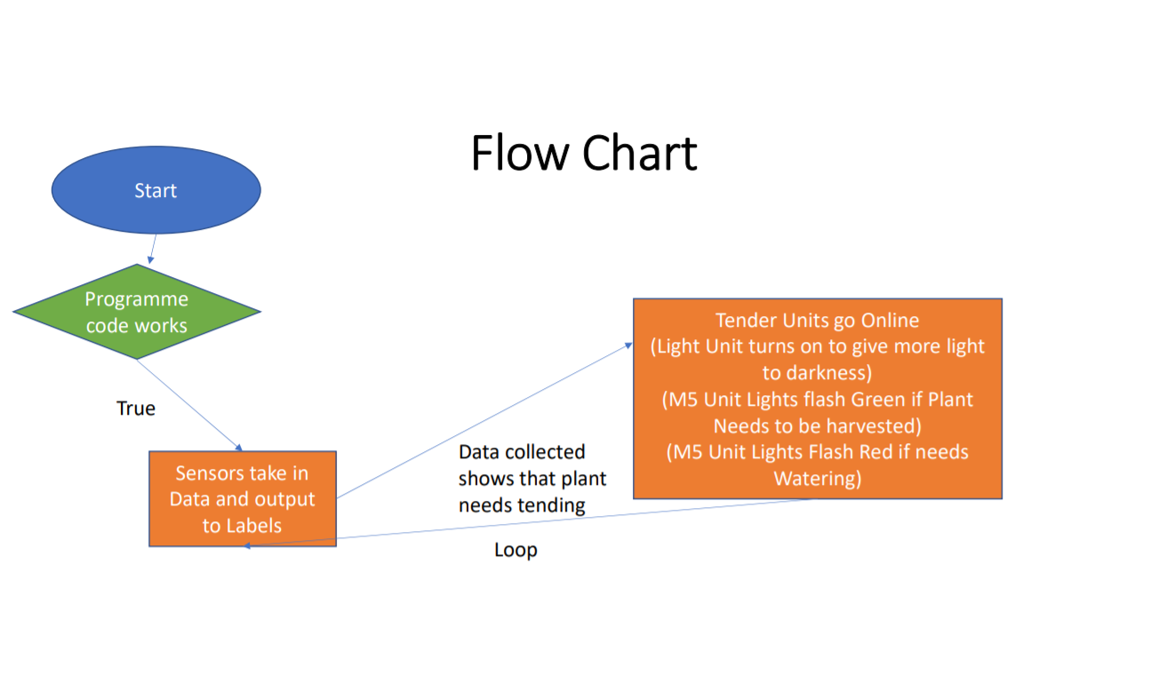

Slide 6
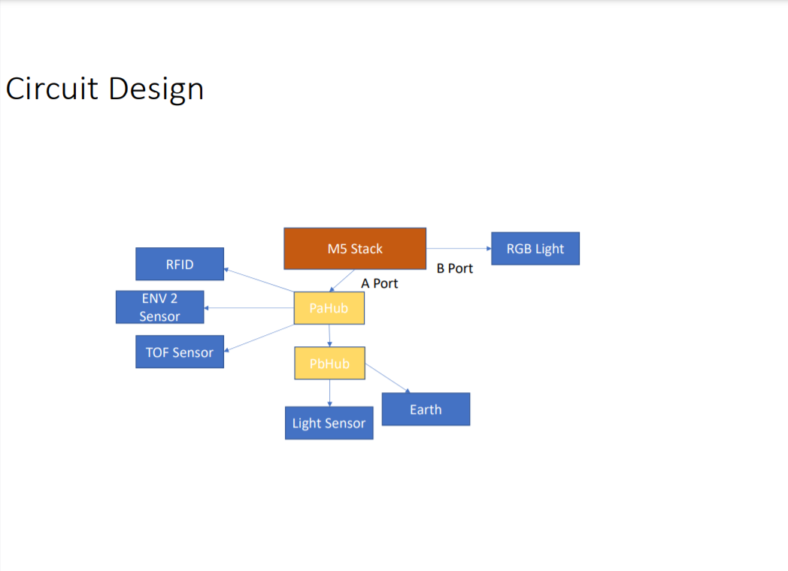

Slide 7
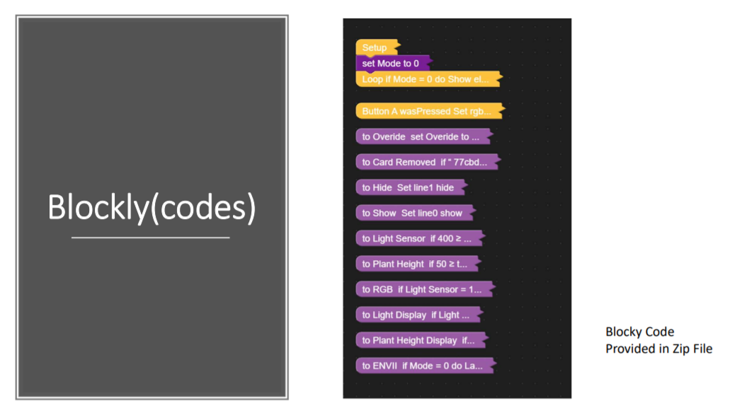

Slide 8


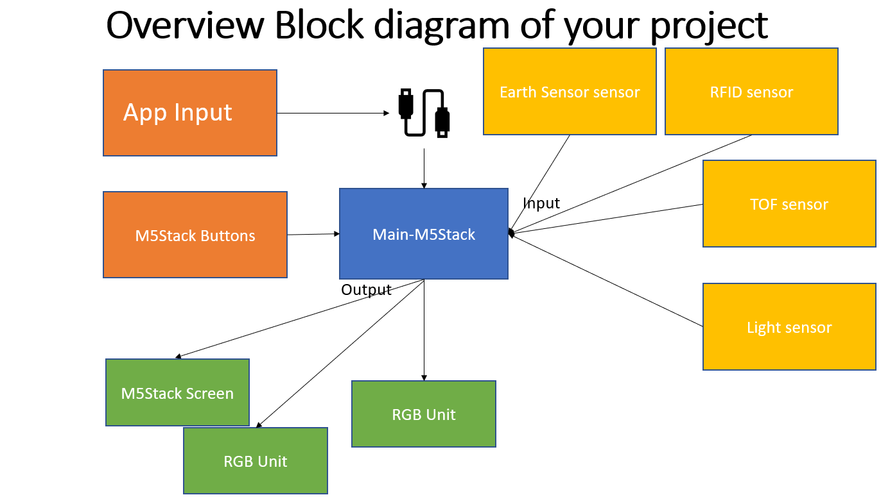
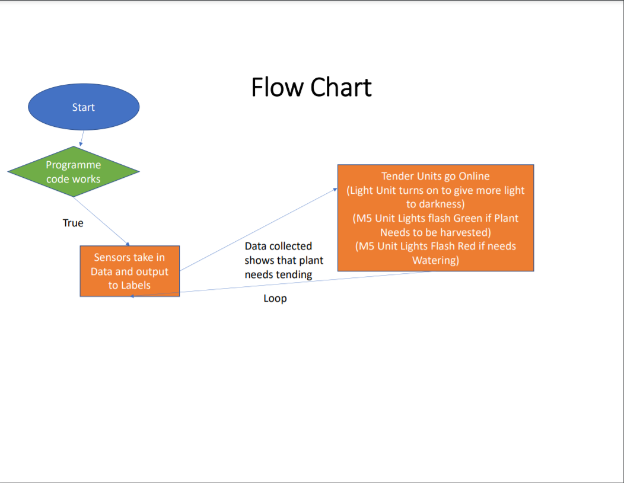
Crowd control monitoring device for
Food Court
Team Members(Group XX):Christian Tan, Adam Ilhan, Zhang Hong Rui
Driving Question
How do we farm with low human intervention?
Introduction
The EcoHouse is a mini greenhouse with a multitude of sensors it assist and manage the growth of the plant it contains as it has self-watering and self lighting functions to enable the plant contained inside it of it to grow in optimal conditions at all times.
Block Diagram
Program Flow Chart
https://doayee.co.uk/wp-content/uploads/2019/01/Flowchart.png
Circuit Design

