Slide 1


1
VALE
B.A.S.T
(Better Autonomous Systems Technology)
CDR
09/30/20

Slide 2

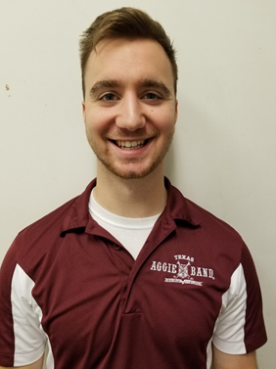


MEET THE TEAM
2
01
02
03
04
Shanley Mullen
Project Manager
Jesse Rosart-Brodnitz
Integration Engineer
Evan Maraist
Software Engineer
Austin Heibel
Hardware Engineer

Slide 3

SPONSOR AND FACULTY ADVISOR
3
Dr. Garth V. Crosby

Slide 4
OVERVIEW
4
  Background
  Objectives
  Conceptual Block Diagram
  Functional Block Diagram
  Technical Overview
    Electronics Design
    Software Design
    Mechanical Design
    Demonstration Contents
    Test Matrix
  Project Status
  Summary
Notes:
Jesse

Slide 5
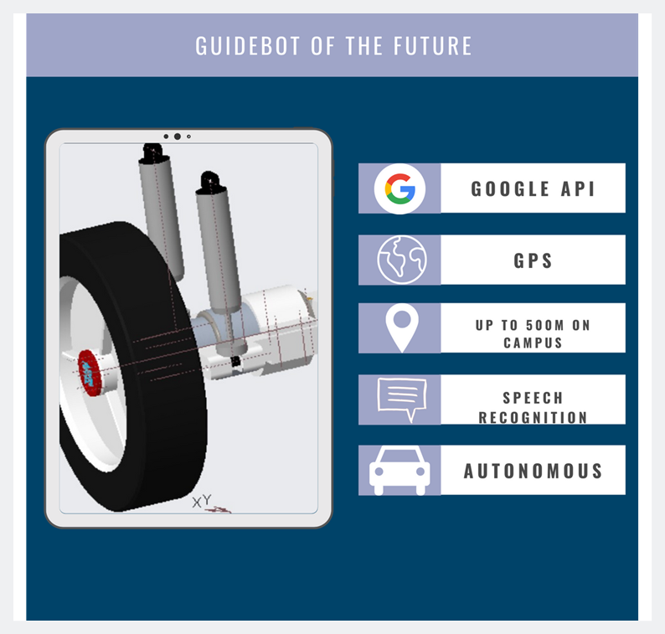
5
Texas A&M has the second largest campus in the country with a main campus that is over 21 square kilometers and has over 200 buildings. With such a large area to cover there is a need for an autonomous guide system for the residents and guests of this campus.
Background

Slide 6
6
VALE, will act as a personal guide for students, faculty, and visitors to Texas A&M campus that can be used at anytime of the day. VALE will utilize obstacle avoidance, speech recognition, cellular connection, and GPS localization to achieve this goal. The user will ask VALE to be taken to a specific location or building on campus. VALE will then drive to that location, leading the user.
Background

Slide 7





7
FUNCTIONAL REQUIREMENTS
Hardware:
Environment Proofing
Power Upgrade
Software:
Obstacle Avoidance
Speech Recognition
GPS & API
Background
Objectives

Slide 8


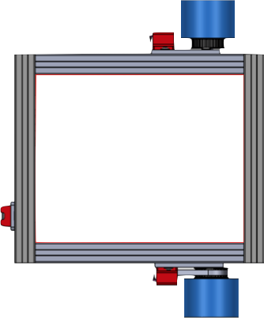


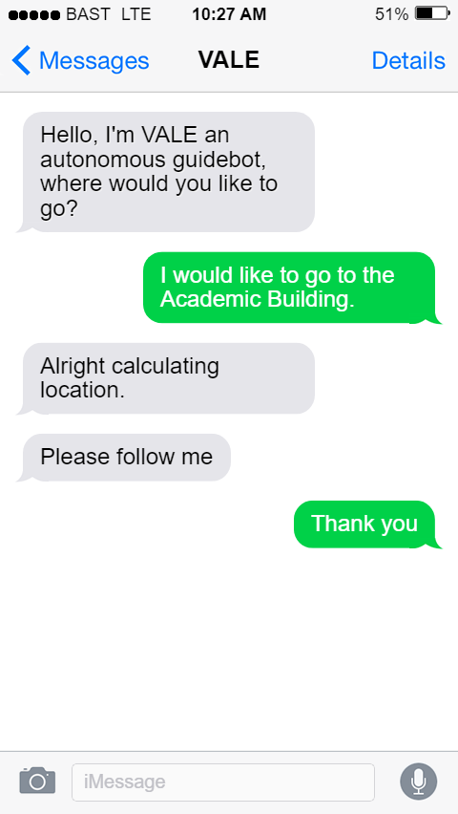




CONCEPTUAL BLOCK DIAGRAM
8
LIDAR
Background
Objectives
Conceptual
Block
Diagram

Slide 9
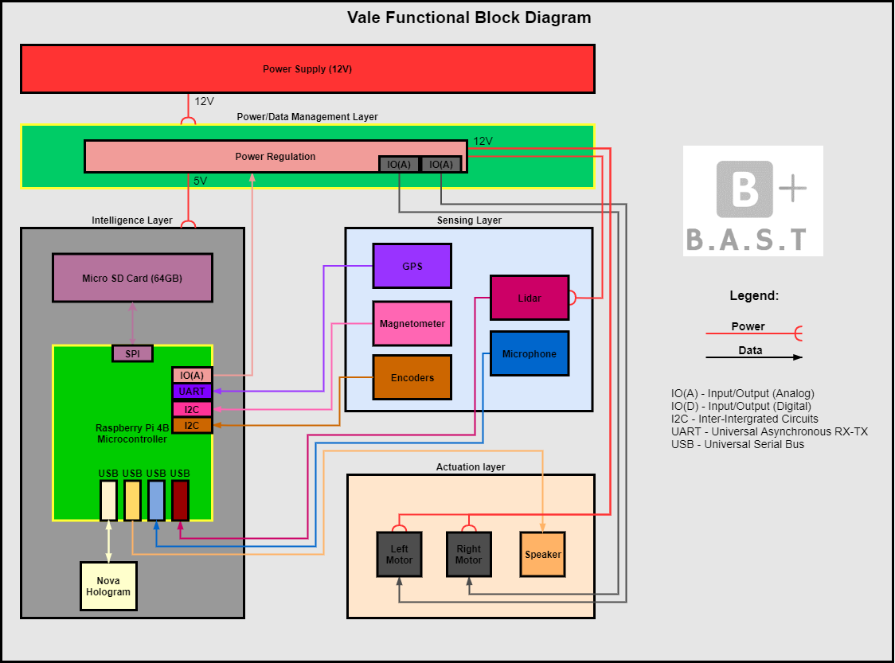
FUNCTIONAL BLOCK DIAGRAM
9
Background
Objectives
Conceptual
Block
Diagram
Functional
Block
Diagram

Slide 10
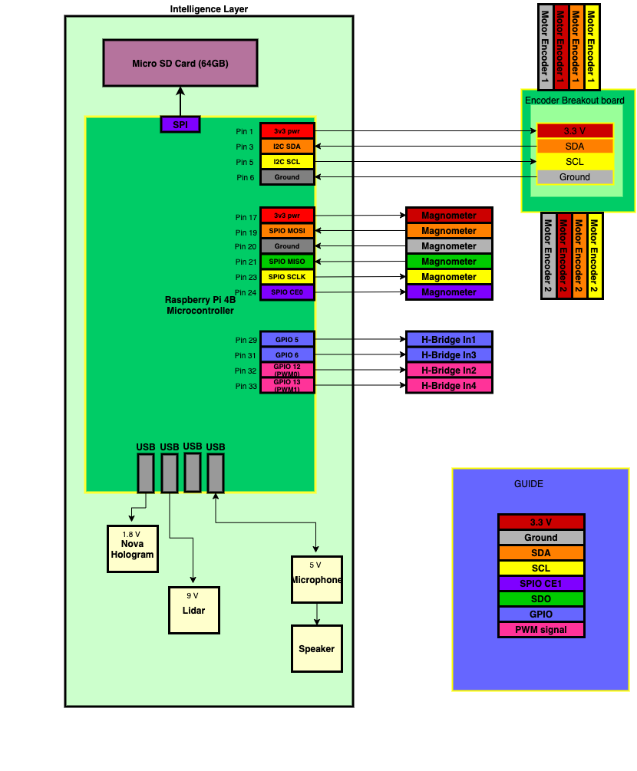
INTELLIGENCE LAYER
10
Background
Objectives
Conceptual
Block
Diagram
Functional
Block
Diagram
Notes:
Jesse

Slide 11

11
TECHNICAL PRESENTATION

Slide 12
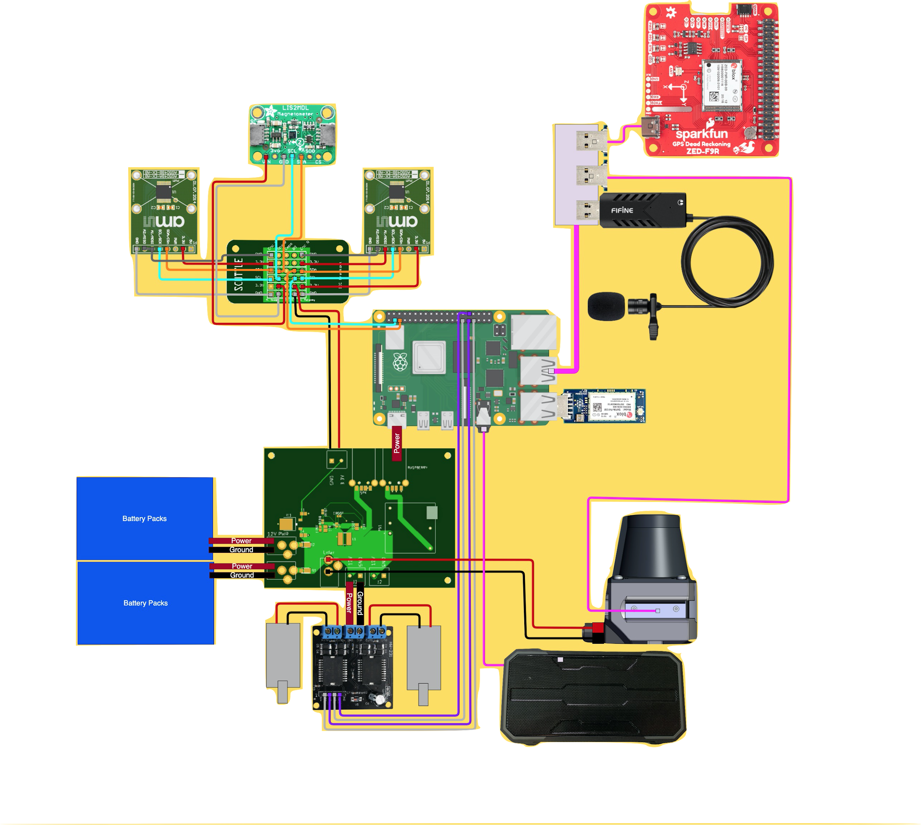
ELECTRONICS DESIGN
12
Background
Objectives
Conceptual
Block
Diagram
Functional
Block
Diagram
Electronics Design
Notes:
Jesse

Slide 13
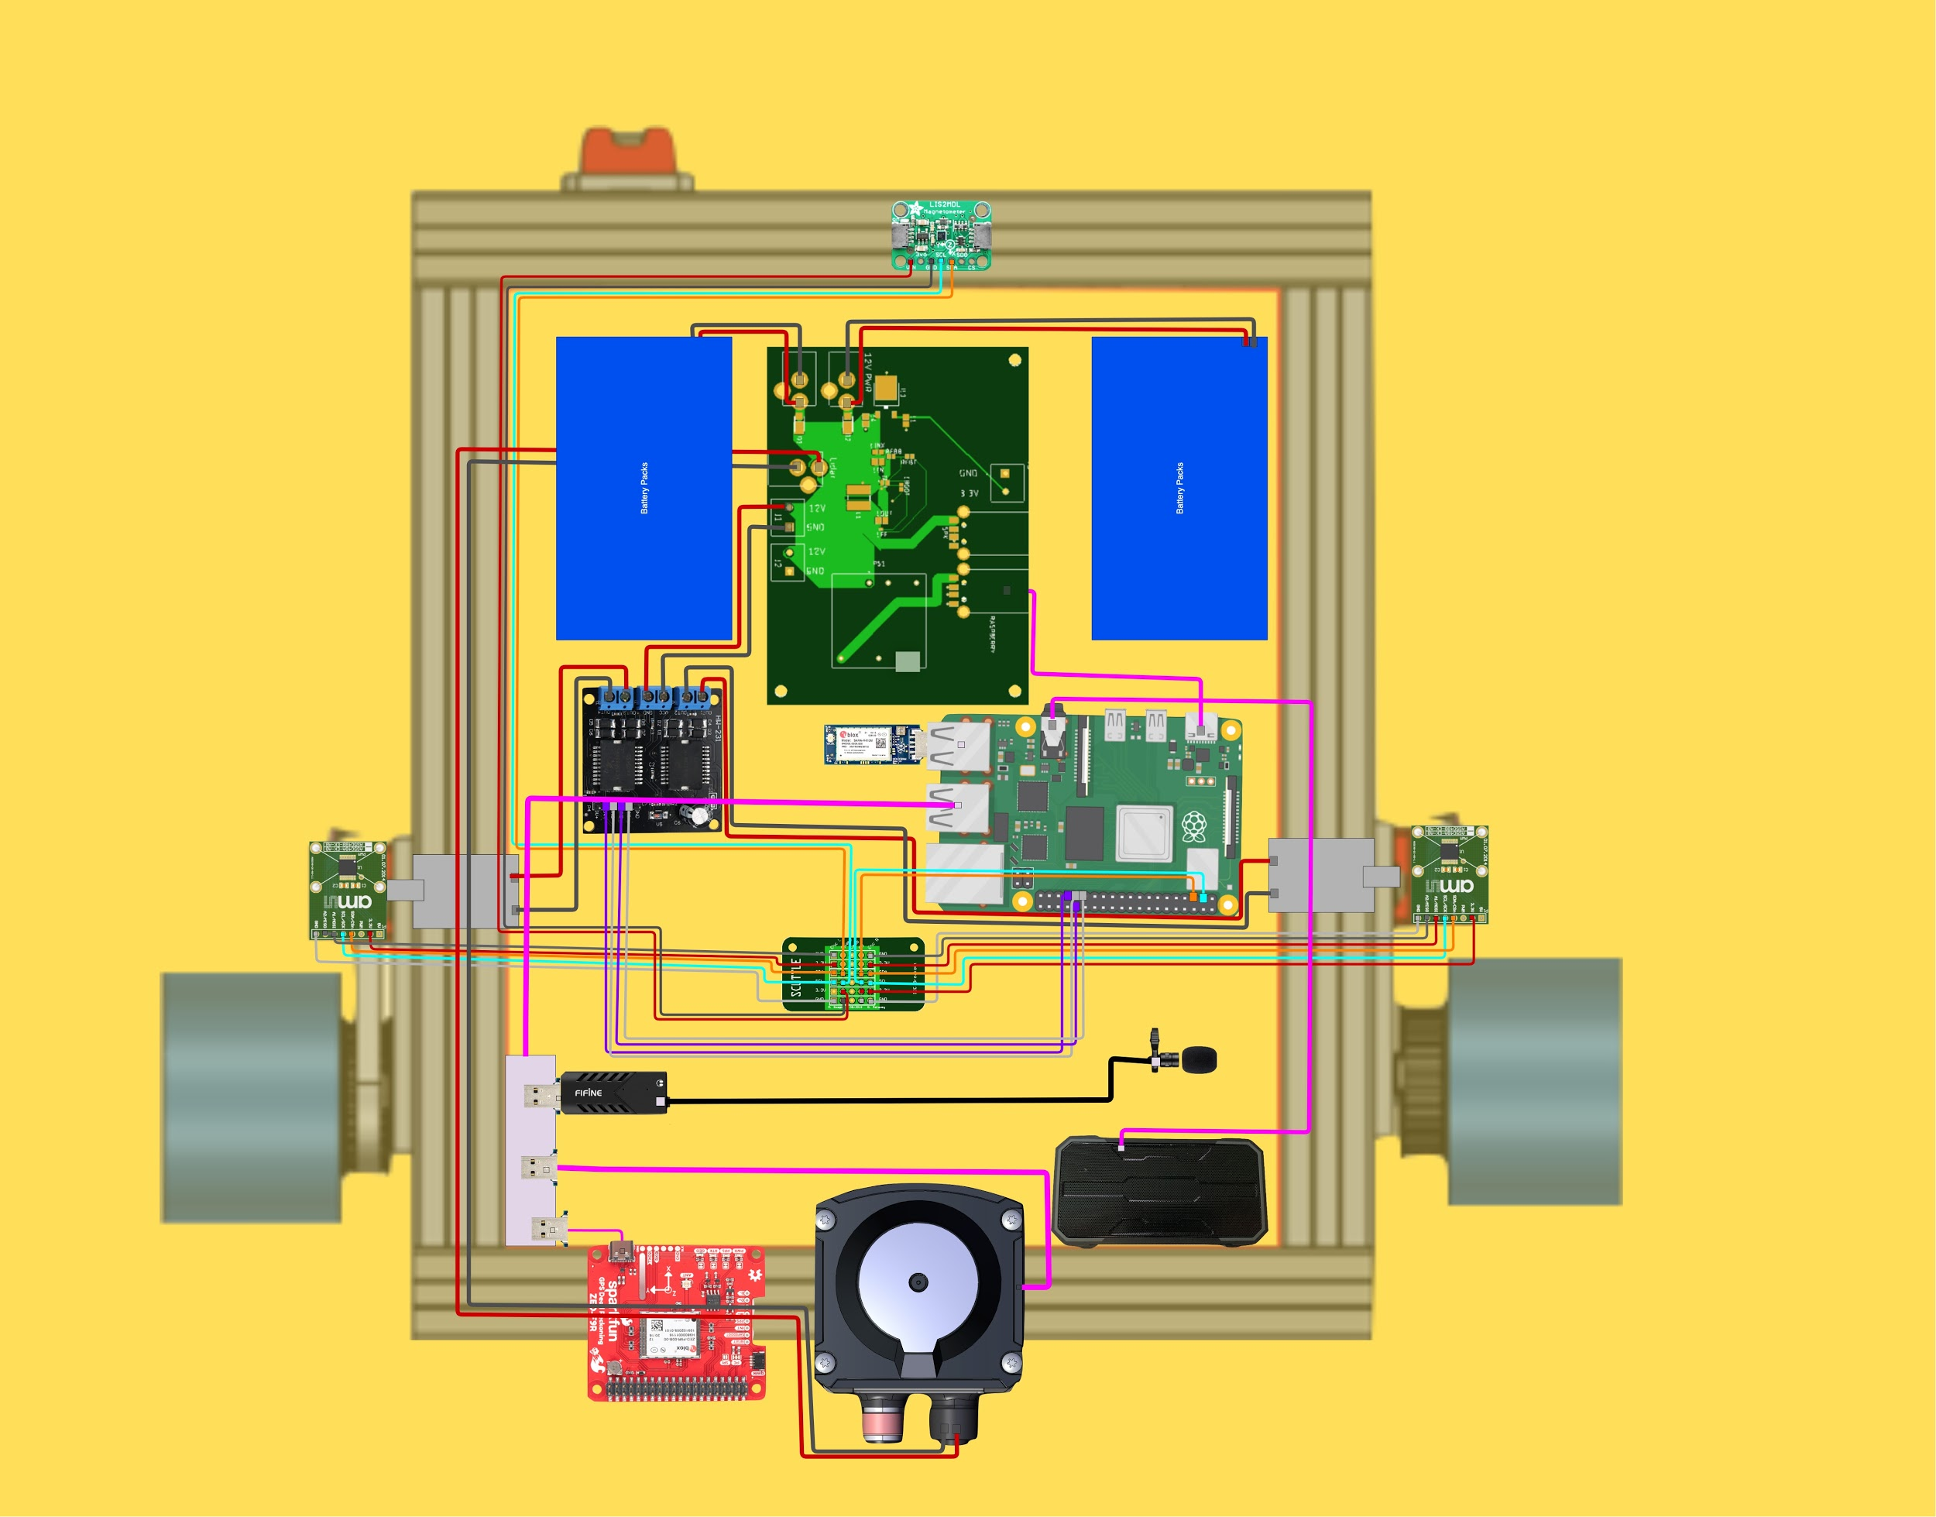
ELECTRONICS DESIGN
13
Background
Objectives
Conceptual
Block
Diagram
Functional
Block
Diagram
Electronics Design
Notes:
Jesse

Slide 14
POWER BUDGET
14
*ESTIMATES ARE LIBERAL INCREASES FROM MEASUREMENTS
Device | Voltage | Amperage | Wattage
SICK TiM LiDAR | @9.9 V | 400 mA | ~4.0 W
*Motors (x2) | @9.9 V/per | 1.1 A*/1 | ~21.8 W
Raspberry Pi 4 | @9.9 V (5 V) | 3 A | ~29.7 W
Total Power Draw | --- | 5.6 A | 55.5 W
Power Supply (9.9V)x2
~ Max Amps Out = 5.6 A
~ 6.4 Amp×Hour Capacity
~ 68 Min. Operation Life
*x2 Op. Time / Min. +Weight
*Motor Amperage 0.1 Amp below stall
**Speaker has seperate battery power
*** H-Bridge, Power Distribution PCB, Encoders, Magnetometer, & wire resistance power draw has been omitted.
****Microphone & NH powered through RP4
Background
Objectives
Conceptual
Block
Diagram
Functional
Block
Diagram
Electronics Design
Notes:
Jesse

Slide 15
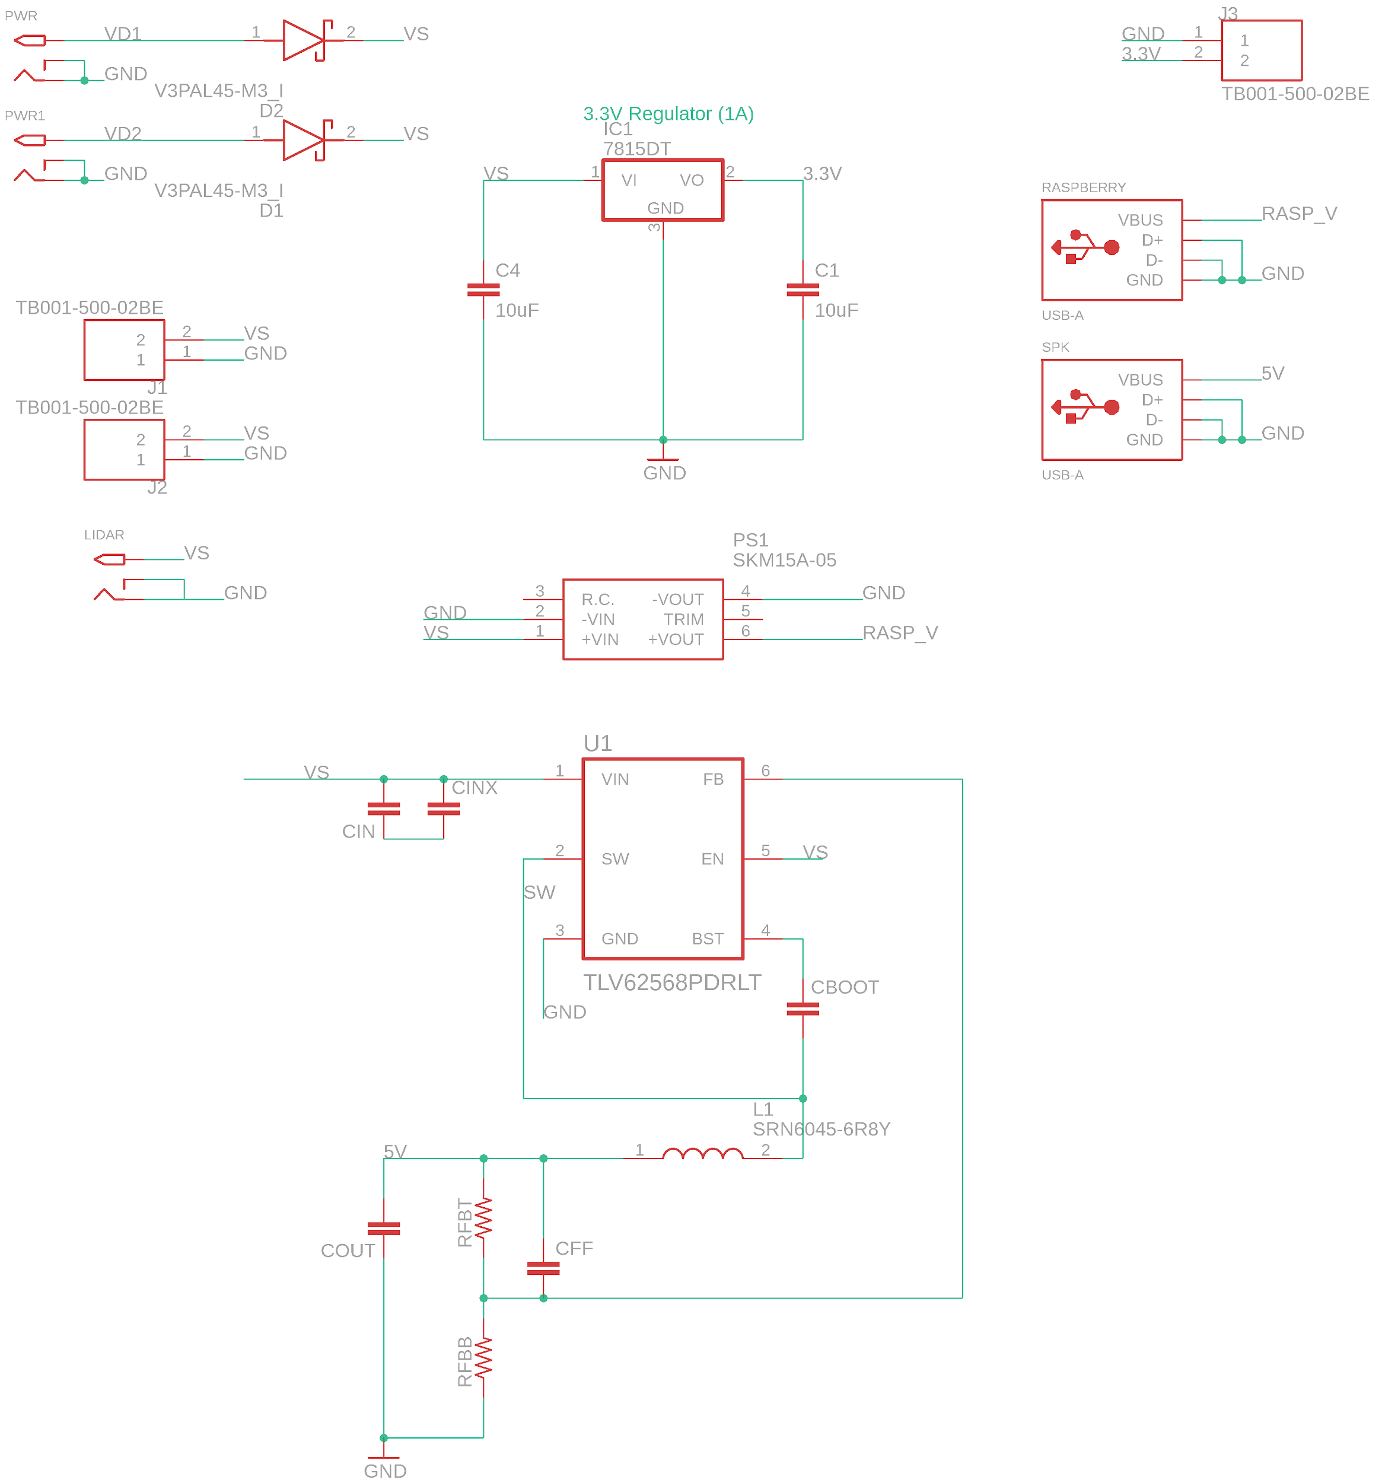
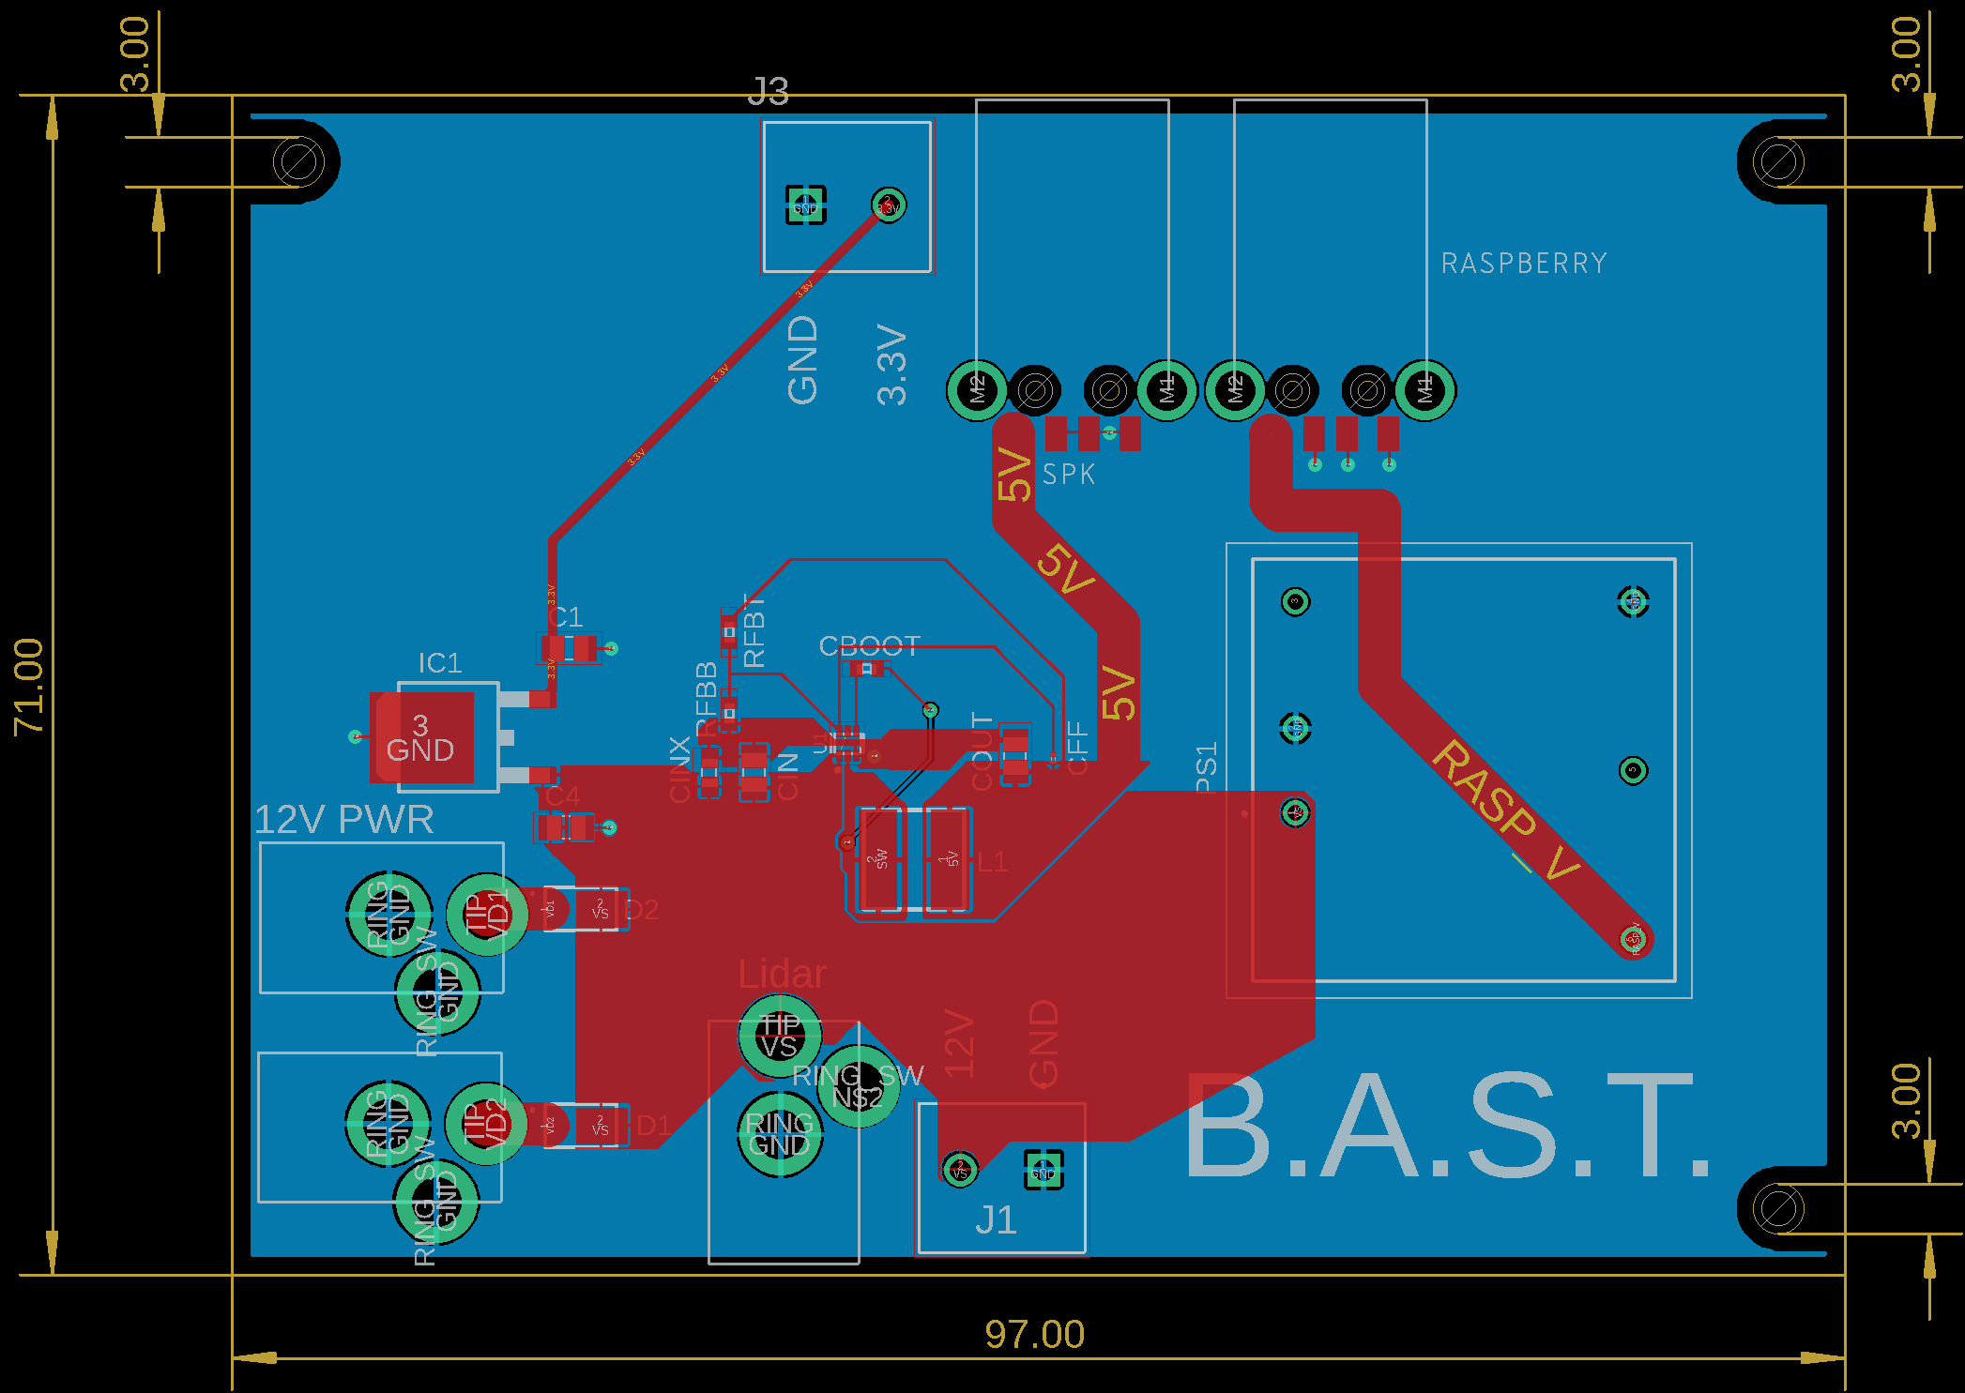
SCHEMATIC
15
Background
Objectives
Conceptual
Block
Diagram
Functional
Block
Diagram
Electronics Design

Slide 16
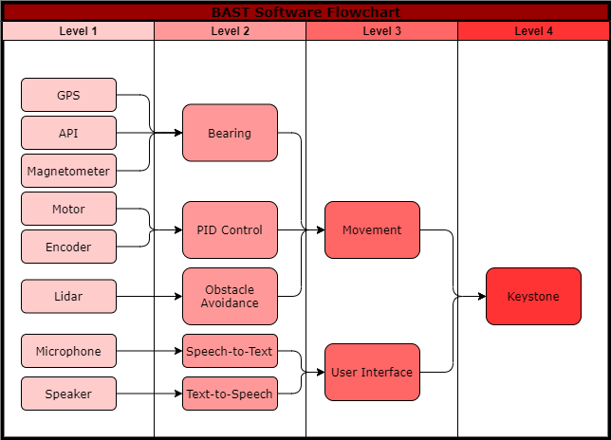
SOFTWARE DESIGN
16
Background
Objectives
Conceptual
Block
Diagram
Functional
Block
Diagram
Electronics Design
Software Design

Slide 17
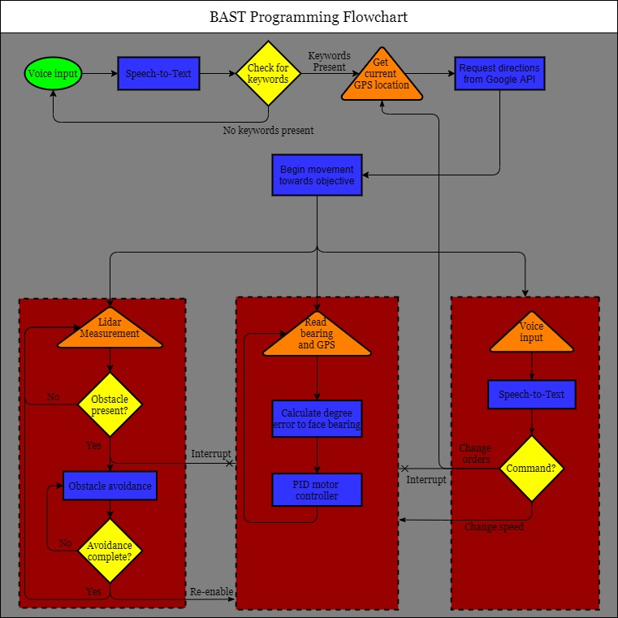
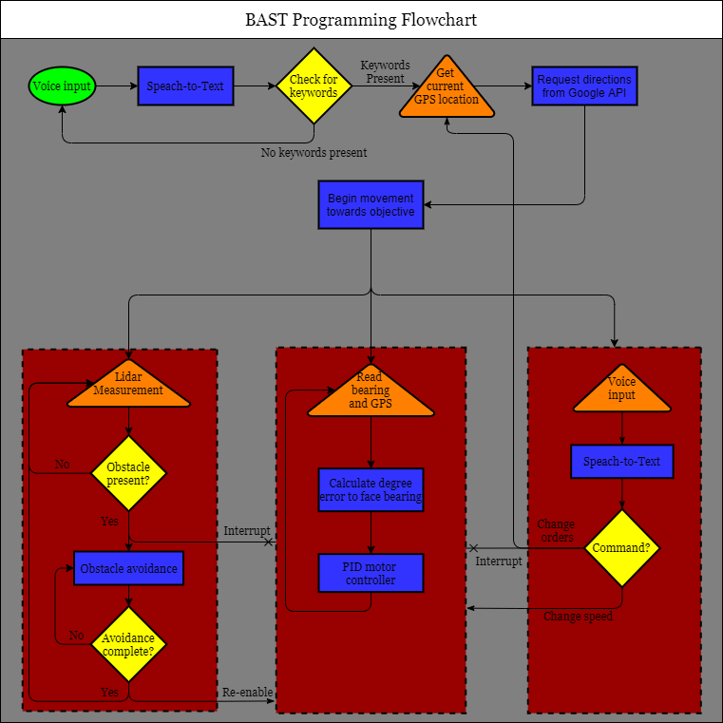
SOFTWARE DESIGN
17
Background
Objectives
Conceptual
Block
Diagram
Functional
Block
Diagram
Electronics Design
Software Design

Slide 18
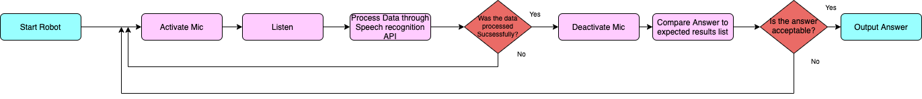
SPEECH RECOGNITION
18
Background
Objectives
Conceptual
Block
Diagram
Functional
Block
Diagram
Electronics Design
Software Design

Slide 19
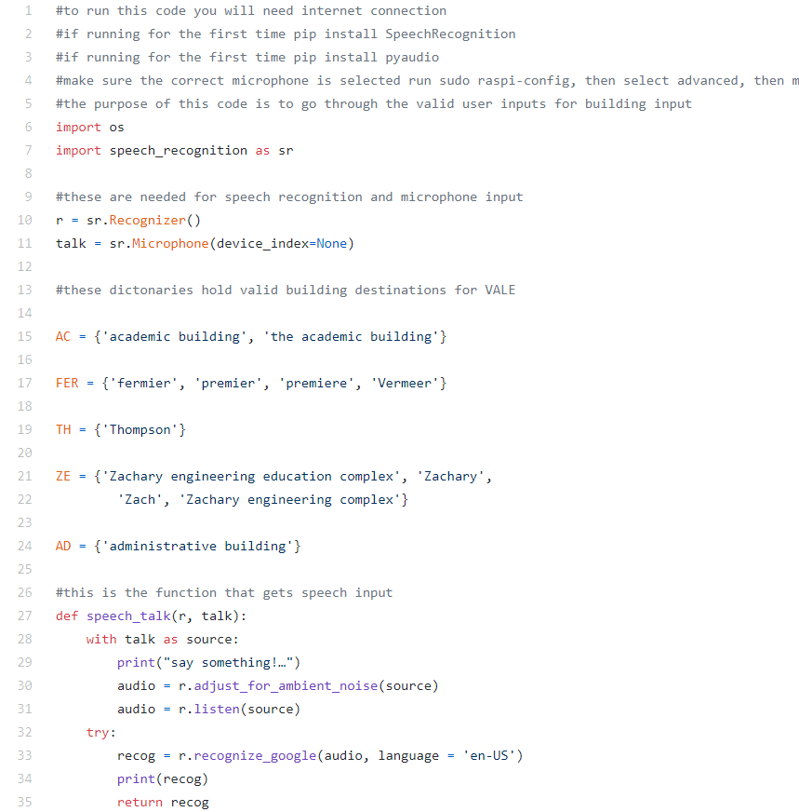
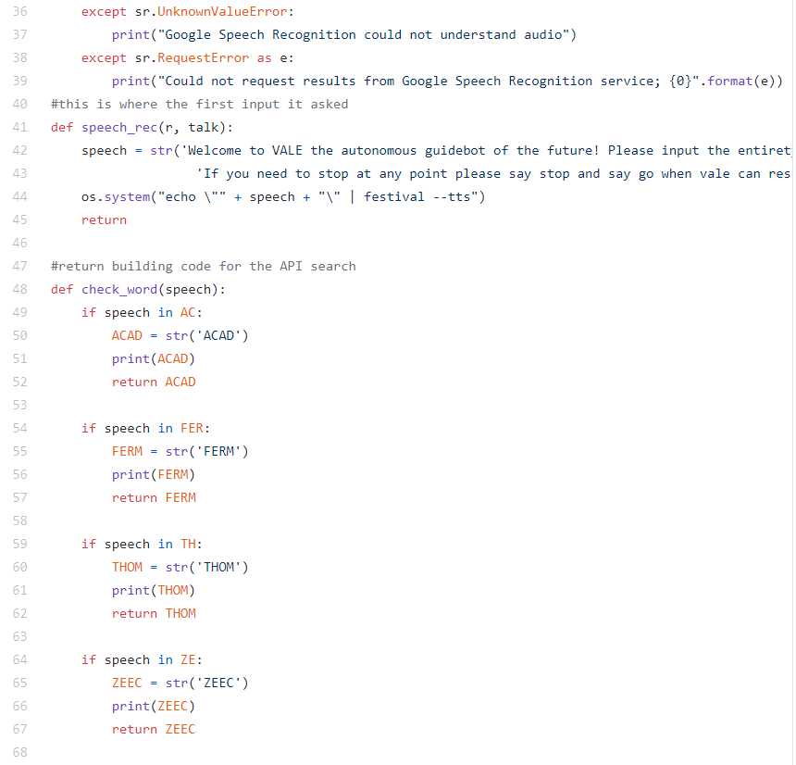
Speech Recognition CODE
19
Background
Objectives
Conceptual
Block
Diagram
Functional
Block
Diagram
Electronics Design
Software Design
Notes:
Jesse

Slide 20
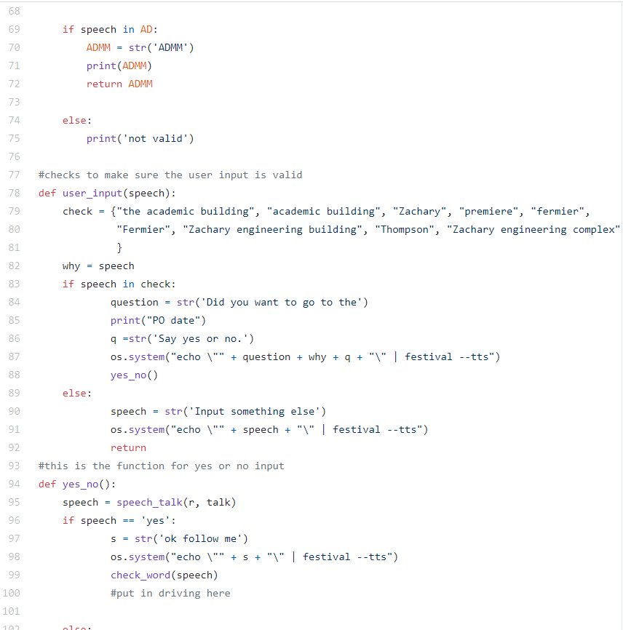
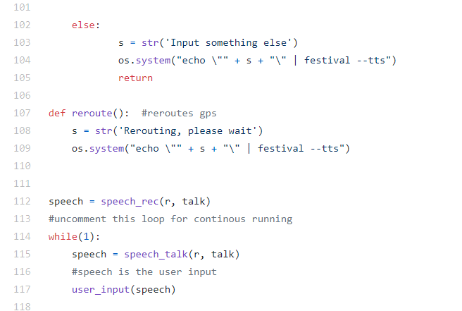
Speech Recognition CODE
20
Background
Objectives
Conceptual
Block
Diagram
Functional
Block
Diagram
Electronics Design
Software Design
Notes:
Jesse

Slide 21
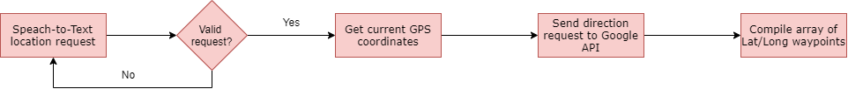
API/GPS
21
Speech
Background
Objectives
Conceptual
Block
Diagram
Functional
Block
Diagram
Electronics Design
Software Design

Slide 22
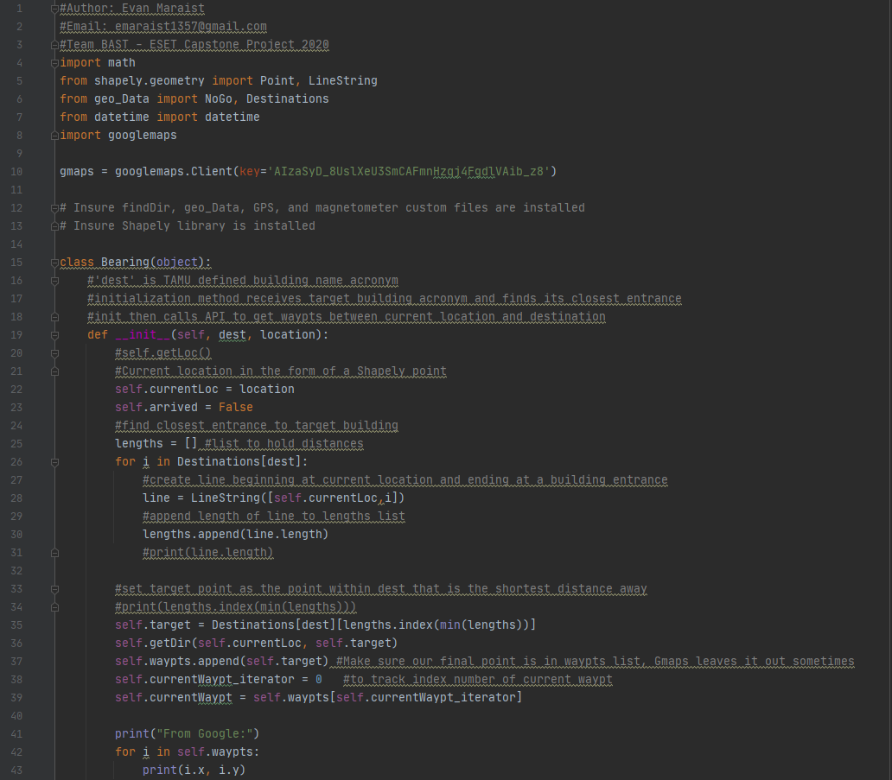
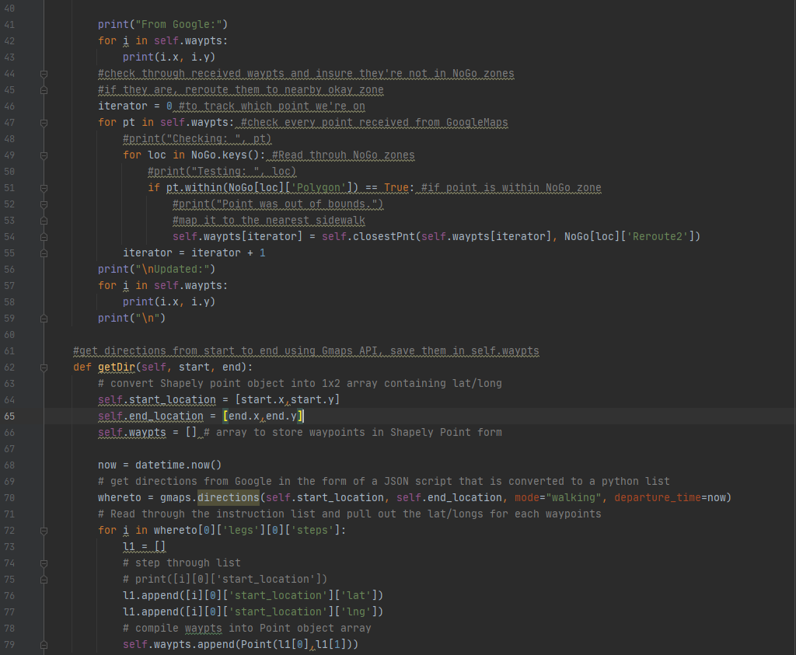
Bearing/API class
22
Background
Objectives
Conceptual
Block
Diagram
Functional
Block
Diagram
Electronics Design
Software Design
Notes:
Jesse

Slide 23
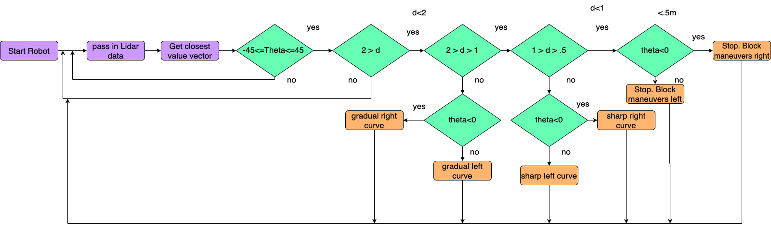
OBSTACLE AVOIDANCE
23
Background
Objectives
Conceptual
Block
Diagram
Functional
Block
Diagram
Electronics Design
Software Design
Notes:
Jesse

Slide 24
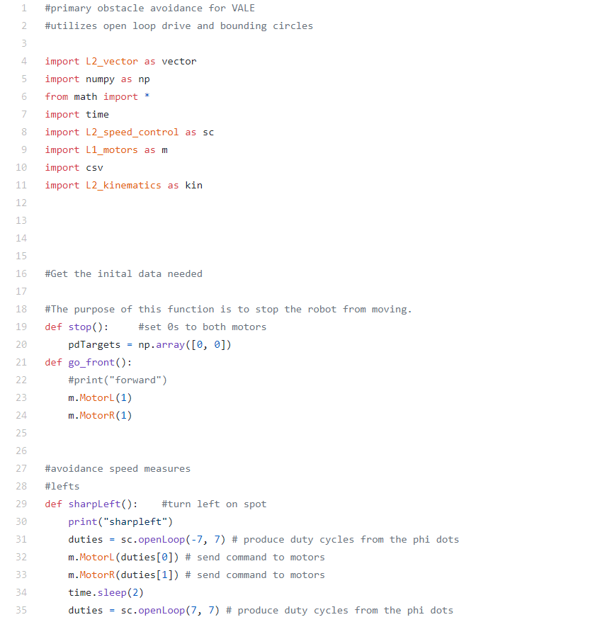
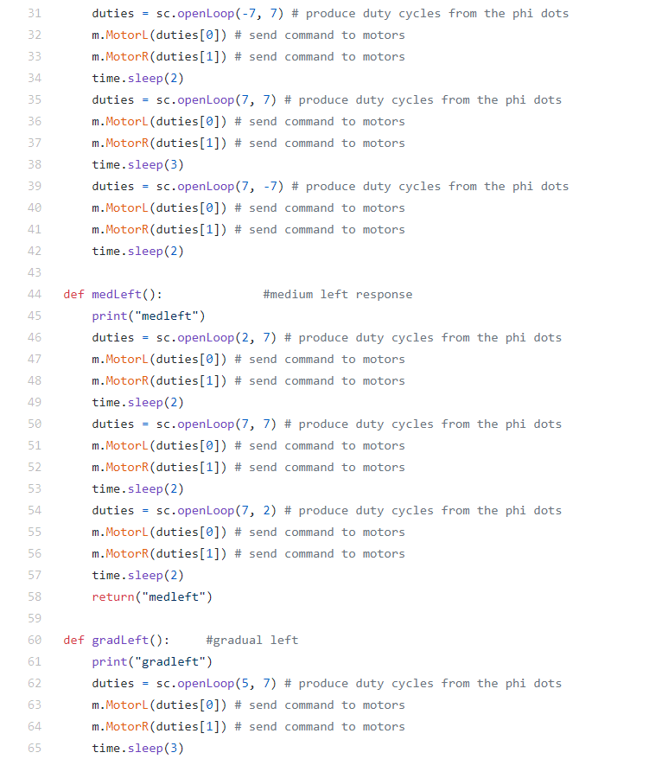
OBSTACLE AVOIDANCE CODE
24
Background
Objectives
Conceptual
Block
Diagram
Functional
Block
Diagram
Electronics Design
Software Design
Notes:
Jesse

Slide 25
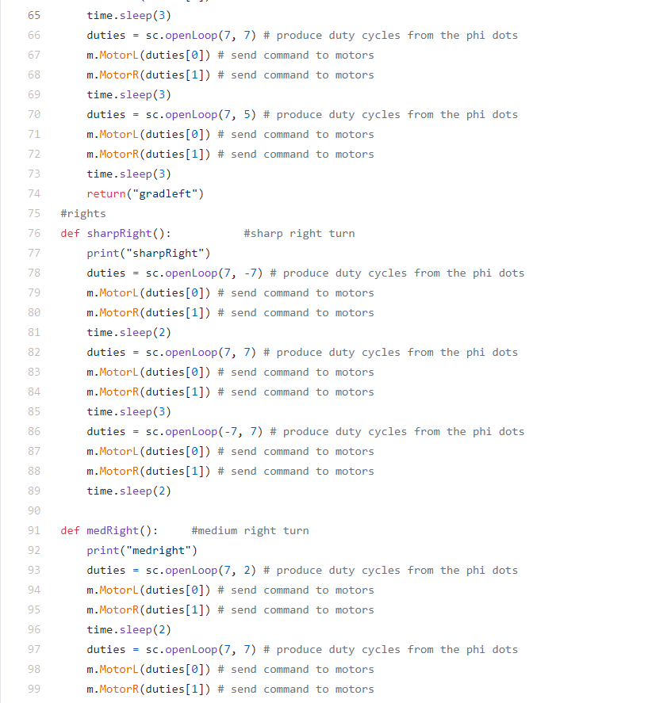
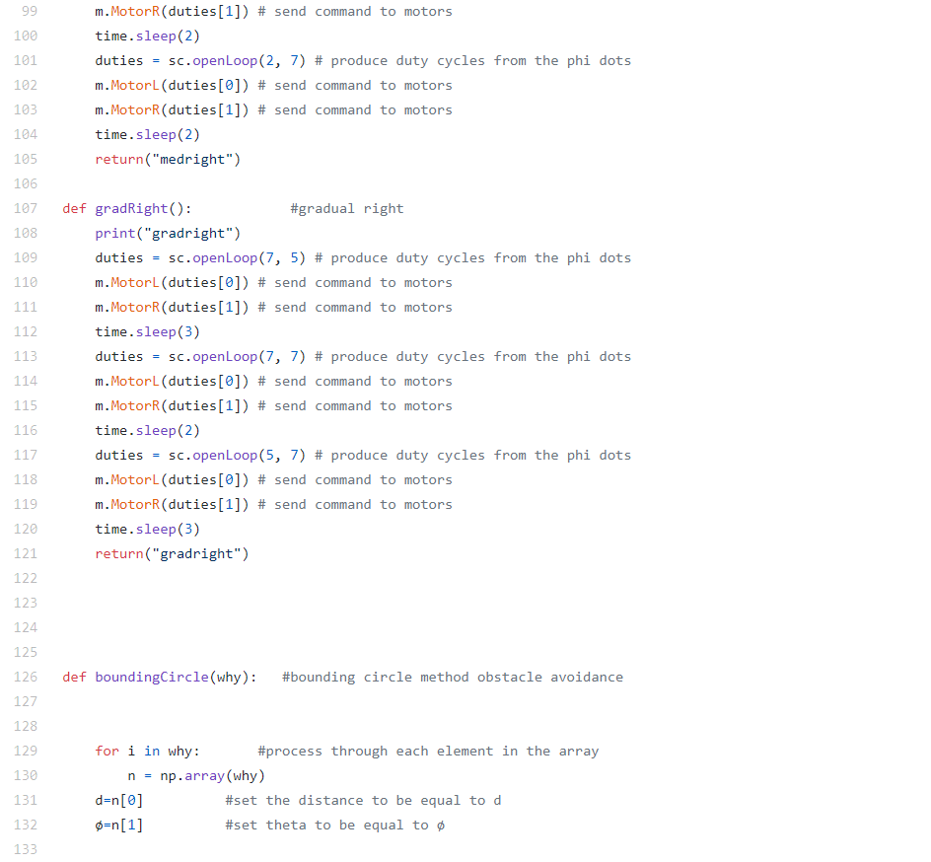
OBSTACLE AVOIDANCE CODE
25
Background
Objectives
Conceptual
Block
Diagram
Functional
Block
Diagram
Electronics Design
Software Design
Notes:
Jesse

Slide 26
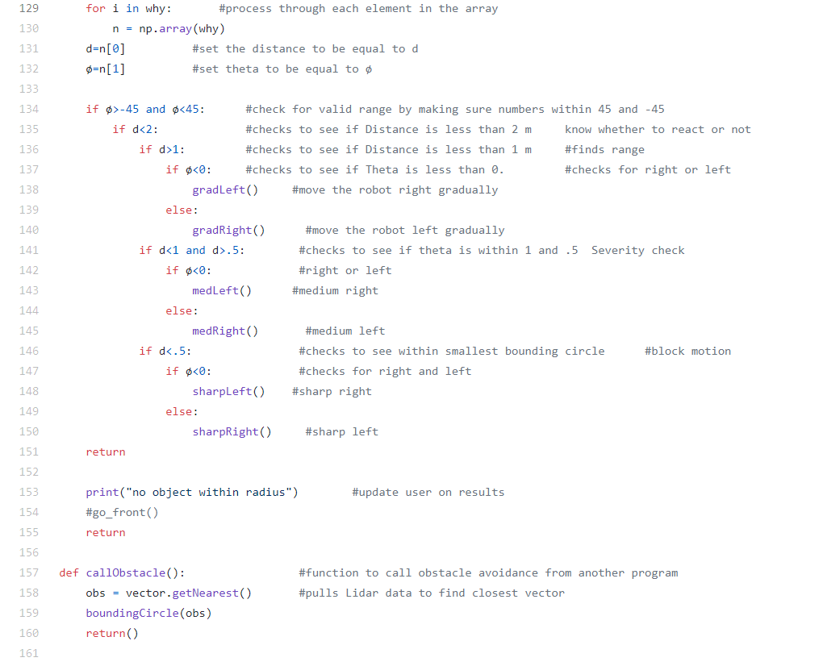
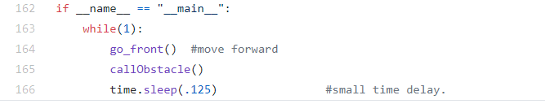
OBSTACLE AVOIDANCE CODE
26
Background
Objectives
Conceptual
Block
Diagram
Functional
Block
Diagram
Electronics Design
Software Design
Notes:
Jesse

Slide 27
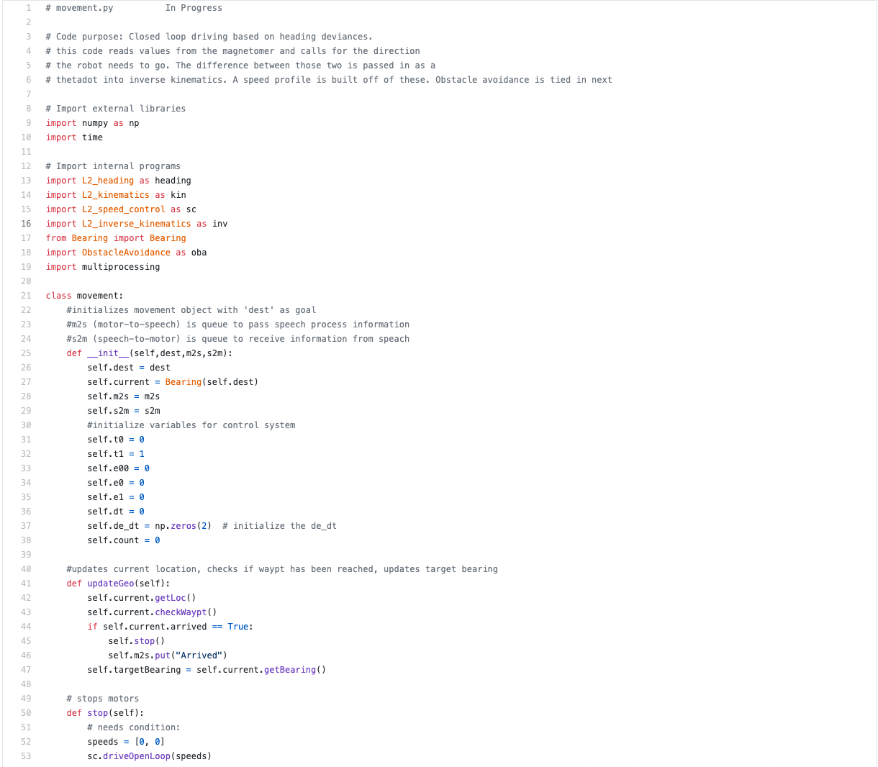
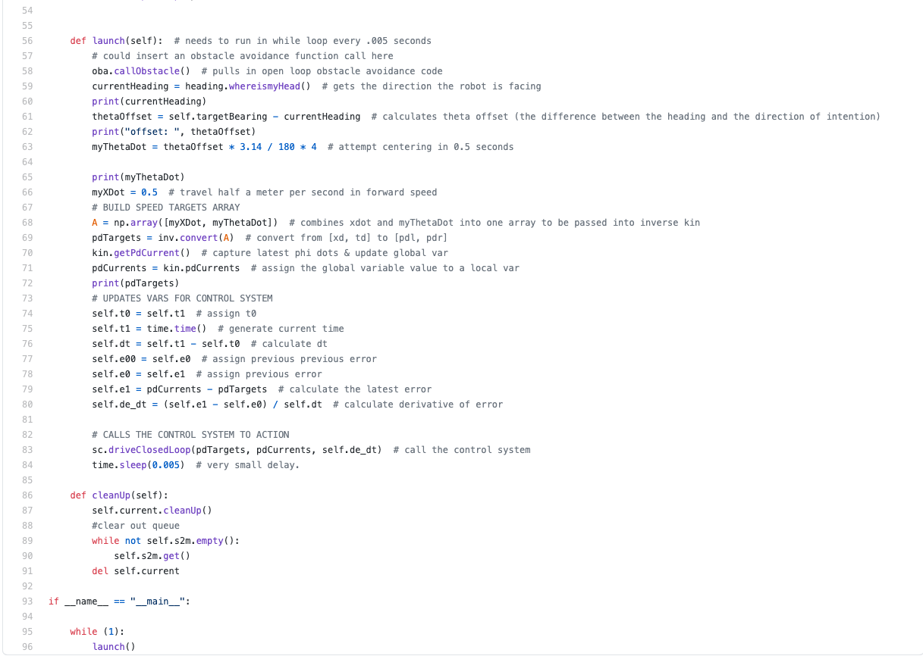
Movement CODE
27
Background
Objectives
Conceptual
Block
Diagram
Functional
Block
Diagram
Electronics Design
Software Design
Notes:
Jesse

Slide 28
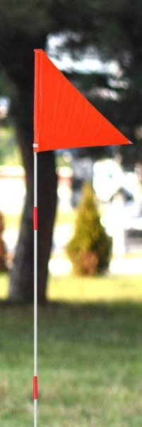
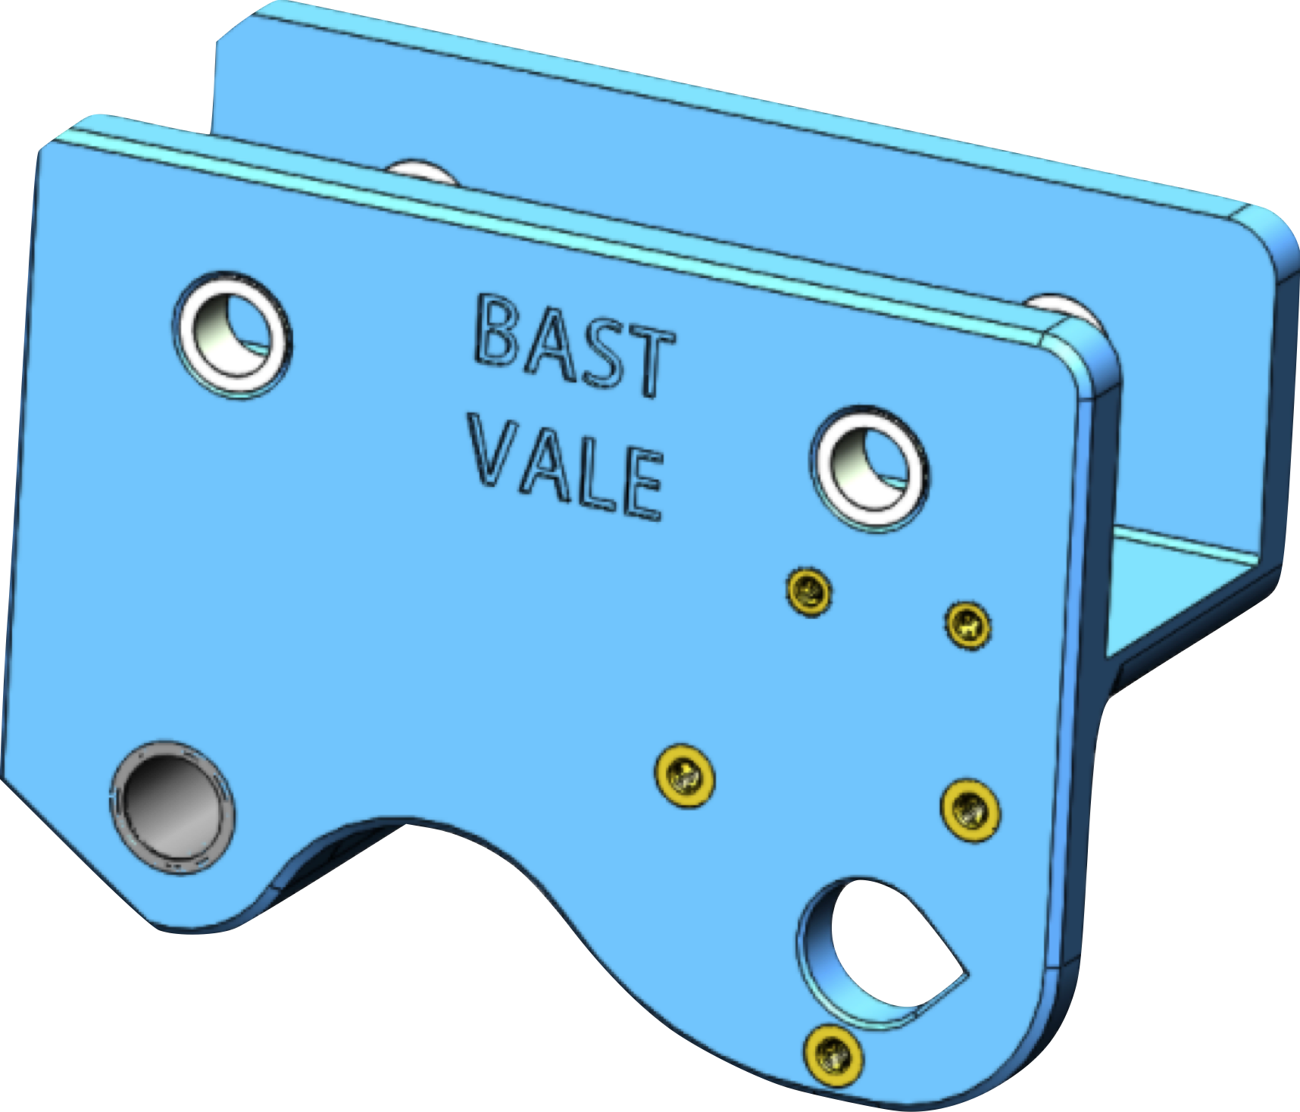
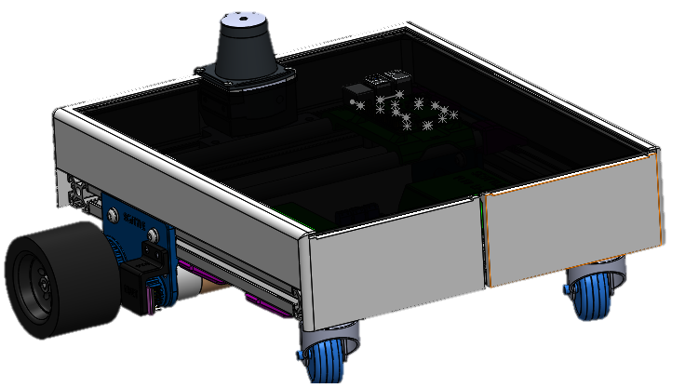
MECHANICAL DESIGN:
Environment Proofing - Protection
28
01
02
03
Item#B085M9B8BB
On Amazon.com
ASA Weather Protection Case
Acrylic Lid
PETG Parts
Flag Pole
Background
Objectives
Conceptual
Block
Diagram
Functional
Block
Diagram
Electronics Design
Software Design
Mechanical Design
Notes:
Austin

Slide 29
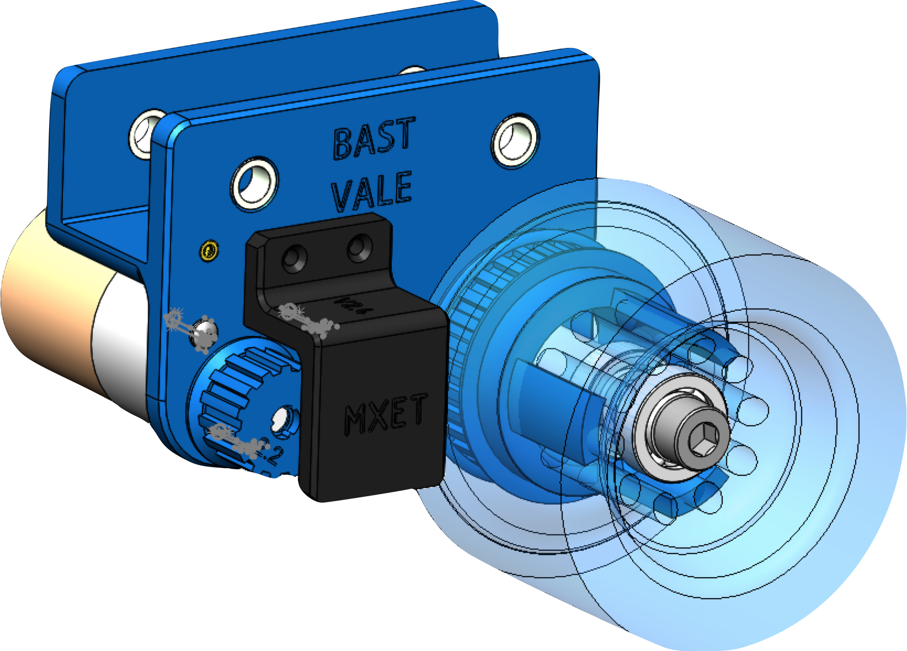
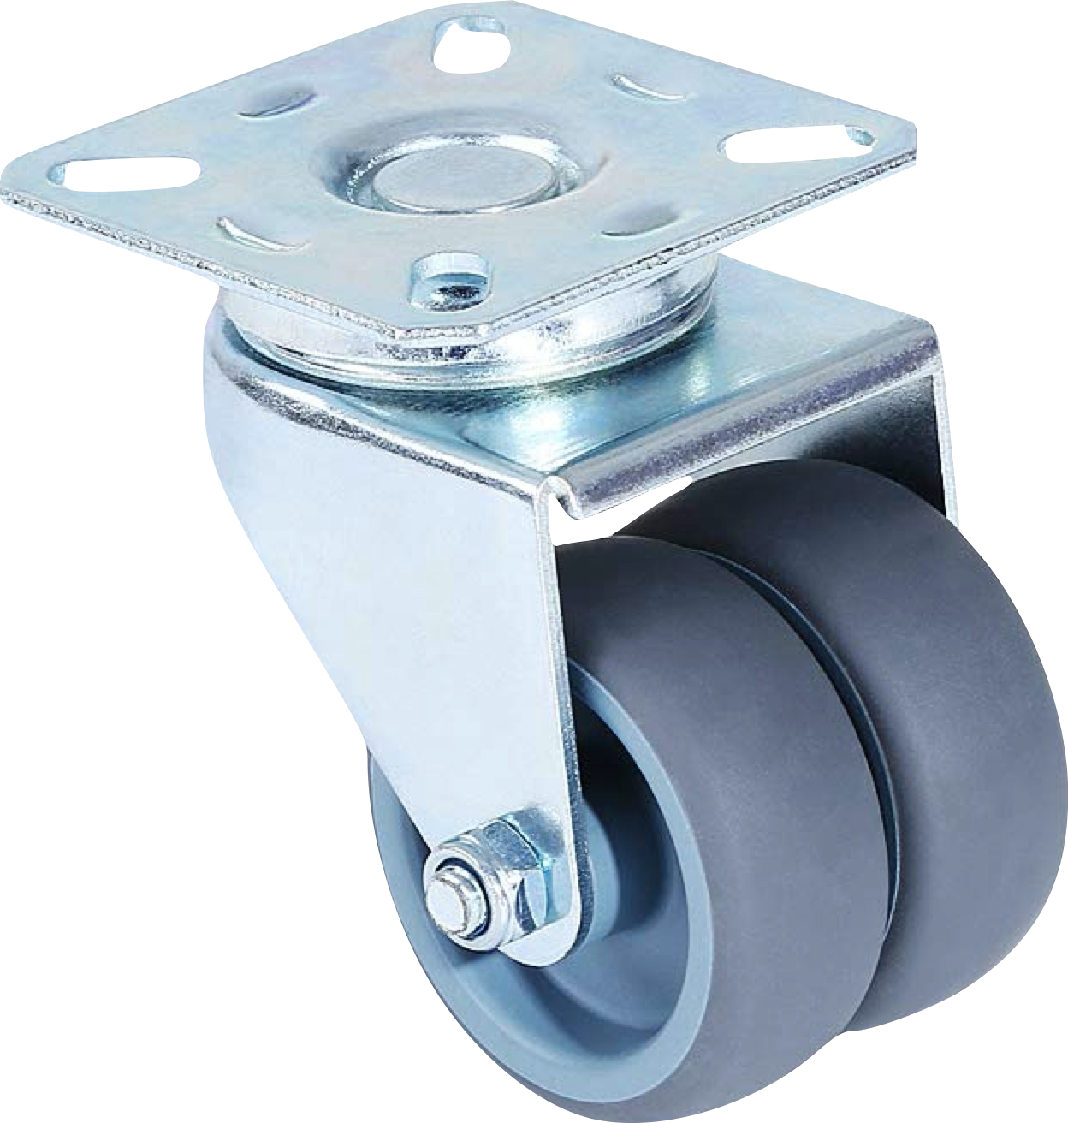
MECHANICAL DESIGN:
Environment Proofing - Drivetrain
29
01
02
Item # B077SQ3BZR
On Amazon.com
Wide Casters
Severe Duty Unibrackets
PETG Pulleys
Background
Objectives
Conceptual
Block
Diagram
Functional
Block
Diagram
Electronics Design
Software Design
Mechanical Design
Notes:
Austin

Slide 30
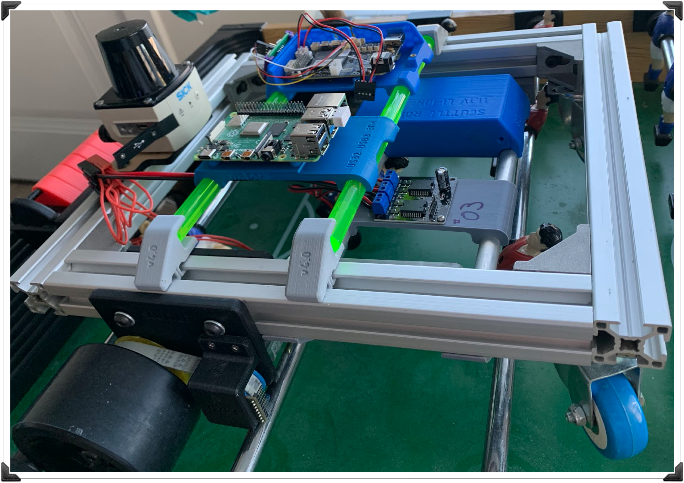
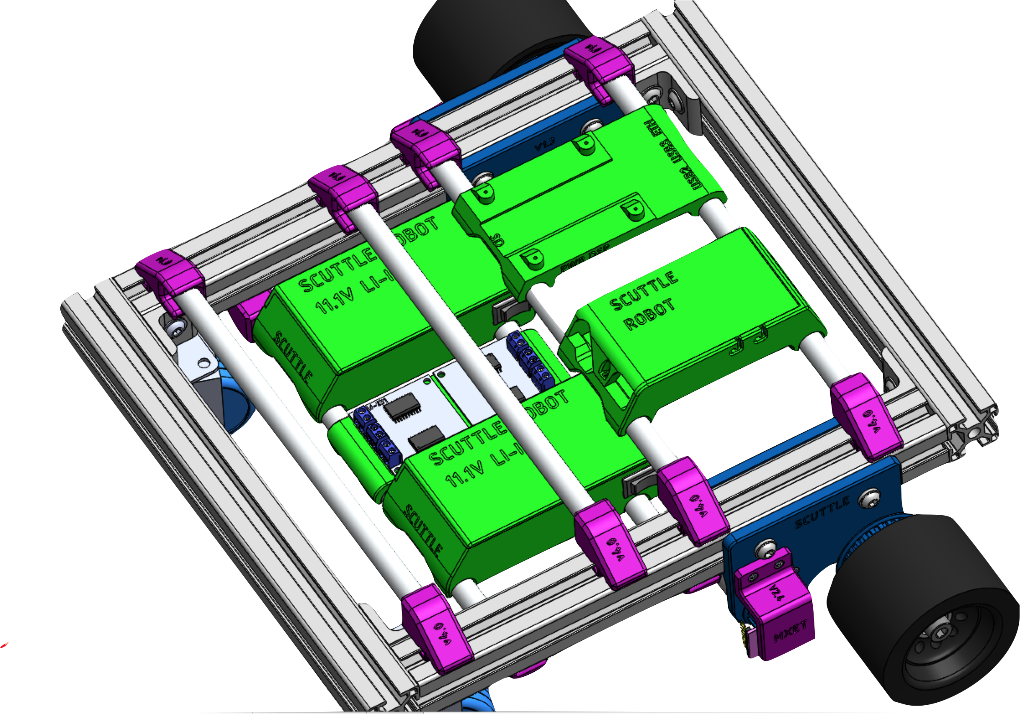
MECHANICAL DESIGN:
Mounting More Parts
30
“Double-Decker” Architecture
Additional Mounts: Raspberry Pi 4 Mount Magnetometer Mount
PCB Mount USB-Expansion Mount GPS-RTK Unit Mount
Background
Objectives
Conceptual
Block
Diagram
Functional
Block
Diagram
Electronics Design
Software Design
Mechanical Design
Notes:
Austin

Slide 31
DEMONSTRATION CONTENTS
31
    Level 1 & Level 2 Demo
      Bearing
        The purpose is to show that we can get the location and using API navigate to that location.
      PID Control
        The purpose of this code is to ensure smooth driving. We will show the Motors and the Encoder code individually while driving will be shown in the Level 3 demo.
Background
Objectives
Conceptual
Block
Diagram
Functional
Block
Diagram
Electronics Design
Software Design
Mechanical Design
Demo
Notes:
Jesse

Slide 32

LEVEL 1 & 2 DEMONSTRATION VIDEO
32
Background
Objectives
Conceptual
Block
Diagram
Functional
Block
Diagram
Electronics Design
Software Design
Mechanical Design
Demo
Notes:
Jesse

Slide 33
DEMONSTRATION CONTENTS
33
    Level 3 Demo:
      Movement
        The purpose of this code is to show the PID controller and the obstacle avoidance code working together.
      User Interface
        The purpose of this code is to take user input from speech and then provide an audible output with the speakers.
Background
Objectives
Conceptual
Block
Diagram
Functional
Block
Diagram
Electronics Design
Software Design
Mechanical Design
Demo
Notes:
Jesse

Slide 34
LEVEL 3 DEMONSTRATION VIDEO
34
Background
Objectives
Conceptual
Block
Diagram
Functional
Block
Diagram
Electronics Design
Software Design
Mechanical Design
Demo
Notes:
Jesse

Slide 35
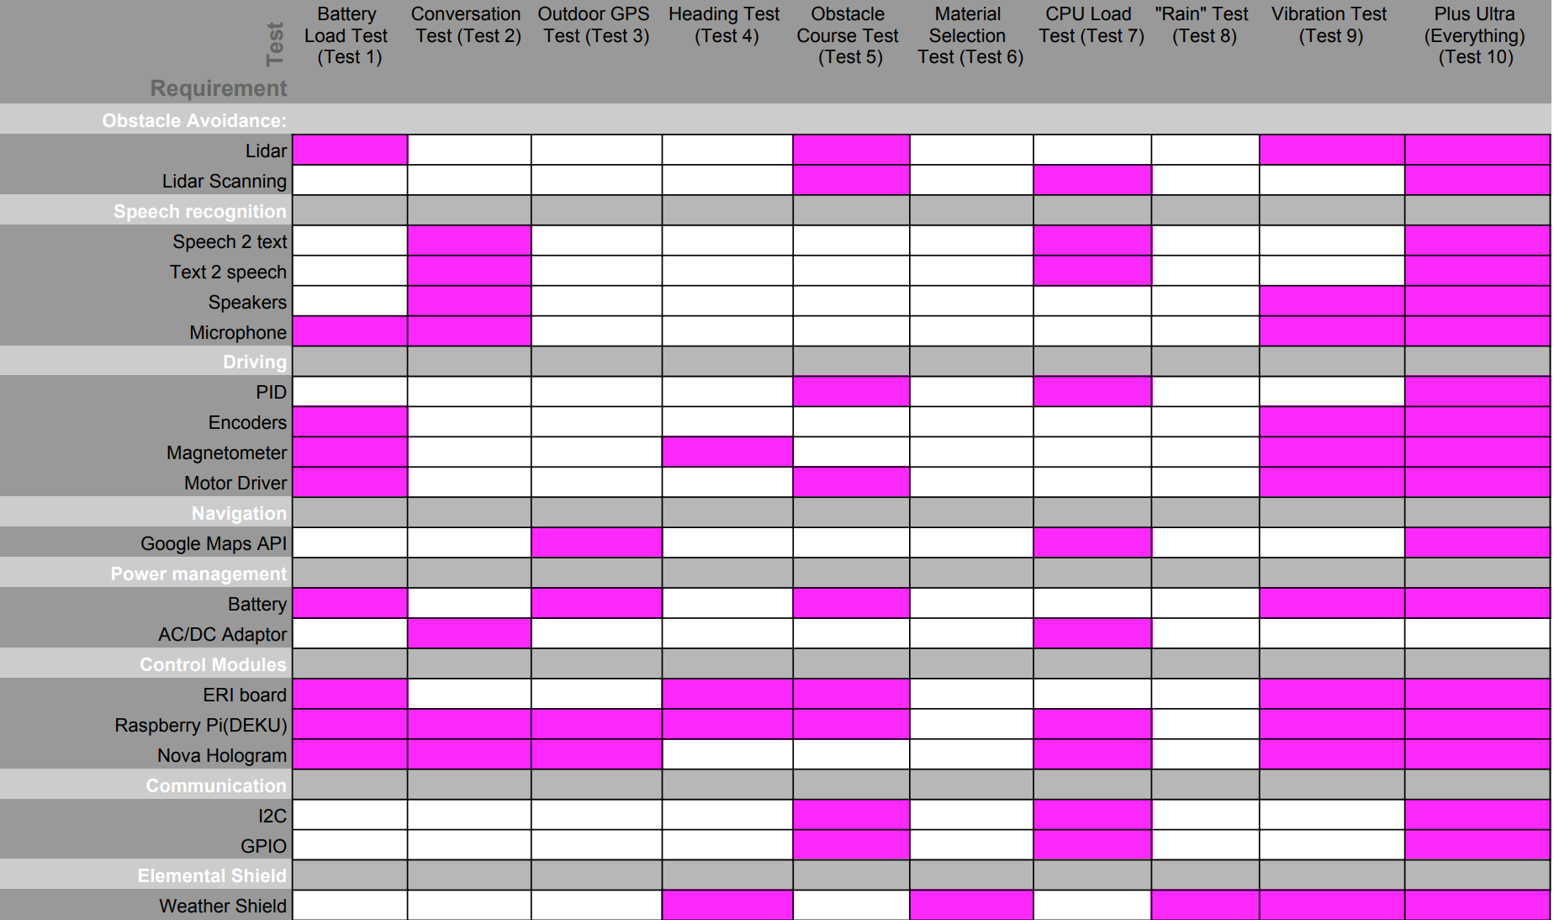
TEST MATRIX
35
Background
Objectives
Conceptual
Block
Diagram
Functional
Block
Diagram
Electronics Design
Software Design
Mechanical Design
Demo
Test Matrix
Notes:
Jesse

Slide 36
36
PROJECT STATUS

Slide 37
MAJOR TASKS REMAINING
37
Task | Orig Sched | Updated Sched | Change this week
Alpha Software | 9/16 | - | NO
Alpha Hardware | 9/9 | 9/25 | NO
CDR | 9/30 | - | NO
Beta Software | 9/30 | - | NO
Beta Hardware | 10/07 | 10/15 | NO
Beta Testing | 11/11 | - | NO
Background
Objectives
Conceptual
Block
Diagram
Functional
Block
Diagram
Electronics Design
Software Design
Mechanical Design
Demo
Test Matrix
Project Status

Slide 38
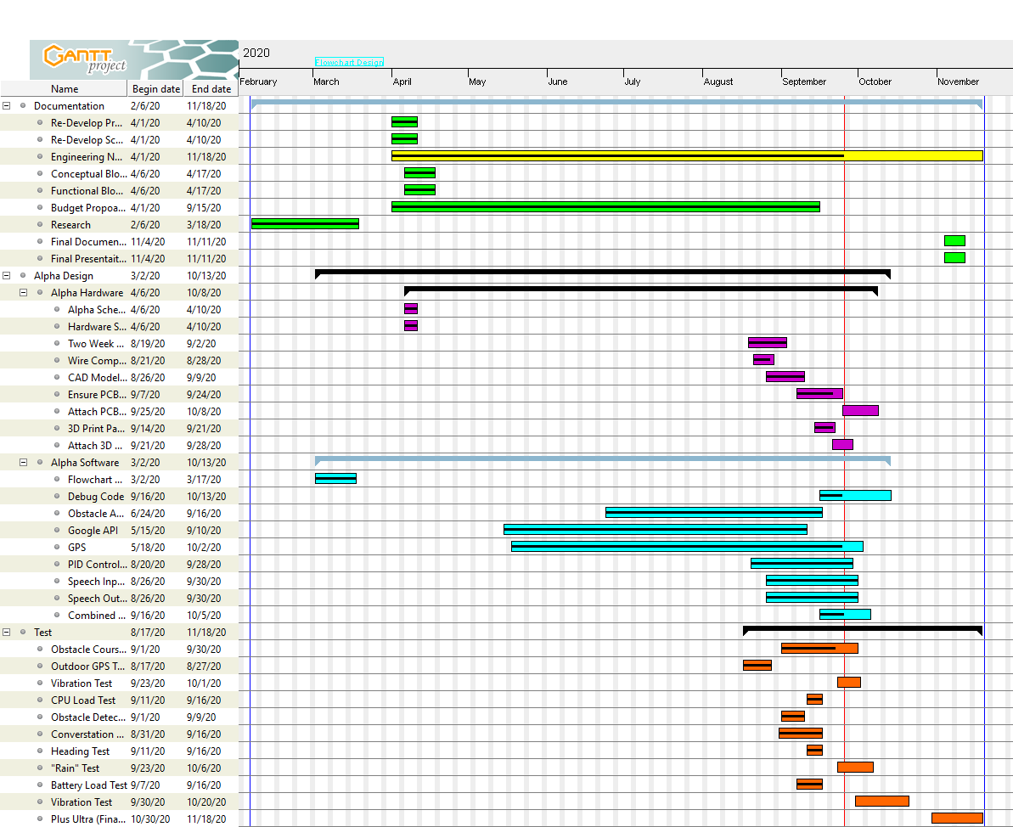
GANTT CHART
38
Background
Objectives
Conceptual
Block
Diagram
Functional
Block
Diagram
Electronics Design
Software Design
Mechanical Design
Demo
Test Matrix
Project Status

Slide 39
SCHEDULE OVERVIEW
39
ALPHA SOFTWARE
FINAL DEMO, PRESENTATION, & REPORT
ALPHA HARDWARE
BETA SOFTWARE
BETA HARDWARE
FINAL HARDWARE
9/16/2020
09/25/2020
11/11/2020
11/18/2020
9/30/2020
10/15/2020
ALPHA TEST
BETA TEST
FINAL TEST
SIGN OFF
09/20/2020
11/11/2020
11/18/2020
11/18/2020
Background
Objectives
Conceptual
Block
Diagram
Functional
Block
Diagram
Electronics Design
Software Design
Mechanical Design
Demo
Test Matrix
Project Status

Slide 40
LABOR STATUS
40
Member | Predicted | Actual | Delta | Next Week | Cumulative
Shanley Mullen | 20 | 23.38 | +3.38 | 25 | 122.26
Jesse Rosart-Brodnitz | 18 | 24.03 | +6.03 | 18 | 171.45
Evan Maraist | 20 | 33.92 | +13.92 | 18 | 101.7
Austin Heibel | 15 | 16.83 | +1.83 | 22 | 81.31
Team Total | 73 | 98.16 | +25.16 | 83 | 476.72
Original SDP Labor Estimate: 2000
Current Labor Estimate: 1126.29
Estimated Remaining Labor: 580
Weeks Remaining: 7
Minimum Hours/Week: 82.2
Background
Objectives
Conceptual
Block
Diagram
Functional
Block
Diagram
Electronics Design
Software Design
Mechanical Design
Demo
Test Matrix
Project Status

Slide 41
FINANCIAL STATUS
41
Category | SDP Est | Curr Est | Past Week | Cumulative | Status
Reference Platform | $0 | $0 | $0 | $0 | ($0)
Parts | $1408* | $1051.31 | $0 | $743.87 | ($356.69)
PCBs | $75 | $75 | $61.39 | $61.39 | ($13.61)
Supplies | $0 | $32.99 | $0 | $32.99 | $32.99
Mechanical | $18 | $18 | $0 | $0 | $0
Team Total | $1501 | $1177.40 | $0 | $838.25 | ($323.70)
$323.70 Under Budget
References:
The data plan is included in parts
Background
Objectives
Conceptual
Block
Diagram
Functional
Block
Diagram
Electronics Design
Software Design
Mechanical Design
Demo
Test Matrix
Project Status

Slide 42

SUMMARY
42
https://gfycat.com/stickers/search/pir
    We discussed our projects goals and purpose.
    Went over our requirements.
    Presented our conceptual and functional block diagrams.
    Gave a technical overview of the electric, software, and hardware components needed.
    We presented a demo of our working components.
    We went over our project status including our schedule and financial status.
Background
Objectives
Conceptual
Block
Diagram
Functional
Block
Diagram
Electronics Design
Software Design
Mechanical Design
Demo
Test Matrix
Project Status
Summary
Notes:
Austin

Slide 43

43
Questions
basttamu@gmail.com
https://www.pinclipart.com/maxpin/bxRmJJ/

