Slide 1




STF 685 ESTIMED - MEC and oneM2M deployments Hackathon - Enabling Innovative Use Cases
Use Case Title
Presented by: Kyeonghwan Nam
Affiliation: Inclusive Edge Safety for Mobility Impaired Users
Co-presenters: Bowon Kwon, Jieun Lee
October 30th, MS Teams
Notes:
Hello, I'm Nam Kyung-hwan from Sejong University's SESLab.
Our team integrated oneM2M and ETSI MEC technologies to implement an inclusive edge safety
service for citizens who are uncomfortable walking. Our team conducted Track #1 and Track #2, and in this presentation,
we will explain the impact from problem recognition to structure design.

Slide 2
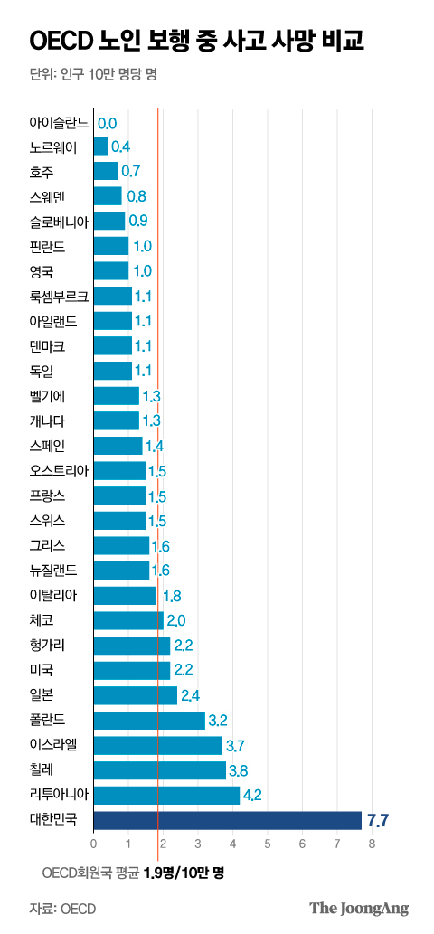
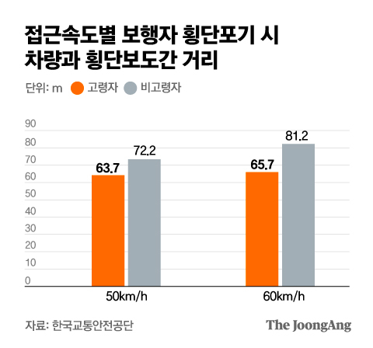
Motivation & Problem Definition
Elderly Pedestrian Safety Issues
  Older Pedestrian, who walk relatively slowly, attempt to cross even when the distance from the vehicle is shorter.
  The number of pedestrian deaths per 100,000 elderly people in South Korea stands at 7.7
  The highest rate among OECD member countries
source: https://www.joongang.co.kr/article/25195547
1
Notes:
First of all, this graph compares the mortality rates of elderly pedestrians in Korea and OECD countries.
In the graph on the right, Korea has 7.7 deaths per 100,000 people, about four times the OECD average of 1.9 and the highest among 38 member countries.
There is also a big difference between Lithuania (4.2), which ranked second, and Chile (3.8).
The graph on the left is the Korea Transportation Safety Authority survey, which shows that when a vehicle approaches a crosswalk,
pedestrians under the age of 60 stop at an average distance of 76.7 m, but those over the age of 60 should approach 64.7 m.
In other words, elderly pedestrians try to cross at more dangerous distances because they are relatively slow.
What these two data tell us is one thing. In Korea, pedestrian safety problems, including the elderly, are the most serious in the OECD,
and they are not just traffic awareness problems but structural problems that require a systematic response. So, we tried to solve this problem
technically by expanding it to an inclusive safety service for "all citizens who are uncomfortable walking."

Slide 3
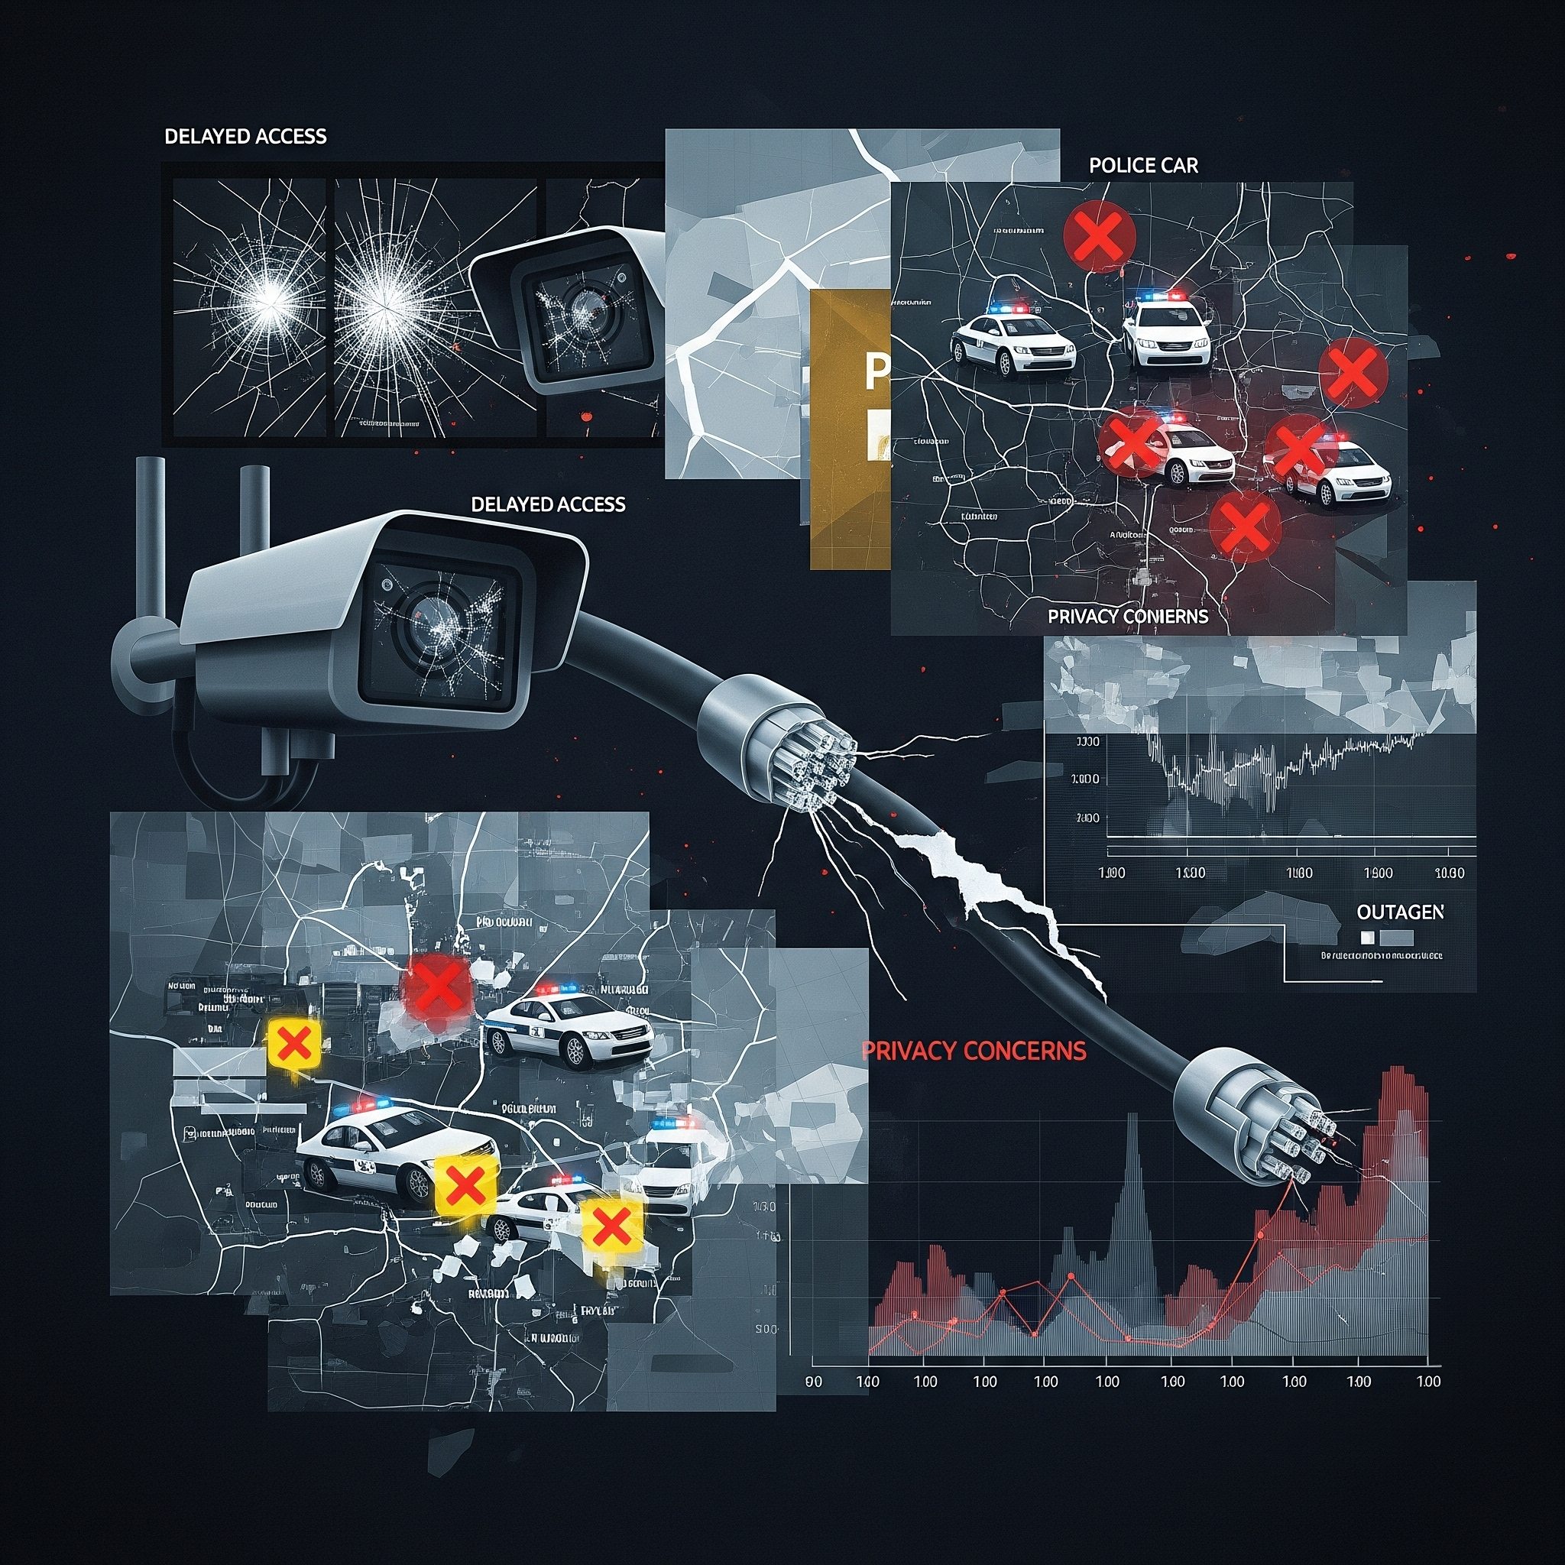
Motivation & Problem Definition
Limitation of Urban Pedestrian system
  Data Disconnection
  Latency
  Privacy
  Unbalanced Service
Key point is lack of Interoperability
2
Notes:
Existing systems have limitations.
Data segmentation and cloud-based systems have problems such as increased delays,
lack of privacy protection, and deviations in service quality by local governments.
In other words, lack of interoperability is a fundamental problem.

Slide 4

Project Goal & Vision
ETSI MEC & oneM2M interworking adoption
What is our objective?
  Integrating the ETSI MEC and oneM2M standards to build a pedestrian safety service platform that guarantees interoperability throughout the city
  Using a standard-based data model, we designed a system that processes data at the edge and integrates a citywide safety infrastructure: Inclusive Edge Safety
3
Notes:
Our goal is clear.
By integrating ETSIMEC and oneM2M standards,
Building a pedestrian safety service platform that guarantees interoperability throughout the city.
To do this, we use a standard-based data model
Detect and respond to dangerous pedestrian situations within 100 ms of the edge,
We designed an Inclusive Edge Safety system that integrates citywide safety infrastructure.
This is the vision we dream of --
Building an inclusive urban environment where anyone can travel safely from anywhere.

Slide 5
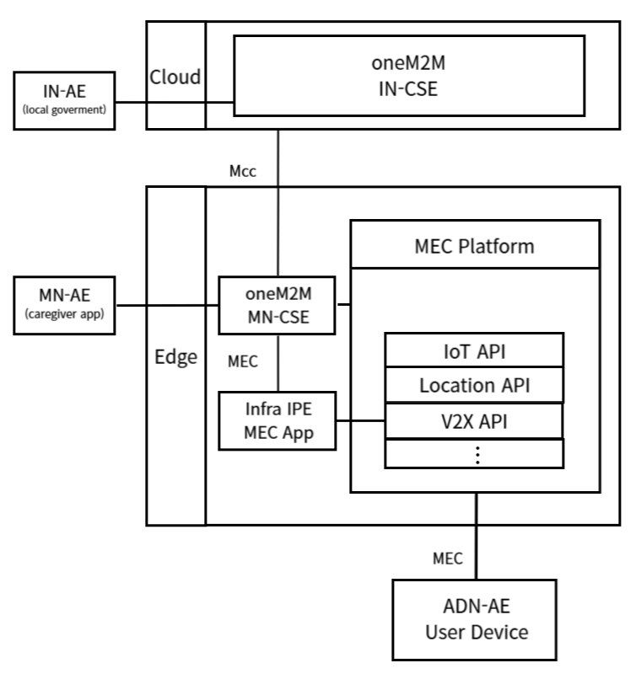
oneM2M - MEC Deployment Option
Option C - MN CSE deployed as a MEC App
  Why Option C?
  Use of Infra IPE
  3 layered Architecture
  Cloud layer
  Edge layer
  Device layer
4
Notes:
To implement this vision, among many deployment options
We chose the MN-CSE structure deployed as Option C, or MEC App.
When this method is selected, the Infra IPE is placed within the MEC
platform to convert data collected from APIs such as Location,
V2X, etc. into oneM2M format and deliver it directly to the MN-CSE.
This centralizes data processing within the edge and significantly reduces latency.
And as you can see, it consists of three layers: Device – Edge – Cloud.
Let's see how the scenario we envisioned is applied and the whole structure is envisioned.

Slide 6








Overall Architecture
Architecture of Inclusive Edge Safety
Federator
Cloud #1 - for city
Cloud #2 - for city
IN-CSE #1
IN-CSE #2
MEO #1
MEO #2
IN-AE(local government)
Edge1 Zone #1
Edge1 Zone #2
Edge1 Zone #3
Edge2 Zone #1
MN-CSE #1
(MEC App)
MEC Platform #1
MN-CSE #2
(MEC App)
MEC Platform #2
MN-CSE #3
(MEC App)
MEC Platform #3
MN-CSE #1
(MEC App)
MEC Platform #1
Infra IPE
(oneM2M AE, MEC App)
Location, Mobility, … etc
Infra IPE
(oneM2M AE, MEC App)
Location, Mobility, … etc
Infra IPE
(oneM2M AE, MEC App)
Location, Mobility, … etc
Infra IPE
(oneM2M AE, MEC App)
Location, Mobility, … etc
City Proxy
City Proxy
handover
Users(Devices - ADE-AE)
MN-AE(caregiver)
5
Notes:
We will now explain the specific flow of service behavior in the Inclusive Edge Safety scenario.
First, we divided the entire city into zone units. Each zone is like a real administrative district or base station coverage unit,
It is designed so that even if a pedestrian on the move leaves one zone, the service will not be cut off and will naturally lead to the next zone.
Each zone has one MEC Host, Inside each MEC Host, an MN-CSE is installed to act as an oneM2M IoT platform.
This structure allows users to receive services from the nearest MEC Host, no matter which Zone they are in,
This allows you to retain mobility and take advantage of oneM2M's standards-based data management capabilities.
—------------- zone 설명 —-------------
Before the service starts,
The MN-CSEs of each MEC Host are already initialized to a resource tree with the same AE-ID.
By doing this, no matter which MEC the user's ADN-AE is connected to
We are ready to send and receive data.
In addition, each MEC Host relays the ADN-AE's session connection through the Proxy server.
ADN-AE sends a request to a fixed Proxy address,
Proxy connects you to the most appropriate MEC Host considering your location or network situation.
Prior to service launch, each MN-CSE is preregistered as an IoT platform on the MEC platform,
When an ADN-AE is registered with an IN-CSE in the cloud, its resource tree is replicated to all MN-CSEs.
Once registered, the user's device is connected to each MEC
You are ready to start the service immediately.
—----------서비스 이전 설정 —--------
When the user receives the device (ADN-AE) and powers it on,
The device sends a request to a fixed proxy address.
Proxy connects the session with the nearest MEC Host based on the current user's location,
The device is ready to provide service immediately.
—--------- 전원 인가 후 서비스 시작 —---------

Slide 7

Use Case Scenarios
Real time Location Monitoring &
Impact detection alert
Vehicle Proximity Alert
Edge1 Zone #1
Edge1 Zone #1
MN-CSE #1
(MEC App)
MEC Platform #1
MN-CSE #1
(MEC App)
MEC Platform #1
Infra IPE
(oneM2M AE, MEC App)
Location, Mobility, … etc
Infra IPE
(oneM2M AE, MEC App)
Location, Mobility, … etc
Personalization Service
Mobility and Service Continuity
4
Notes:
I will explain the real-time location monitoring and collision detection notification, in which caregiver's app, MN-AE, receives information.
For location monitoring, when the ADN-AE periodically transmits location information, the MEC Host's MN-CSE provides the caregiver application (MN-AE)
with a real-time location. Collision detection is when a fall or collision is detected by the IMU or impact sensor,
The ADN-AE sends data to the MN-CSE and the MN-CSE immediately sends notifications to the Guardian Application (MN-AE),
which at the same time sends the same data to the IN-CSE for subsequent analysis by local governments or public systems.
—------- 위치랑 충돌—-----------
For proximity vehicle alert services, the ADN-AE will deliver the alert.
The MEC Host detects access to nearby vehicles or pedestrians via the
MEC Location API and sends alerts to the ADN-AE via voice or vibration notifications.
—--------차량 접근—------
There are two types of Mobility and Service Continuity.
First, if the user crosses the boundary of the Zone on the move, the connection with the existing
MEC Host is terminated and the session is transferred to the adjacent MEC Host. This ensures that the
same session remains in the next Zone without disruption to the service.
The second case is when the user leaves the city, where Federator manages Proxy address information
and device registration procedures. This allows the device to be automatically registered and a resource
tree to continue the service, even in MEC environments in other cities.
—-------- 이동성 과 핸드오버 —---------
Finally, the personalization service analyzes the long-term data accumulated by IN-AE in IN-CSEs to identify
user movement patterns and risk areas, and provides personalized walking support services such as advance notice of risk areas.
—-------- 개인화 서비스—-------
This flow enables Inclusive Edge Safety to simultaneously achieve MEC-oneM2M-based interoperability and service continuity by
handling local edges, notifications, and even transferring sessions that ensure mobility within hundreds of ms.

Slide 8
Expected Benefits
Category | Expectation Effectiveness
Social Inclusion | Provide balanced safety services to all pedestrians, ease regional gaps
Scalability | Easy scaling with standards-based oneM2M, MEC platform
Low-Latency | Edge processing handles local notifications such as fall detection and alerts within hundreds of ms
Administrative Efficiency | Convenience transportation and welfare policy support/improvement by integrating local government data
4
Notes:
Finally, let me tell you the changes and expected effects that Inclusive Edge Safety will make
In terms of social inclusion, the safety gap between regions can be mitigated by providing equal and uniform safety services to all pedestrians.
In terms of scalability, the combination of standards-based oneM2M and MEC platforms makes it easy to scale to new cities or services.
In terms of low latency processing, the edge can handle fall detection or crash warnings in hundreds of milliseconds for immediate response.
Finally, in terms of administrative efficiency, data integration between local governments can help support transportation and welfare policies more precisely.

Slide 9
Impact Analysis
Aspect | Effect
Technical Aspect | Minimizing latency through edge processing and balancing cloud load
social aspects | Providing inclusive and safe services for people with walking difficulties
economic aspects | Reduce infrastructure costs by integrating local governments and cities.
4
Notes:
Here is Impact Analysis, or the overall impact of the project.
On the technical side, Edge processing minimizes latency and distributes cloud loads.
On the social side, we provide inclusive and safe mobility services to all citizens, including those who are uncomfortable walking.
On the economic front, local governments and urban infrastructure can be integrated to reduce unnecessary redundant investments and increase cost efficiency.

Slide 10



Thank You!
Kyeonghwan Nam
nkh0721@gmail.com
Bowon Kwon
bowon1207@gmail.com
Jieun Lee
love9ly@gmail.com
Notes:
All of these effects come together to create the true value of Inclusive Edge Safety.
Inclusive Edge Safety is not just a technology experiment, it is a new safety infrastructure model for all pedestrians in the city.
We wanted to piece the whole city together into one safety network through real-time response at the edge level, standards-based interoperability, and service continuity.
After all, what we want to create is not smart technology, but a society itself that can move safely.
Thank you.
Thank you all for your attention. We warmly invite you to join us in at the Hackathon, and we look forward to seeing you there!!

