Slide 1





STF 685 ESTIMED - MEC and oneM2M deployments Hackathon - Enabling Innovative Use Cases
Vulnerable Road User (VRU) Detection Use Case — ETSI MEC / 5G / oneM2M
Presented by: Yann Garcia
Affiliation: FSCOM
Co-presenters:
October 30th, MS Teams

Slide 2
Agenda
  Overview
  Use case story
  MEC/oneM2M Edge Architecture
  Components overview
  Deployment overview
  ETSI MEC Sandbox context
  Conclusions
  Q&A
1

Slide 3
Overview
  A smart city intersection is equipped for vulnerable user detection. The environment contains:
    Connected vehicles (e.g. cars…);
    Pedestrians with smart devices;
    RSUs placed at major crossings.
  All components communicate using ETSI C-ITS Release 2 V2X protocols
  All components share data through a oneM2M Release 4 service layer operating on the edge using ETSI MEC Release 3.
  Security is out of scope of this use case
  Hackster.io link: ESTIMED_Hackathon1_FSCOM
2

Slide 4
Use case story (1/3)
  When a vulnerable user (e.g. pedestrians, cyclists) approaches an intersection:
    On-board sensors collect GNSS, inertial, and camera data
    RSUs detect presence via radar, LIDAR, and camera
    Cars provide proximity detection through on-board LIDAR and V2X radios
    Data is offloaded to MEC hosts where fusion and AI-based risk analysis is performed in real-time
    oneM2M mediates information sharing and semantic query between multi-vendor RSUs, vehicles, and applications
    Critical alerts (potential collision, high-risk crossing) are broadcast with millisecond latency (V2X 5G slicing) to nearby (vehicles and to the pedestrian's device)
2

Slide 5
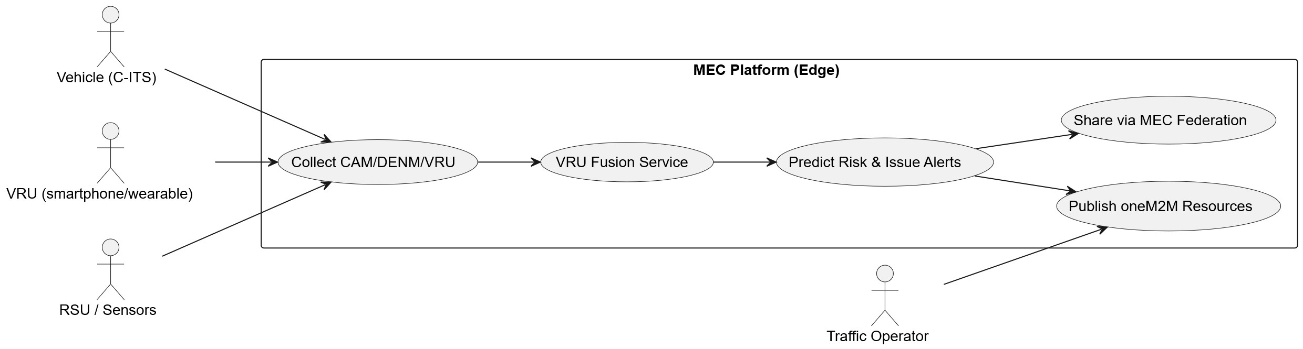
Use case story (2/2)
2

Slide 6
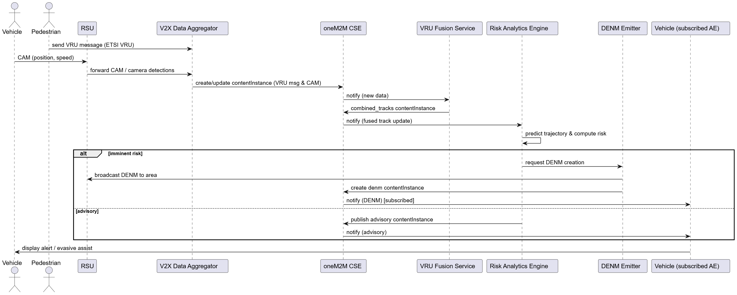
Use case story (2/3)
2

Slide 7
MEC/oneM2M Edge Architecture (1/3)
  Edge Layer: MEC platforms deployed at network edge (RAN component)
  Infrastructure Layer: Roadside Units (RSUs), sensors, and traffic management systems
  Device Layer: Connected vehicles, VRU devices, smartphones
2

Slide 8
MEC/oneM2M Edge Architecture (2/3)
  V2X Data Aggregator
    Collect, normalize, pre-process V2X messages and sensor streams;
    Perform time synchronization and initial filtering;
    Publish normalized state to oneM2M resources and to local MEC apps
  VRU Fusion Service
    Combine multiple sensor modalities into coherent VRU tracks with uncertainty models
    resolve occlusions
    associate VRU IDs to physical tracks (i.e. representation of VRU positions and movements in real-time)
  Risk Analytics AI Engine
    Compute short-term trajectory predictions,
    Compute collision probability and risk score,
    Generate alerts (local WARNs, DENM generation), and operator-level reports
2

Slide 9
MEC/oneM2M Edge Architecture (3/3)
  ETSI MEC Release 3: MEC platform services (ETSI GS MEC 003)
  ETSI MEC 040: MEC federation enablement
  ETSI C-ITS Release 2: Cooperative awareness and VRU protection
  oneM2M Release 4: IoT data management and interoperability
  3GPP Release 16: 5G NR with URLLC and network slicing
2
Notes:
Here are the technical stacks used by the scenario.
3GPP only for real deployments

Slide 10
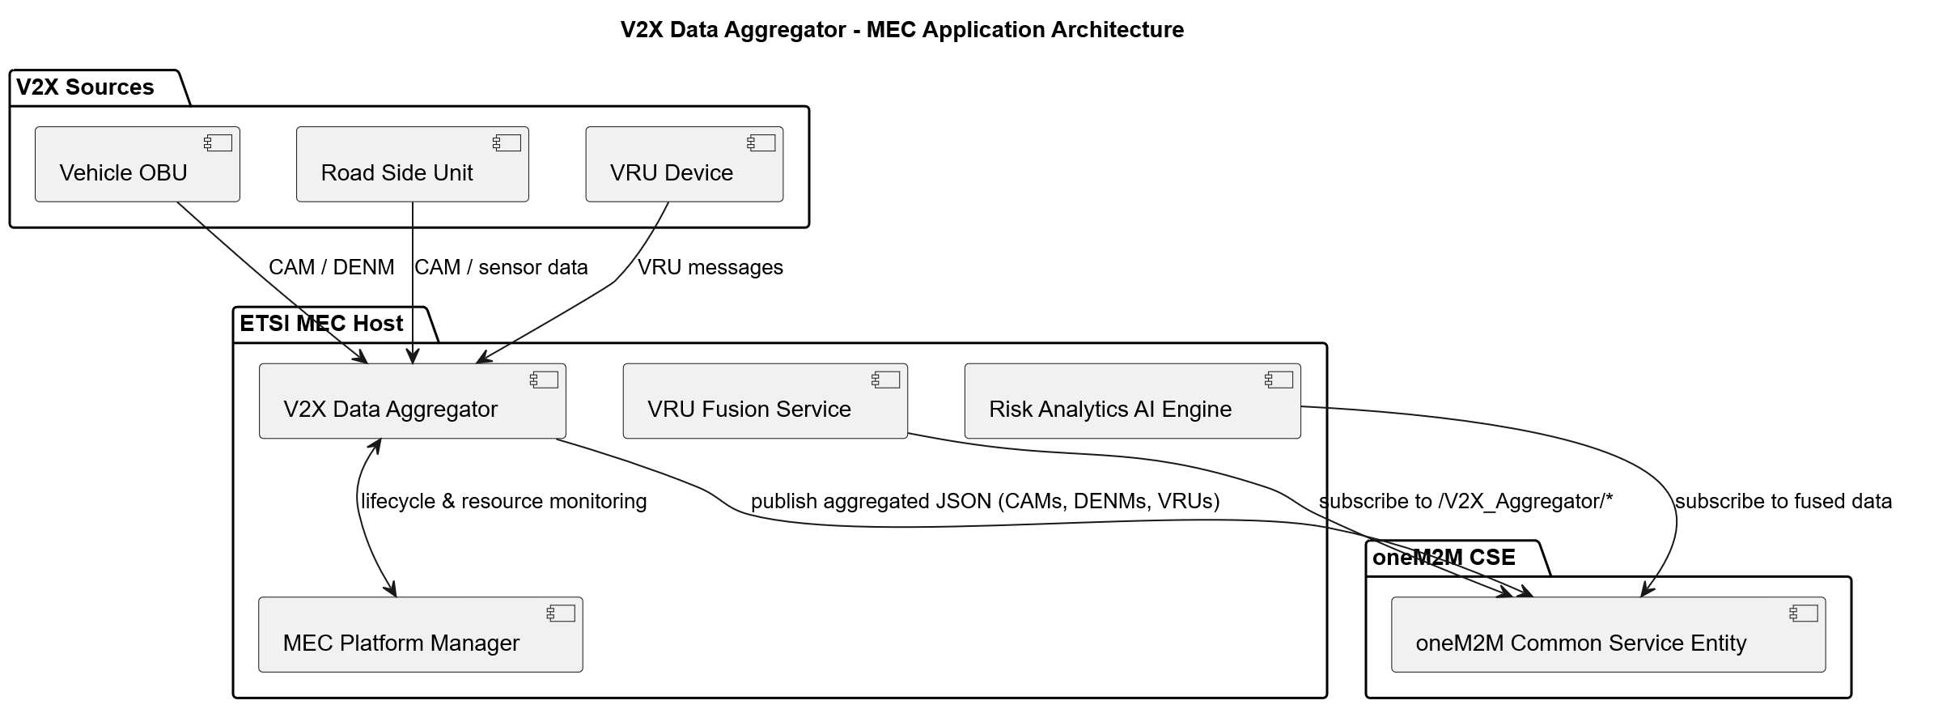
Components overview (1/4)
  Component V2X Data Aggregator
    To collect, normalize, pre-process V2X messages and sensor streams
    To perform time synchronization and initial filtering; publish normalized state to oneM2M resources and to local MEC apps
2

Slide 11
Components overview (2/4)
  VRU Fusion Service
    To combine multiple sensor modalities into coherent VRU tracks
    To resolve occlusions (map data + LiDAR)
    To associate VRU IDs to physical tracks
  To be refined, this is one of the most complex component (Kalman/particle filters, geospatial computation…)
2

Slide 12
Components overview (3/4)
  Risk Analytics AI Engine
    To compute short-term trajectory predictions
    To compute collision probability and risk score
    To generate alerts (local WARNs, DENM generation)
    To provide operator-level reports
  To be refined, this is one of the most complex component (Federating learning, predictions such as Time To Collision & trajectories)
2

Slide 13
Components overview (4/4)
  oneM2M Role & Integration
    To provide CSE (Common Services Entity) at the edge (co-located with MEC) to hold normalized VRU/track resources
    To offer AE (Application Entities) for VRU Fusion Service, V2X Aggregator, Risk Engine, dashboards
    To manage Subscriptions: operator dashboards or other MEC apps subscribe to oneM2M resources for content Instance updates
    To exploit oneM2M resources map
      containers for sensors
      containers for fused VRU tracks
      containers for DENM events, etc.
2

Slide 14
Deployment overview
  In dense urban zones, RSUs are deployed every major intersection, each connected to local MEC host
  Vehicles and pedestrians dynamically share data during proximity events
  All nodes interoperate through common oneM2M and C-ITS message sets
  Local and cross-MEC federation enable service continuity across city zones and multiple operators
2

Slide 15
ETSI MEC Sandbox context
  Intersection: Avenue des Papalins / Quai Jean-Charles Rey (43.7384°N, 7.4246°E)
  Telecom infrastructure
    gNodeB-1 (Primary Coverage)
    gNodeB-2 (Secondary/Handover)
  V2X infrastructure
    RSU-1 with weather station (rain, wind, temperature, visibility) and air quality sensors (PM2.5, NO2, CO2)
    RSU-2 with air quality sensors (PM2.5, NO2, CO2)
    RSU-3 with air quality sensors (PM2.5, NO2, CO2)
    Connected traffic lights (4 intersections)
    Variable message signs (2 units)
    Emergency vehicle detection system
2

Slide 16
Conclusions
  This architecture ensures rapid detection, notification, and response for vulnerable users in complex 5G and V2X environments
  This architecture is aligned with the latest ETSI and oneM2M standards.
  Many different type of sensors is required, fusion is essential
  5G NR provides the infrastructure to reach latencies (E2E) and high accuracy requirements
2

Slide 17
References (1/4)
  oneM2M TS-0001 v4: Functional Architecture
  oneM2M TS-0004 v4: Service layer Core Protocol
  oneM2M TS-0033 v4: Interworking Framework
2

Slide 18
References (2/4)
  ETSI GS MEC 011: Edge platform application enablement
  ETSI GS MEC 021: Mobility Service API
  ETSI GS MEC 028: WLAN information API
  ETSI GS MEC 030: V2X information service API
  ETSI GS MEC 040: Federation Enablement API
  ETSI MEC Sandbox
2

Slide 19
References (3/4)
  ETSI TS 103 900: Cooperative Awareness Message (CAM)
  ETSI TS 103 831: Decentralized Environmental Notification Message (DENM)
  ETSI TS 103 300-3: VRU Awareness Message (VAM)
  ETSI TS 122 186: Sidelink & Uu Interfaces
  ITS-G5: IEEE 802.11p/OCB for V2X communication
2

Slide 20
References (4/4)
  5G Infrastructure Public Private Partnership (5G PPP)
  5G Intelligent Automotive Network Applications (5G IANA)
2

Slide 21



Thank You!
Yann Garcia
yann.garcia@fscom.fr
Notes:
Thank you all for your attention. We warmly invite you to join us in at the Hackathon, and we look forward to seeing you there!!

