Slide 1
Otto
Monitoring the Cloud with Alexa
Proof of Concept
Douglas Yoon
November 30, 2016

Slide 2






VUI
Alexa,
ask Monitor Board the current status
Account Key Store
3
“Monitor Board”
Handler
1
2
4
(((
Monitored Subnet
Amazon IoT Button used to create/change/terminate instances
Reply Card
5
Key:
There are currently 3 instances…
1
Otto skill invoked via Echo
Otto calls lambda
Function gets AWS account information
Access is granted to specific subnet, to get status
of EC2 instances in that subnet
Running State of instances are returned to Echo
2
3
4
5

Slide 3
Network Diagram
“Monitor Board”
Handler
Account Key Store
Monitored Subnet
us-west-2
Target subnet being monitored
was hosted in another region to
simulate another account.
us-east-1
Otto is hosted in us-east-1

Slide 4
Summary
Otto is a proof of concept Alexa skill to help enterprise customers get status updates on their AWS environments. Otto triggers a Lambda function, which uses cross account access techniques and the AWS node.js API’s to inform the listener of their production environments.
In this demo, the Alexa account id is used to get credentials to an AWS account. Use of the OAuth 2.0 framework is in development. And, currently, only this developer’s Alexa/AWS accounts are available.

Slide 5
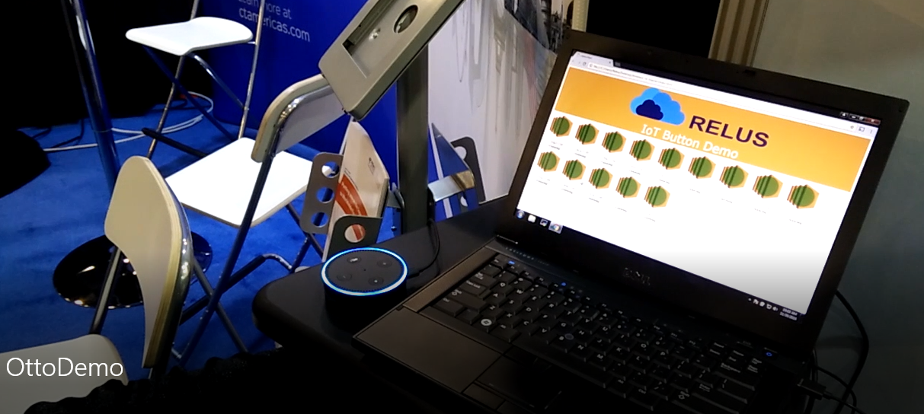
Explanation of the Demo
The Otto demo is tied into the Relus Cloud IoT Button demo. The IoT Button demo integrates Amazon’s IoT Button and starts/stops instances in a specific subnet in us-west-2. The webpage polls that subnet and displays the running EC2 instances.
Otto grabs information about the EC2 instances in that same subnet, and verbally tells the user about the fleet.

Slide 6

Software Design
Node.js
Lamba function is written in node.js
Upon invocation, function will use the Alexa account id to retrieve credentials to access the monitored AWS account from DynamoDB
  The demo uses the accessKey/secretAccessKey for a restricted user
  Ideally, Alexa’s OAuth 2.0 authorization framework (in development)
Once credentials are retrieved, the AWS Account status is requested
That status is summarized and sent back to the Alexa Skill

