Slide 1
3D MODEL
SCI4YOU

Slide 2
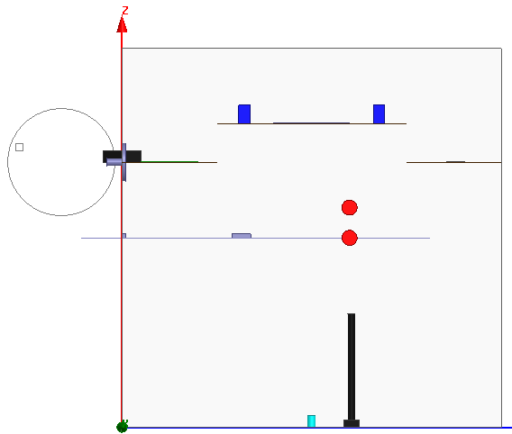
Encoder: This is used for the measure wind speed
Pushbuttons
Potenciometer
Lever for the giroscope
Led

Slide 3
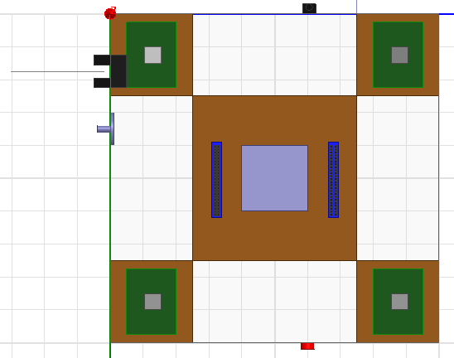
Sensor1
Sensor3
Horseshoe sensor for encoder
MKW40Z160
Sensor2
Sensor4

Slide 4
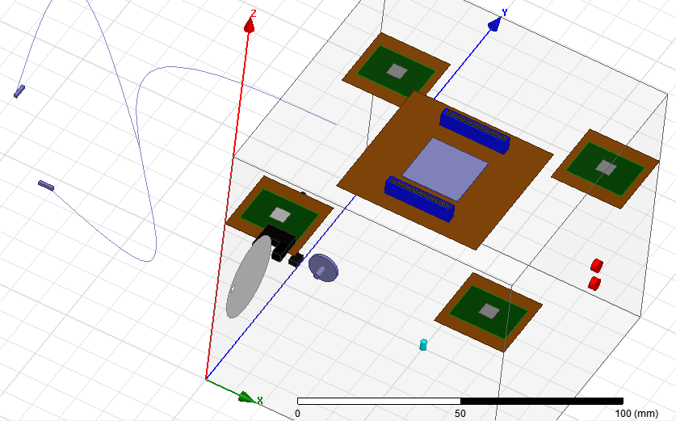
Like termocuple

