Slide 1
Smart Doorbell
Using Raspberry Pi
Umang Ajmera
Shriya Shah
Project Guide:
Prof. Vishal Barot

Slide 2

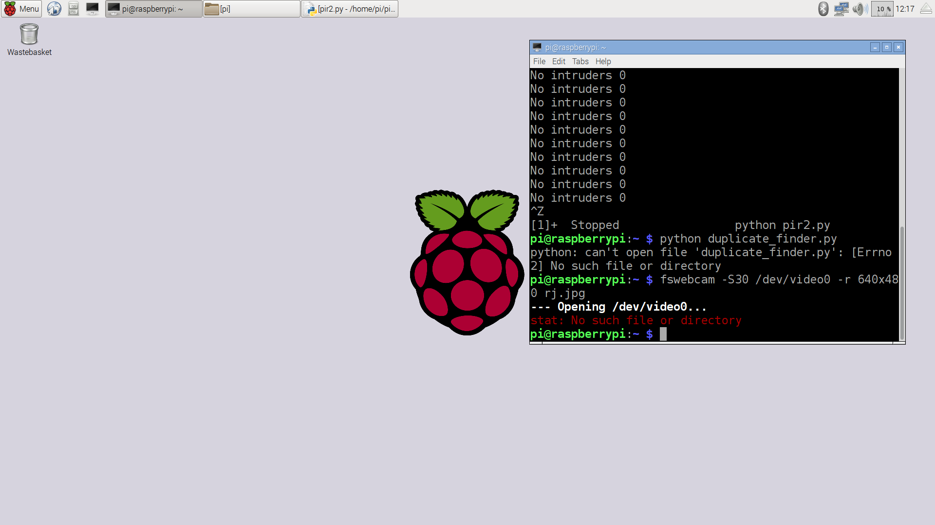

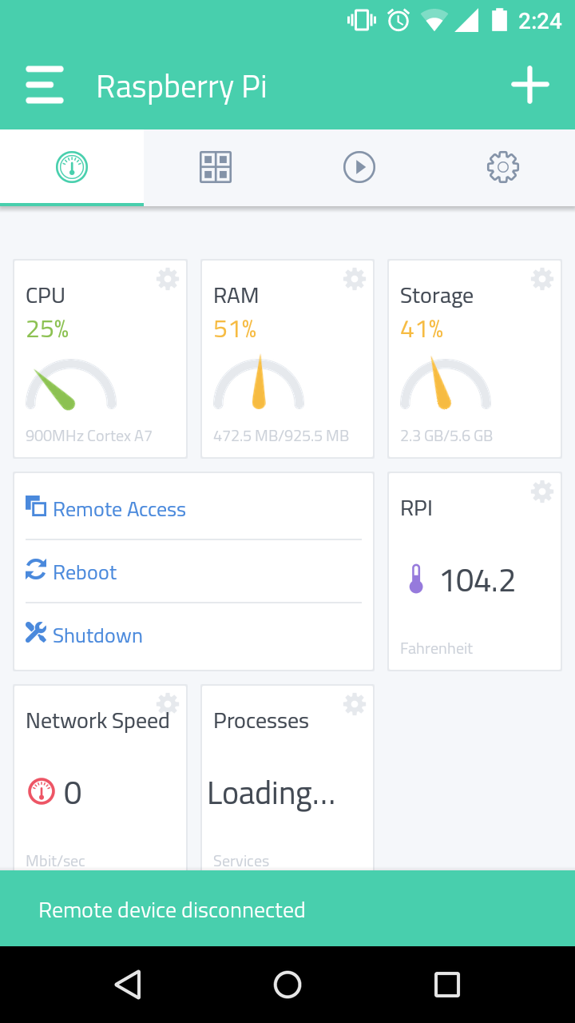
Smart Doorbell
A Doorbell which is smart enough to sense human presence, trigger a photo capture and sending notifications to the registered users.

Slide 3
Abstract
A doorbell which sends you real-time notifications! That is something very new and innovative. It uses a PIR Motion Sensor to detect human presence, a Standard USB Webcam (for demonstration) for capturing photos and a special blend of Python Code to integrate all the modules and sends you a notification on your mobile.

Slide 4
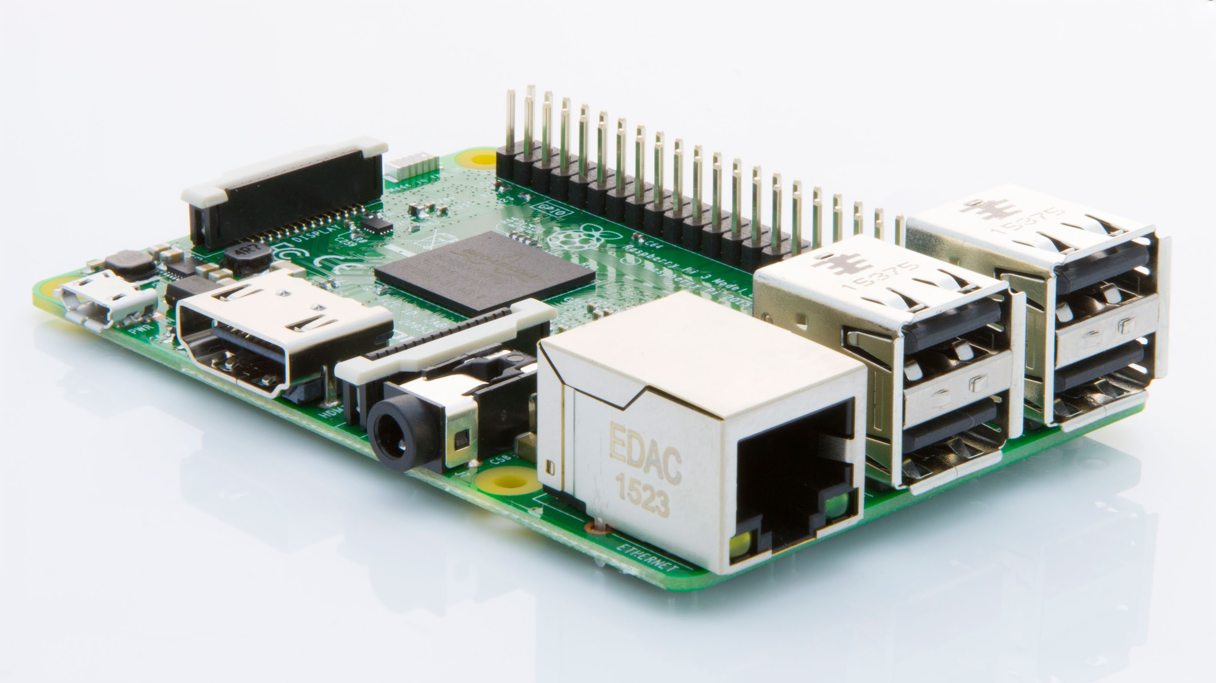

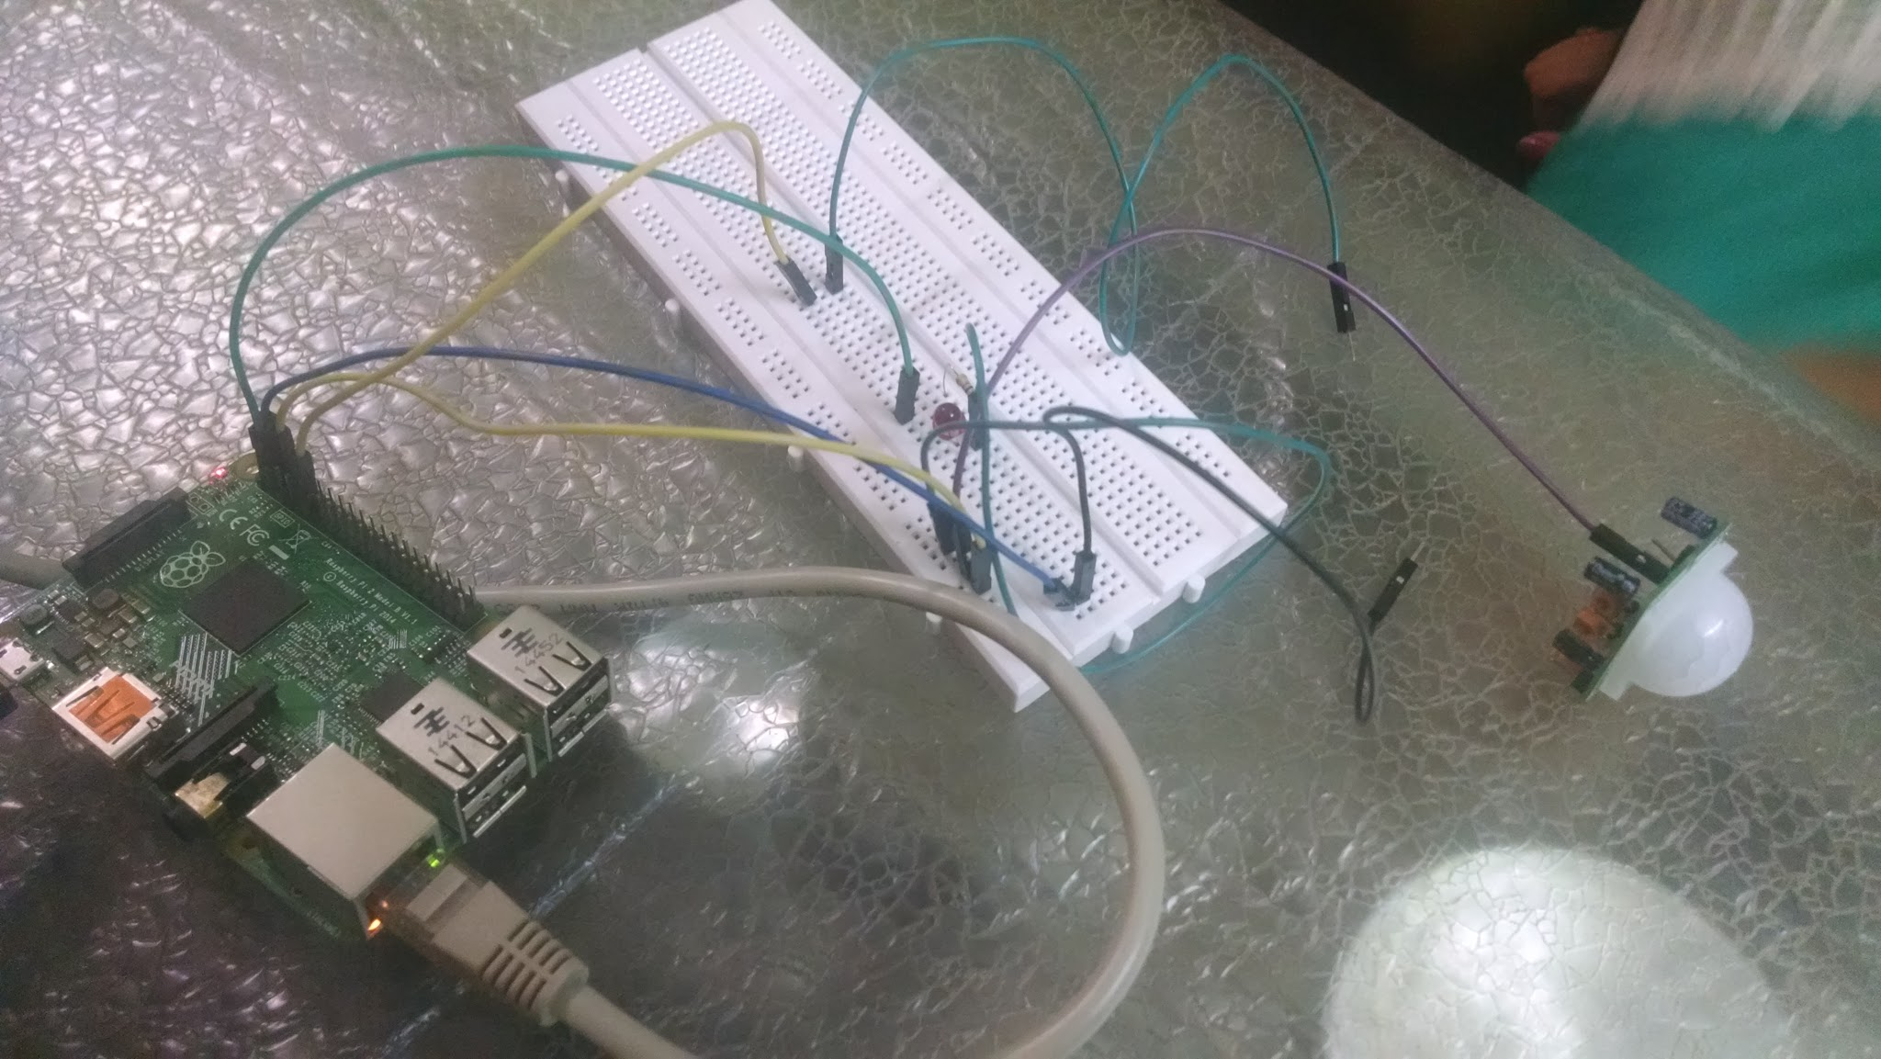
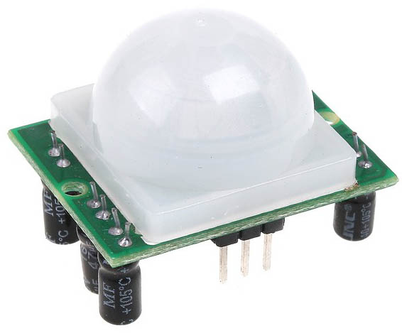
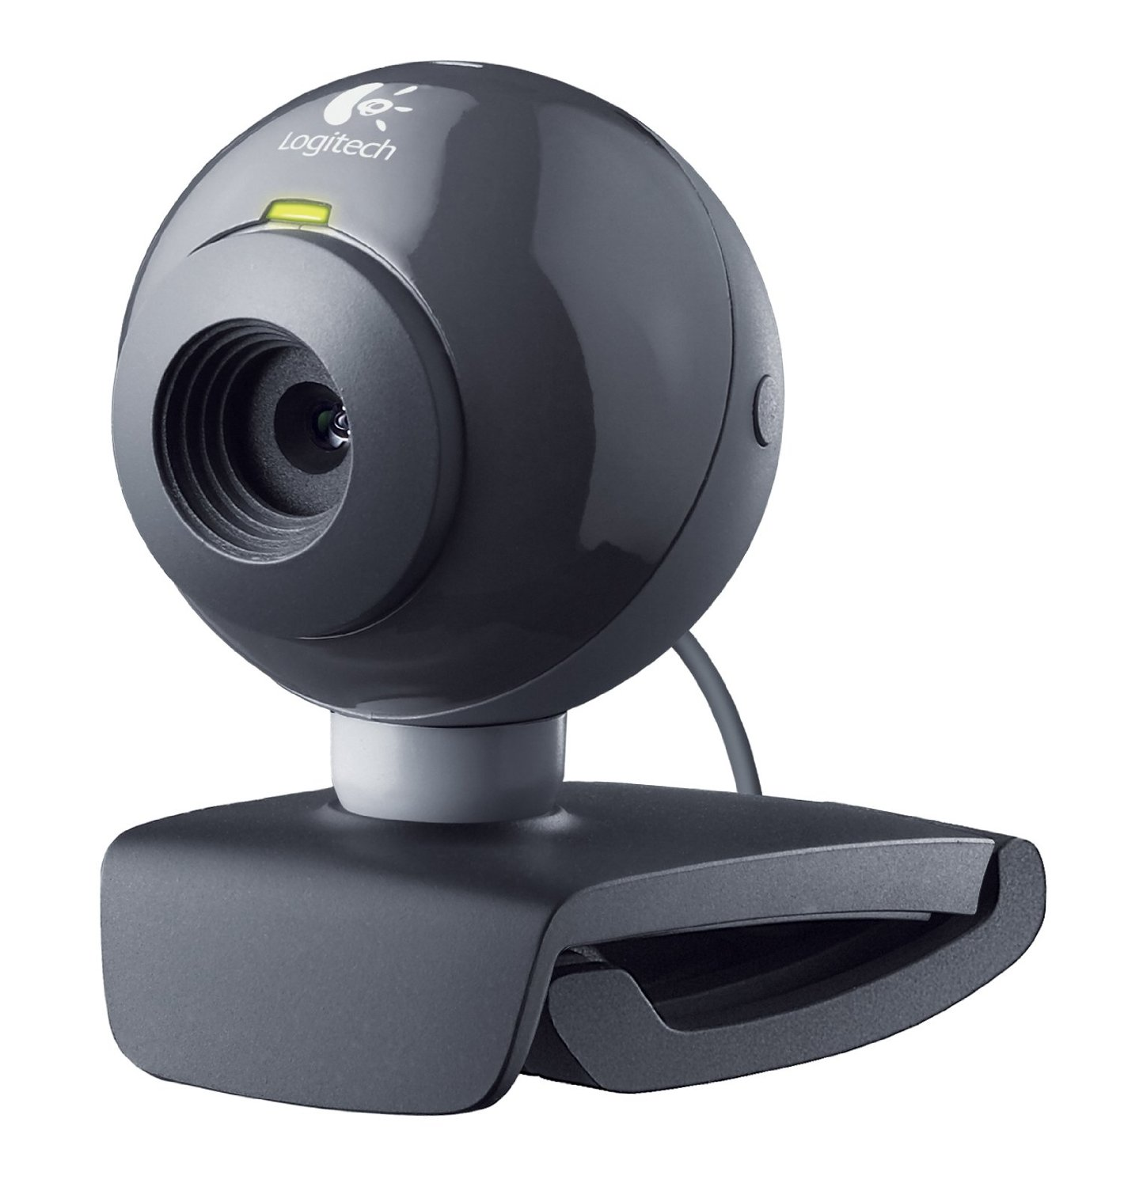
Components View

Slide 5
Features
Automatic Photo Capture
Real Time Notification
Cloud Storage for 24*7 access to photos from anywhere
Face Recognition of registered users

Slide 6
Existing Products

Slide 7
Literary Survey
Very New & Developing in the field of IoT/ Home Automation.
Existing products used in India are just a normal indoor audio/video intercom applications.
Some international companies have manufactured similar products with enhanced functionality. August Inc and Skybell Inc
A similar project based on Win 10 IoT Core using Azure cloud services is under development. Hackster.io
Overall, the scope of this project can be extended further with display modules and security purposes which can enhance its functionality.

Slide 8
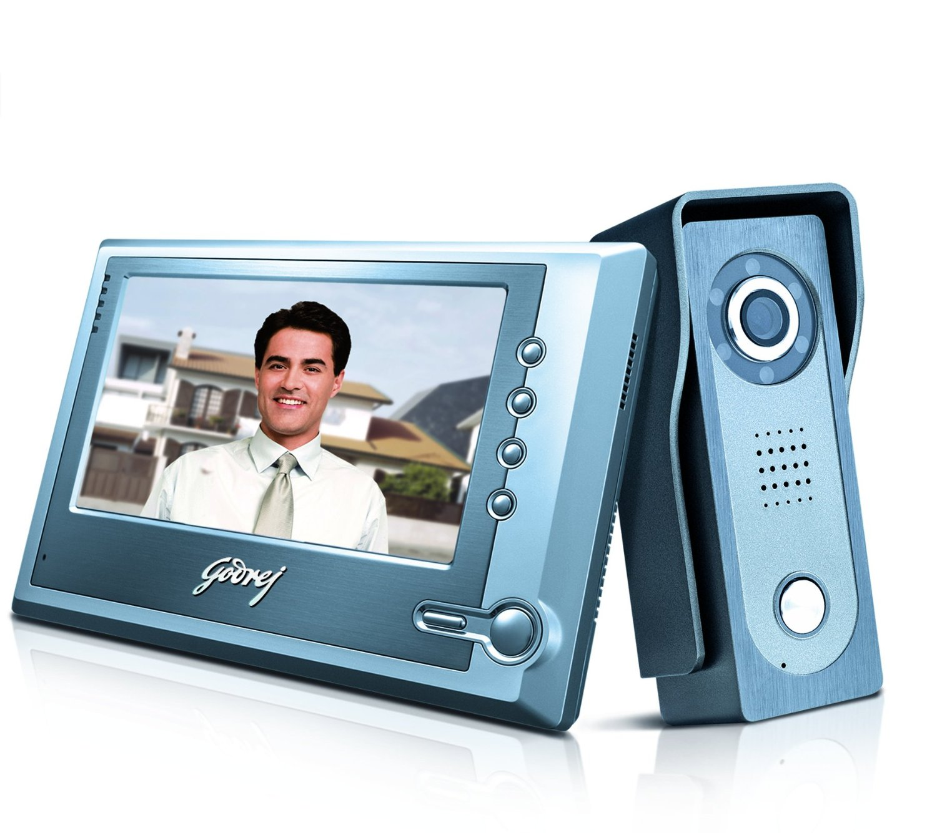
Nationally Available
A widely used godrej application which can show the image outside of your door as and when the bell is pressed.
And it costs around 8.5K

Slide 9
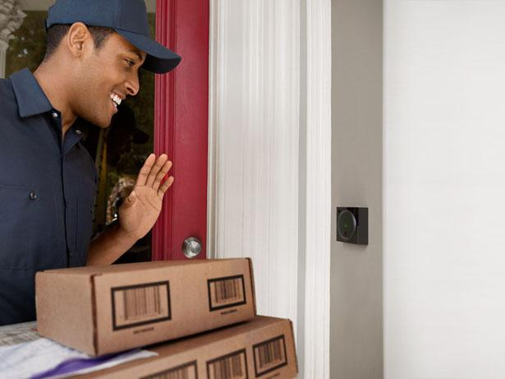
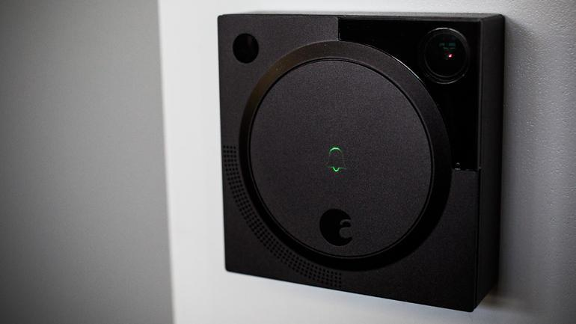
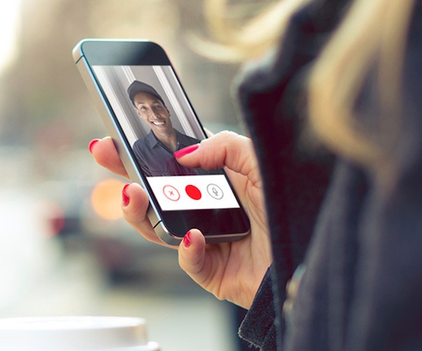
Internationally Available

Slide 10
Comparison: Proposed vs Existing
A round-the-clock anywhere you go photo-stream available.
Sensor to sense and capture a photo.
If user is away, he/she can still view the image later or simultaneously.
An SMS/Email Notification Module
Only indoor video streaming available.
No as such sensors available and if present, it only rings door bell.
If user away, doorbell of no use.
No notification module present.

Slide 11
Circuit Diagram

Slide 12
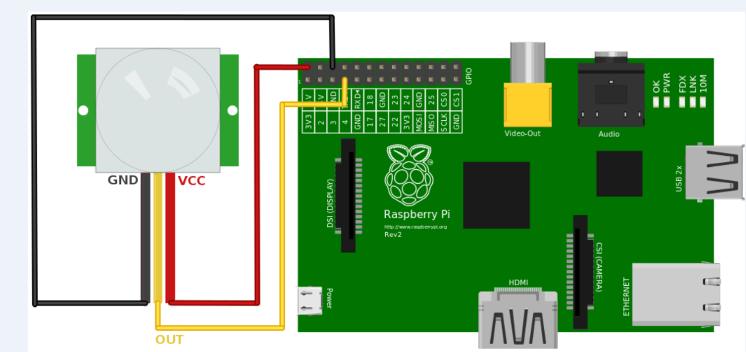

Slide 13
UML Diagrams

Slide 14
System Architecture (Flow)

Slide 15
Use Case Diagram

Slide 16
Sequence Diagram

Slide 17
Activity Diagram

Slide 18

Thank You
Umang Ajmera
1317BECE30115
Shriya Shah
1317BECE30103

