Slide 1
ViewRemotely

Slide 2
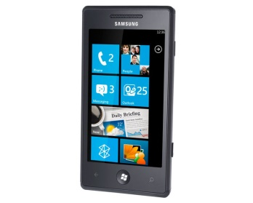



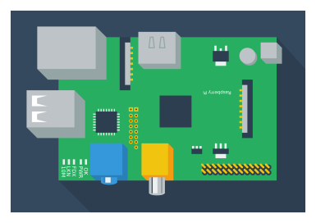



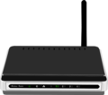
ViewRemotely
Phone
5. View image
Server where images are stored
4. Image is saved
Internet
Raspberry Pi2 With Wifi dongle
1. Requests Image
3. Uploads image
Wifi IP cam
2. Sends image
Wifi router

